Slide 1
Disclaimer
The GCA Forum will be recorded and retained for the legally approved retention period under Washington State Policy
It is subject to release under the Washington State Public Records Act or Federal Freedom of Information Act (FOIA)
It will be posted publicly on our GCA YouTube channel
Slide decks and recordings for this and past Forums are linked on our GCA Forum web page: https://finance.uw.edu/gca/resources/gca-forum

Slide 2
GCA Fall Forum 2023
11/29/23

Slide 3
Welcome!
Please make sure you are muted in order to reduce background noise during the presentation
Please ask us questions using the Chat feature in Zoom
We want you to be engaged. This meeting is for you

Slide 4
AGENDA
Award Portal Updates
ASR/MOD Updates/Tips for Success
MODs as Replacement for TPUs
Invoicing Tips & Tricks
Cost Reimbursable Line Status Report Demo

Slide 5
Award Portal Updates
Michelle Davis

Slide 6
Update 1: Search Options
Search by ticket number

Slide 7
Search by Award (AWD-) number or Grant (GR) ID:
Only need to type in the number portion – the AWD/GR prefix will be auto-populated

Slide 8
Update 2: Award Line Financial Information
Column order rearranged
New column: subrecipient name for subaward lines
High level overview of award allocation, expenditures, encumbrances can be viewed/extracted

Slide 9
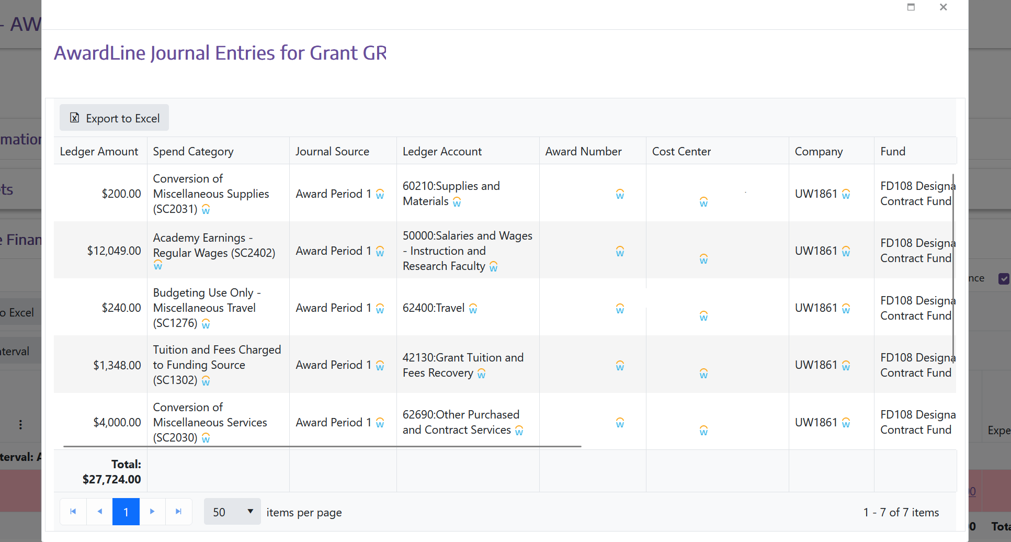
Award Line Amount

Slide 10
Expenses

Slide 11
Encumbrance

Slide 12
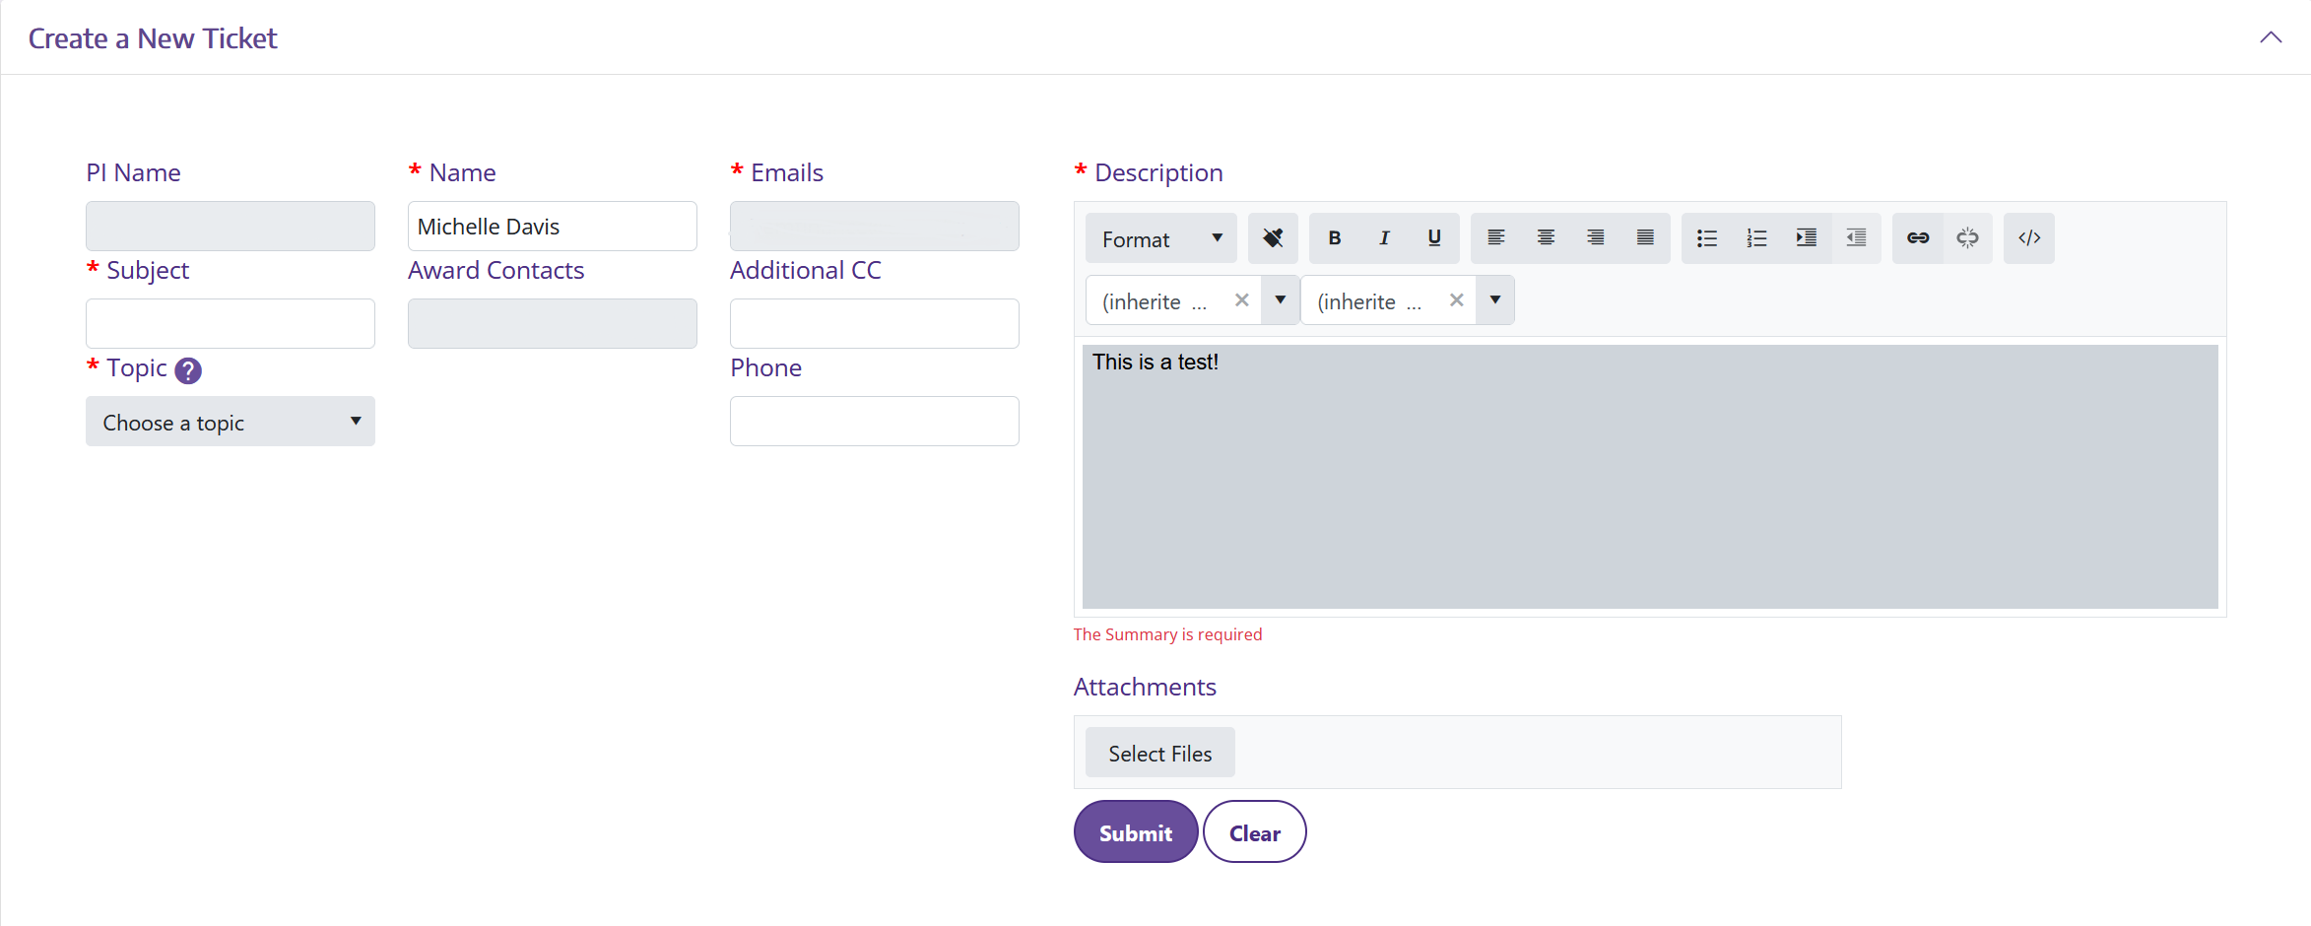
Update 3: Tickets
Column layout changes
Moved Attachments, Submit ticket button to align with Description box
Larger font size for communications

Slide 13
Update 4: Award Portal browser tabs
Includes AWD, GR, or AP ticket number in tab label for easier navigation

Slide 14
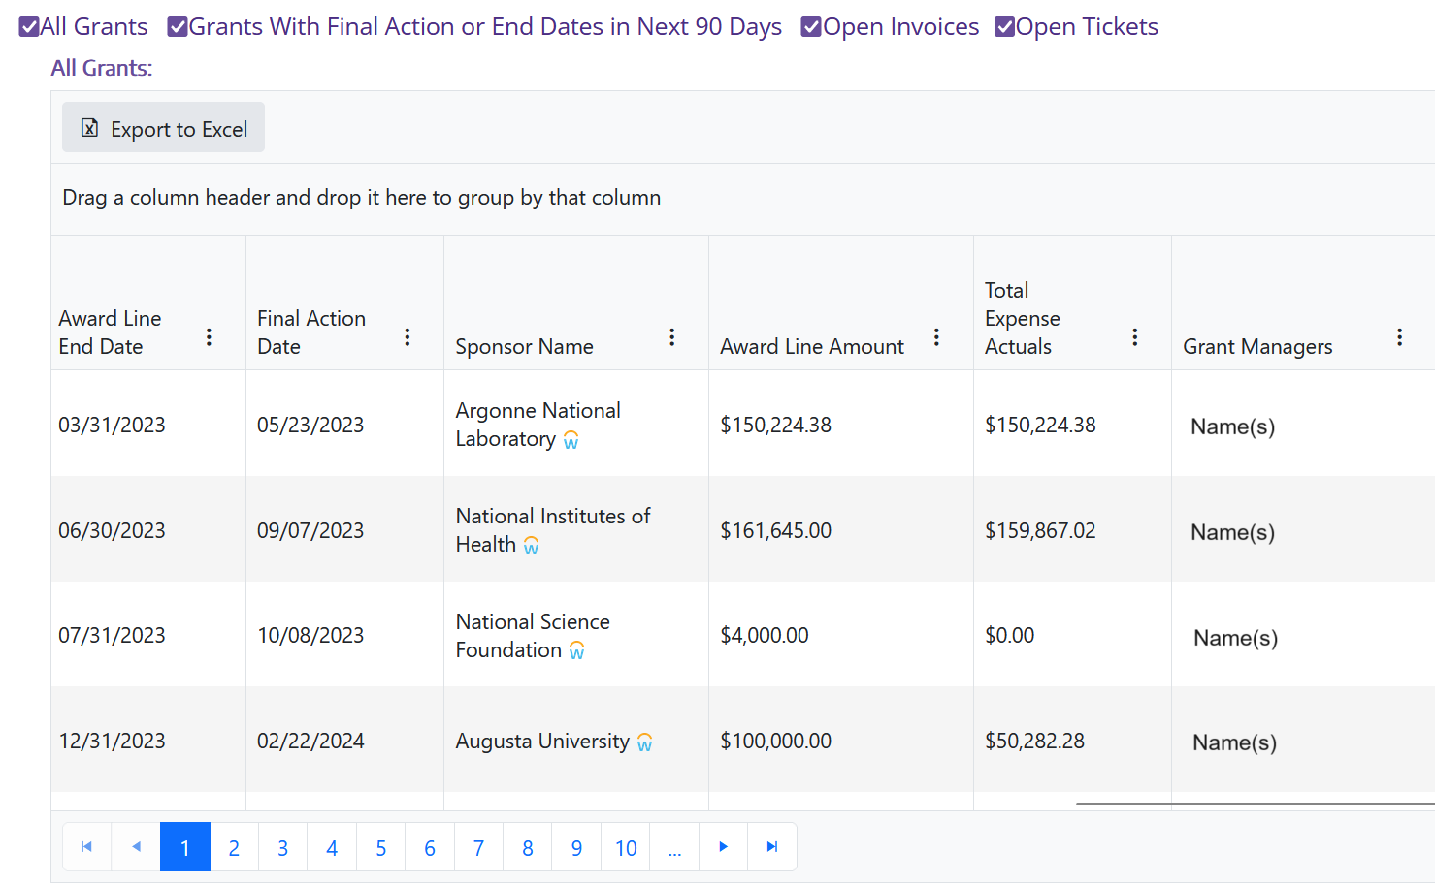
Update 5: CC Reports
3 new columns: award line amount, total actual expenses, Grant Managers

Slide 15
Future Updates
Itemized list of Letter of Credit draws
Current state: you can only see the total of each draw, but not the expenses included in the draw
Award payment information will be available
Receipts section has been renamed ‘Payments’
Increased time before Award Portal times out
Search by Balancing Unit in CC Reports

Slide 17
ASRs, ADVs, and MODs
Tips and Tricks for Success
Jonathan Nagle

Slide 18
The Current State of Affairs
ASRs
Oldest items: 9/5/2023
Total Workload: 514
MODs
Oldest items: 7/25/2023
Total Workload: 1156
ADVs
Oldest items: 9/20
Total Workload: 45

Slide 19
What Can You Do?
Make Sure
Your new item gets routed to the right place!
Items for OSP and GCA
Sponsor approval required
Supplements
Extensions
PI changes
Items for GCA only
Sponsor approval not required
Elective grant lines
Rebudgeting
Cost center changes

Slide 20
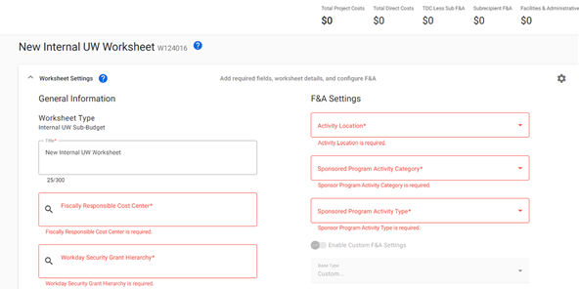
What Can You Do?
Make Sure
You have the right kind of SAGE request for your item!
Your SAGE items are filled out completely!
This goes for new items submitted going forward and existing items already in the queue.

Slide 21
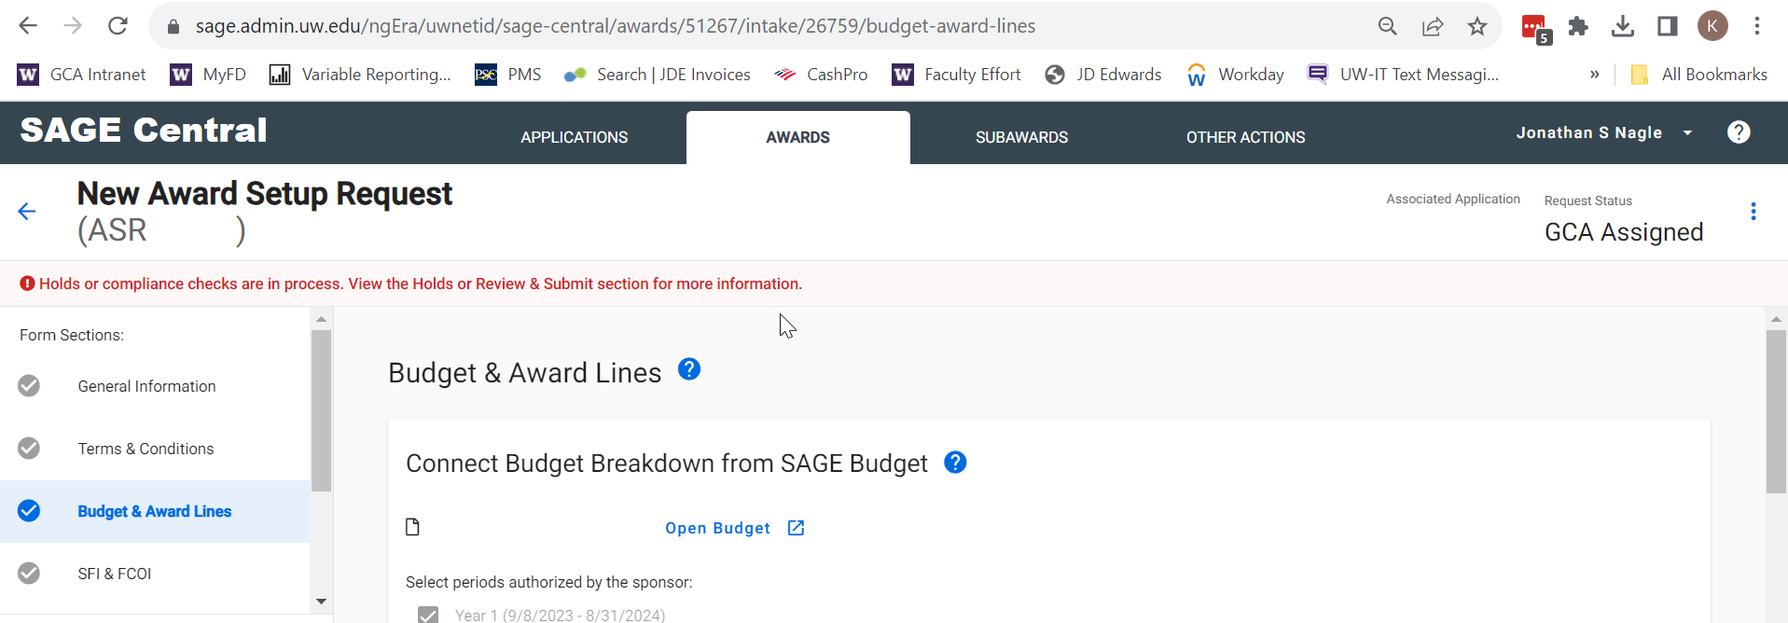
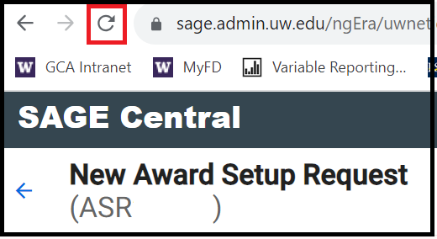
Missing Items – SAGE Budgets
Refresh the item page in your browser to pull SAGE budget changes through

Slide 22
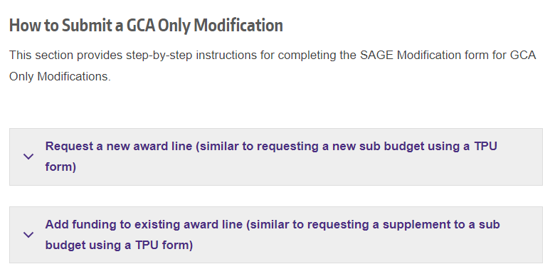
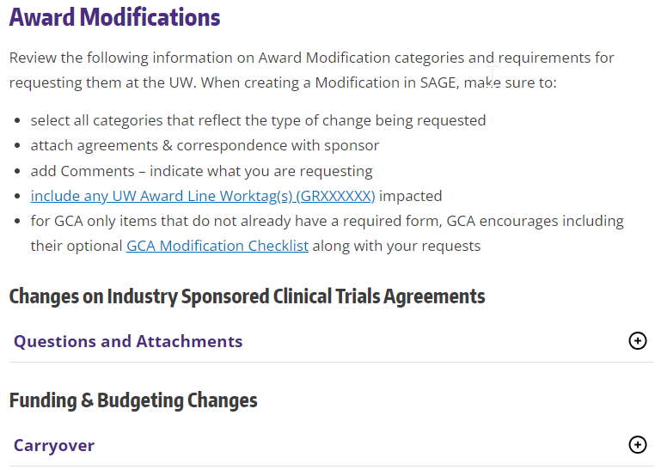
Missing Items - ???
No sponsor approval?
GCA Modifications
Sponsor approval?
OSP Award Changes

Slide 23
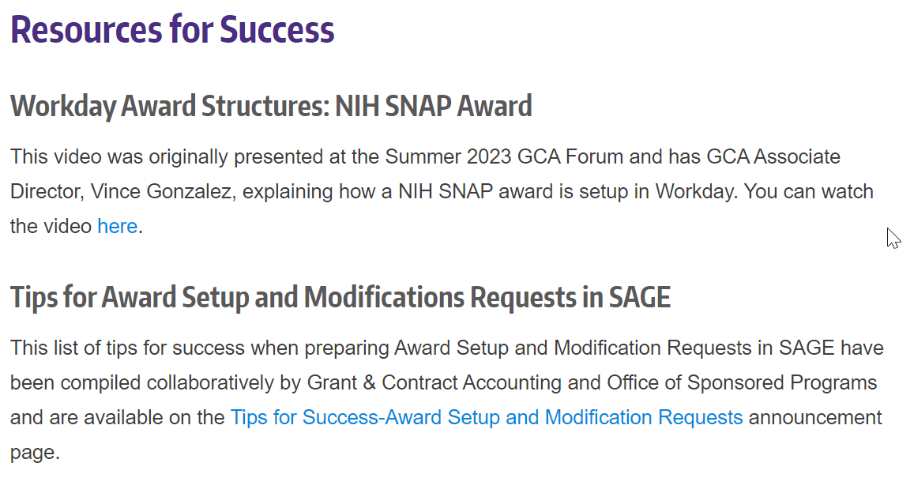
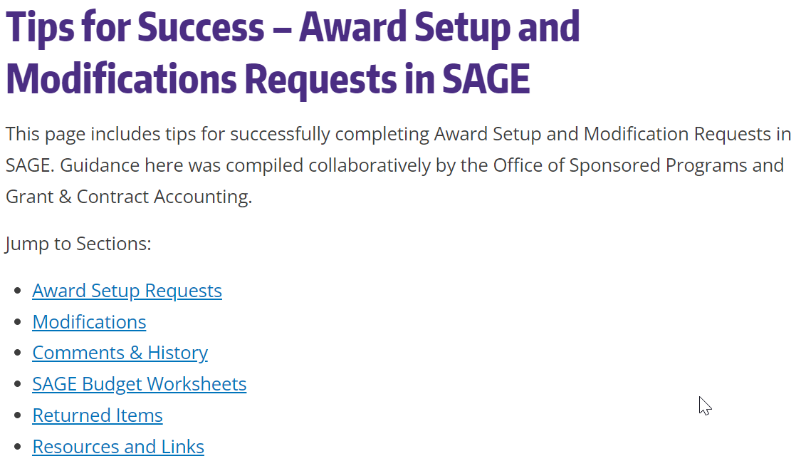
Missing Items - ??? (continued)
GCA Award Setup Page (link)

Slide 24
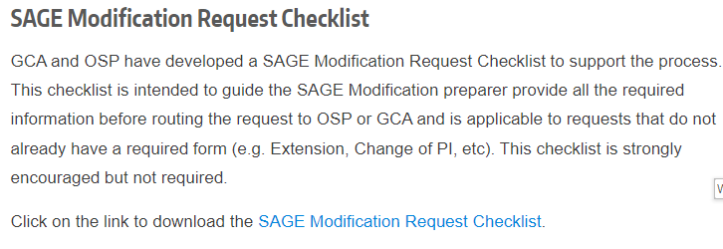
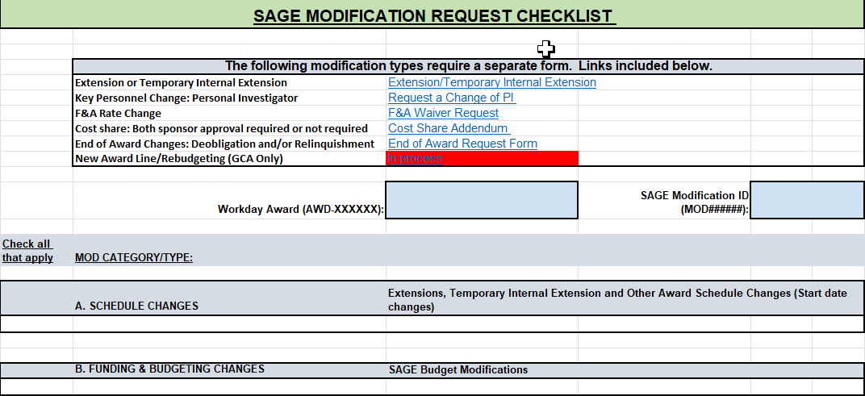
Missing Items - ??? (continued)

Slide 26
MOD Replacement for Transpasus
Patrick Carney

Slide 27
New Terms
With the launch of Workday, there are some new terms in the process that while not directly correlated in this system are closely related.
MOD
Award Line
GR/Worktag

Slide 28
Submitting a MOD
Within SAGE you can generate a MOD for a new award line by clicking create a request
For new award lines, you would select “Modification Request (GCA)”.

Slide 29
After selecting to create a MOD you are presented with the box to search for your AWD in SAGE. Here you select the AWD where you would like to add the new award line.
Please note, it is a known issue that non converted AWD’s are not being added to the SAGE database, so they do not show up when you search here. You will need to email sagehelp@uw.edu and have the AWD manually added until this is corrected.

Slide 30
On the MOD, you will complete a SAGE budget sheet for each of the new award lines you would like established.
The whole SAGE budget needs to be completed for our Award Setup team to process; it is more detailed than the prior TPU process, but is required as it will help with integration into Workday. This includes the budget breakdown in the SAGE budget, the AWD title for the new line, the Grant Hierarchy, and the Cost Center.

Slide 32
Invoicing Tips and Tricks Duplicate Requests to GCA Help
Azalea Vasquez

Slide 33
Invoicing Tips and Tricks: Edition
Azalea Vasquez

Slide 34
How To View Invoices in Award Portal

Slide 35
How To View Invoices in Award Portal

Slide 36
How To View Invoices in Award Portal

Slide 38
Non-CTMS Customer Invoices
Non-CTMS awards are legacy Form of Payment 11 (FOP 11) awards
Clinical studies not billed in OnCore
Department submits invoice to sponsor (not GCA)
Departments must contact GCA before sending the invoice to the sponsor
GCA will create a Workday Customer Invoice (CI) number
Department will add the number on the invoice
Allows receivable to be tracked centrally and streamline cash application process

Slide 39
Non-CTMS Customer Invoices
Action items for departments
Create an Award Portal Ticket on the associated Grant ID (GRXXXXXX) using the topic "Sponsor Billing"
Confirm your request is for a non-CTMS invoice
Provide the invoice amount you are billing for
Include any additional information you would like shown in the Workday memo field of the invoice to assist with the cash application or department reconciliation
Visit our website - Invoicing Sponsors

Slide 40
Non-CTMS Customer Invoices
This is a non-CTMS invoice request.
Please create a Workday Customer Invoice (CI) with the following information:
Invoice Amount: $X,XXX.XX
Memo: Survival follow ups for study RXXXXXXX, invoice number XXXXXX

Slide 41
Clinical Trial Awards – OnCore Invoicing

Slide 42
Clinical Trial Awards – OnCore Invoicing

Slide 43
Budget Date and Final Invoices
Workday will not include expenditures on an invoice if the Budget Date is outside of the award line dates.
Work with your Shared Services Team to change the Budget Date on a transaction if it is incorrect.
Failure to do this by your Final Action Date may delay GCA's ability to issue a Final invoice on time.

Slide 44
Zero Final Invoices
Workday does not generate a Zero Final Invoice
Last interim invoice has billed the award in full
Send an Award Portal ticket to GCA if the sponsor is requesting a Zero Final invoice

Slide 45
Duplicate Requests Sent to GCA Help
GCA Help receives on average 300+ requests a day
GCA Help has three intake systems:
Email – gcahelp@uw.edu
Award Portal
Phone - 206-616-9995
Please pick one system to use to avoid duplication of efforts
Do not send an email and an Award Portal Ticket
Do not add gcahelp@uw.edu to an Award Portal Ticket

Slide 47
Cost Reimbursable Line Status Report
Susan Wilbanks

Slide 48
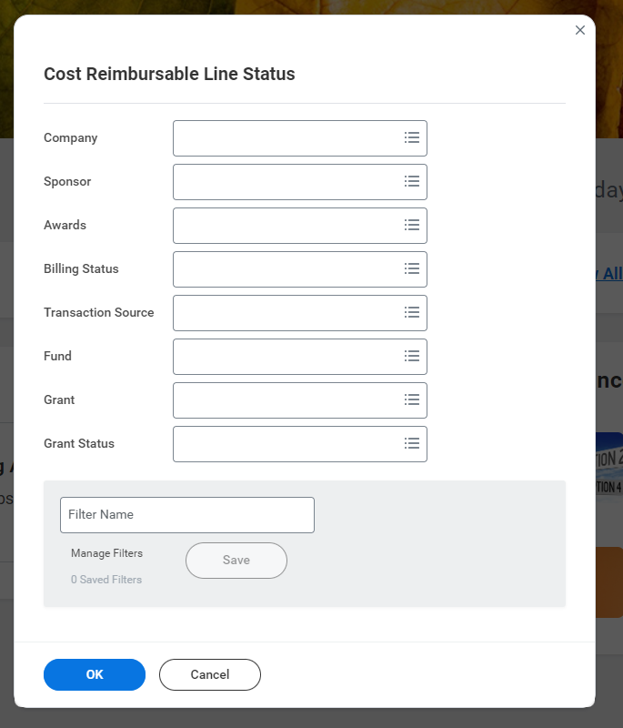
What is the Cost Reimbursable Line Status Report?
Allows users to view all the transactions included on a cost reimbursable invoice.
Can be used for research when a sponsor needs backup for transactions or when an invoice doesn’t match an R1234 report.

Slide 49
LIVE DEMO (detailed steps to follow)

Slide 50
Report Criteria
Enter All Companies under Company to ensure that all transactions are pulled in.
Enter your award number.
You can also enter your Grant number (optional).

Slide 51
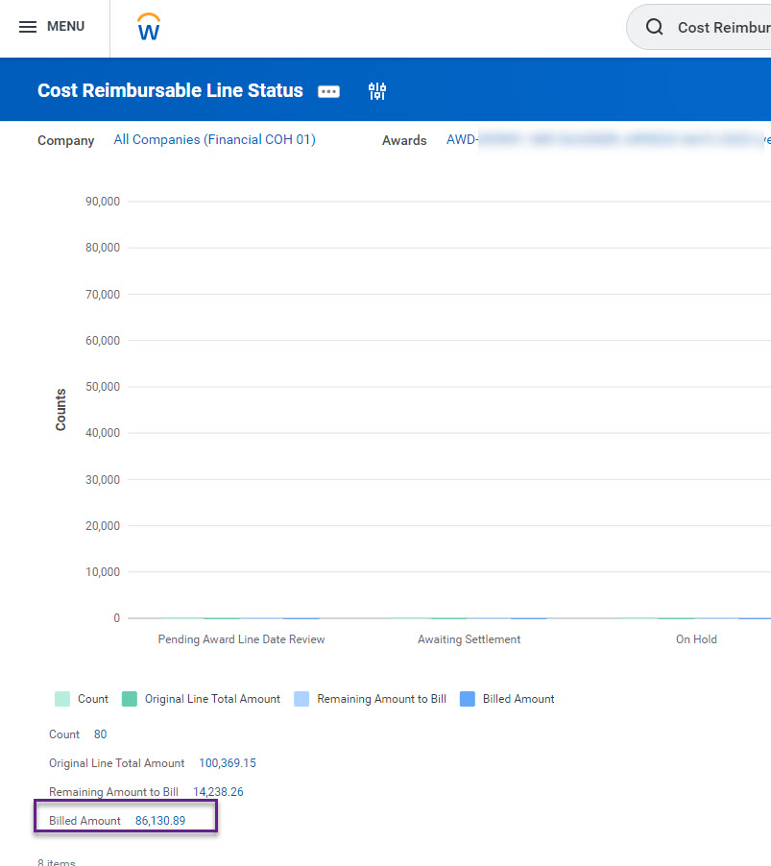
On the next screen, click on the Billed Amount.

Slide 52
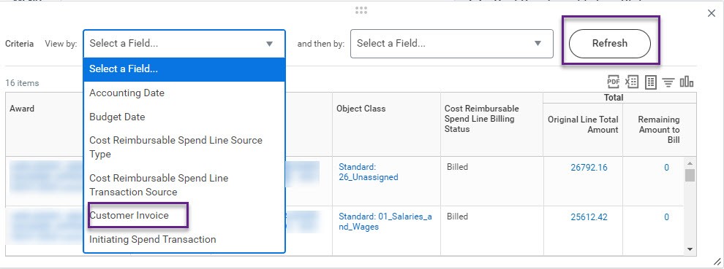
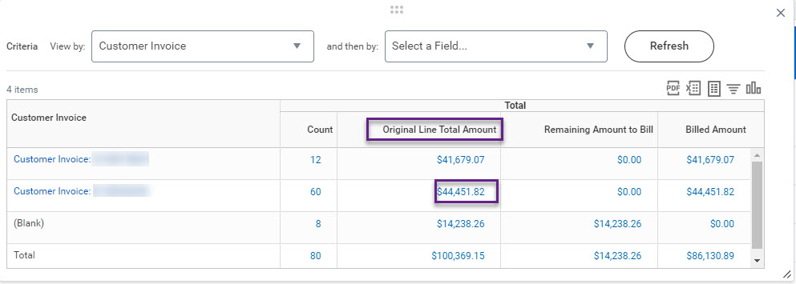
Change the View By field to “Customer Invoice.”
Find the invoice you want to review, then click on the Original Line Total amount.

Slide 53
Now you have a transaction list you can import to Excel and sort as needed.

Slide 54
Tips and Tricks
The Initiating Spend Transaction column is particularly useful, especially for non-payroll expenditures—you can use it to locate supplier/subaward invoices and similar backup.
In cases where the invoice (and this report) doesn’t match the R1234 data for the billing period, look for the following:
Transactions on the invoice from earlier periods. E.g. if you recently received a supplement on an award where the original award amount was billed in full, the invoice may include “catch up” transactions.
If your budget is overspent, GCA can only bill up to the award amount, but the R1234 will include all expenditures.
If you cannot identify the cause of the mismatch, please contact us via Award Portal. Attach a copy of your R1234 report and a screenshot of the criteria used for it.

Slide 56
Future Forum
February via Zoom
https://finance.uw.edu/gca/training-outreach/gca-forum
Survey about today’s forum will be sent out soon!

Slide 57
Contact Us
Award Portal: https://finance.uw.edu/gca/award-portal
Email: gcahelp@uw.edu
GCA Help: 206-616-9995
9:00am-12:00pm & 1:00pm-4:00pm

