Slide 1
GCA UPDATE
Vince Gonzalez
Associate Director, Grant & Contract Accounting
December 14, 2023 MRAM

Slide 2
TOPICS
Backlog Update
Status Update by Process
Known Issues Updates
Tips for Success

Slide 3
STATUS UPDATE: BACKLOGS
As of Monday, December 11:
Award Setup: 1,636 unprocessed items
Reporting: 512 backlog reports
Closing: 3,738 backlog closings
Customer Service: 5 day response time
All backlog volumes are updated weekly on GCA Homepage

Slide 4
STATUS UPDATE: BY PROCESS
Award Setup
Advance extension temporary process ended
Advance requests are current
New Workday Award Line Lifecycle statuses webpage
Invoicing
Change to Month-End Close allows interim invoices to be sent on time (Month-End Close calendar with dates)
Creating invoices is subject to a schedule-please give GCA as much notice as possible for urgent requests
All requested invoice templates have been added to Workday
Work ongoing to correct incorrect posting of pre-WDF go-live expenses to the unallocated category
Notes:
Speaker notes for Invoicing:
The invoicing integration schedule is available on GCA’s Invoicing Sponsors webpage.
More invoice templates added to WD means more automation.

Slide 5
STATUS UPDATE: BY PROCESS
Reporting
Working with UW DATAGroup and Deloitte to automate financial reports
Highest population is SF425 for federal awards and UW standard report format (UWROE) for non-federal awards
Closing
X-functional Closing Working Group started this month
Closing actions (e.g. deobligations, deficits, residual balance transfers) will resume next quarter
Notes:
Speaker note for Closing: provide an explanation to campus when you're talking about Closing about what this actually refers to. Campus is thinking that we're not doing closeout actions (final invoices, reports) so we need to be more careful what we mean when we say closeout. This is a good opportunity for us to explain. (from Juan’s comment)

Slide 6
KNOWN ISSUES UPDATES
Program income job aids are published on our Program Income Guidelines webpage under “Resources”
Some “tuition” is appearing as “scholarships” in Workday
Notes:
Speaker note about Tuition posting as scholarships. We are working with subject matter experts on the topic to ensure correct categorization as well as ensure necessary updates are made in Workday.

Slide 7
TIPS FOR SUCCESS: EXPENSES
Process expense transfers timely
More questionable to auditors the longer they go on
Can jeopardize sponsor reimbursement
Review your expenses’ budget dates
Job aid available on UW Connect to edit budget dates
Work with Shared Environment to edit budget dates. GCA no longer has the ability.
Notes:
Speaker Note: Questions about budget dates can be directed to your Shared Environment.

Slide 8
TIPS FOR SUCCESS: SAGE
Check SAGE to see if your advance request has been processed
See How do I know if my advance request is processed? FAQ for step-by-step instructions
Read an item’s Comments & History section for information about returns and holds before reaching out to OSP or GCA
Include SAGE Budget Snapshot URL for Funding & budgeting change MODs
Notes:
Speaker note about advances: We received feedback in the GCA Fall Forum about prioritizing advance requests so we encourage departments to check SAGE to see if their request is processed.

Slide 9
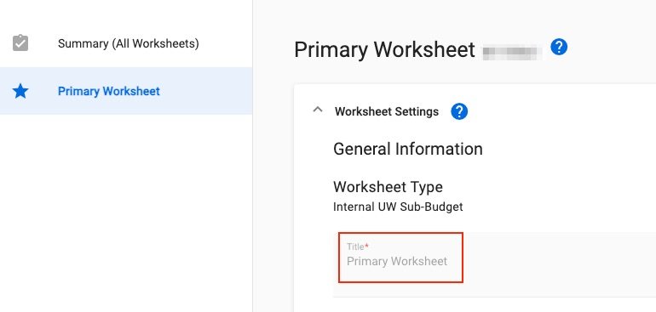
TIPS FOR SUCCESS: SAGE
Change the name your SAGE Budget Worksheet from “Primary Worksheet” to have a meaningful WD Grant Name
Update worksheet title in SAGE Budget and send GCA Only MOD to change WD Grant Name
Notes:
Speaker note: GCA uses worksheet title for grant name in most cases (exception: subaward). GCA can’t follow up with campus unit to get a different worksheet title (feedback from GCA Fall Forum).

Slide 10
QUESTIONS
Questions about using SAGE: sagehelp@uw.edu
Other questions can be sent to: gcahelp@uw.edu

