Slide 1
Award & Modification Requests - Tips for Comments & Budgets
November 2023 MRAM
Vince Gonzalez, Associate Director, Grant and Contract Accounting
Carol Rhodes, Director, Office of Sponsored Programs

Slide 2
COMMENTS & HISTORY
Location to provide information to OSP and GCA
Bottom left side of Advance Requests, Award Setup Requests, and Modifications
Notes:
Carol

Slide 3
COMMENTS & HISTORY
Character Limit Awareness
Be aware of character limits!
Comments allow for 1000 characters
Returns and Resubmitted
When GCA returns an item, 300 character limit
When campus resubmits an item, 300 character limit
Text entered into pop-up windows appears in Comments & History
Notes:
Carol

Slide 4
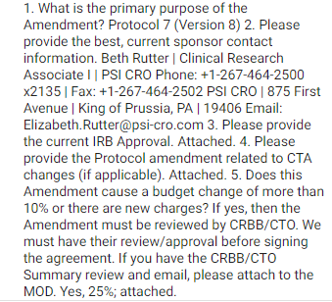
SAMPLE COMMENTS
Clinical Trial Amendments
Providing OSP with Required Information
Information required for OSP to review and approve any Changes to Clinical Trials:
Primary purpose of change
Current sponsor contact info.
Do changes add or subtract $$?
If yes, indicate modified sponsor total all spending periods
Budget changes greater than 10%?
If yes, UW Clinical Trials Office review & their approval attached to MOD
firstname last
(425(123-444
contact@xyzfg.edu
Notes:
Carol-
Proactively include required information that facilitates OSP review e.g. Clinical Trial Amendments always needs this information included for OSP review and approval.

Slide 5
EXAMPLE COMMENTS -
MODIFICATIONS
“I revised the SAGE Budget to match the initial awarded increment of $4,538,270. I also attached the approval email. See link to SAGE Budget snapshot”
“When the Mod request is forwarded to GCA please include the note that a CI is needed in order to claim the first payment in the amount of $112,500, ACH #903710050306813, received 10/5/23.”
Notes:
Carol
Modification requests that include changes to a budget should always include a link to the SAGE Budget Snapshot detailing changes you need GCA to make and a brief description of what the change is.

Slide 6
AWARD SETUP REQUESTS CREATED BY OSP
FAQ will be Linked in Comments
What do I do when I receive an Award Setup Request created by OSP?
OSP setup includes
eGC1 selection, attaching award document, total amount
Campus completes remainder visible to them
Including SAGE budget data
When you (campus) complete the fields available to you on the ASR, OSP (& GCA) reviewers have more work to do, such as completing fields for OSP/GCA use, not visible to you until processed.
Notes:
Carol - Speaking of comments… new comment on ASRs created by OSP will be a link to a new FAQ

Slide 7
QUESTIONS ABOUT RETURNED ITEMS
Have a question about a returned item?
Read the comments first. Still have questions?
Item returned by GCA? Email gcahelp@uw.edu or send Award Portal ticket
Item returned by OSP?
Email OSP reviewer who returned the item to you
Find your OSP Reviewer name in the Comments & History or in the Award Requests List
Notes:
Carol

Slide 8
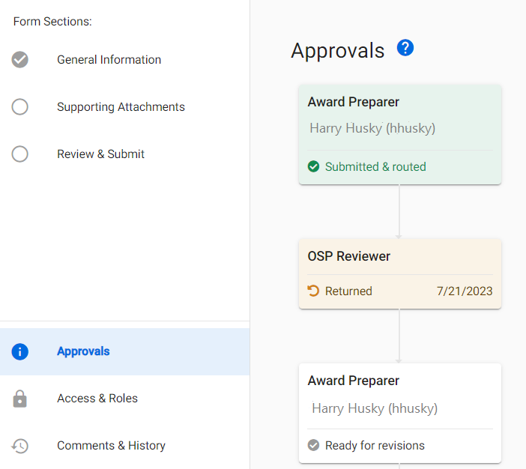
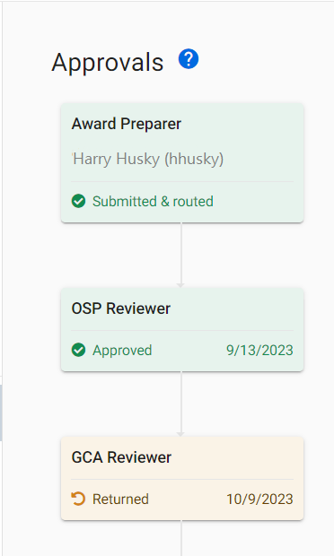
ITEM RETURNED BY GCA OR OSP?
Check the Approvals graph for whether OSP or GCA returned the item
Notes:
Carol

Slide 9
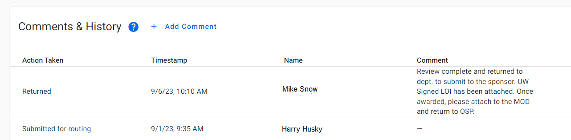
FINDING YOUR OSP REVIEWER
Find your OSP reviewer in the Comments & History Section or in the Award Requests list
Notes:
Carol

Slide 10
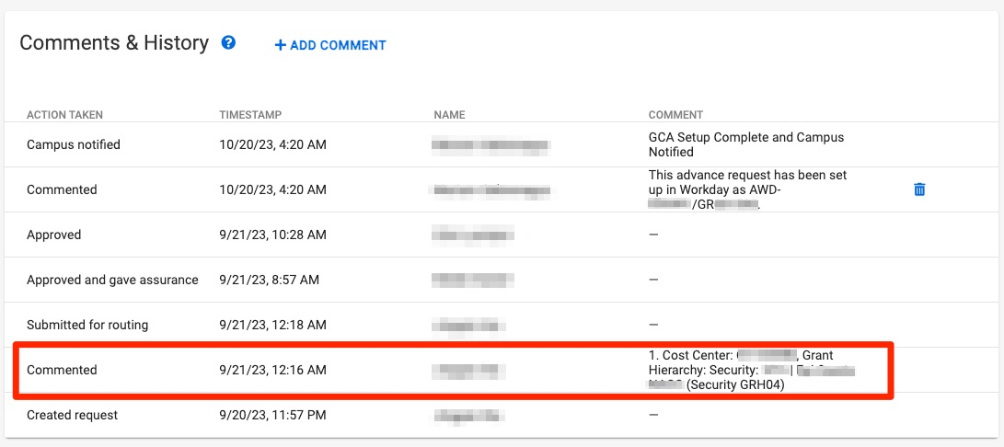
TIPS FOR ADVANCE REQUESTS
Include the Grant Security Hierarchy in the Comments & History
Notes:
Vince

Slide 11
COMMUNICATING YOUR BUDGETS
Use the SAGE Budget Snapshot
Include all information GCA needs to update Workday
Grant Security Hierarchy
Cost Center
Principal Investigator (Grant)
Excel export does not include Grant Security Hierarchy and Cost Center
Review SAGE Budget Snapshot:
How to Make a SAGE Budget Snapshot
How to Include Your SAGE Budget Snapshot on a SAGE Modification Request
Notes:
Vince

Slide 12
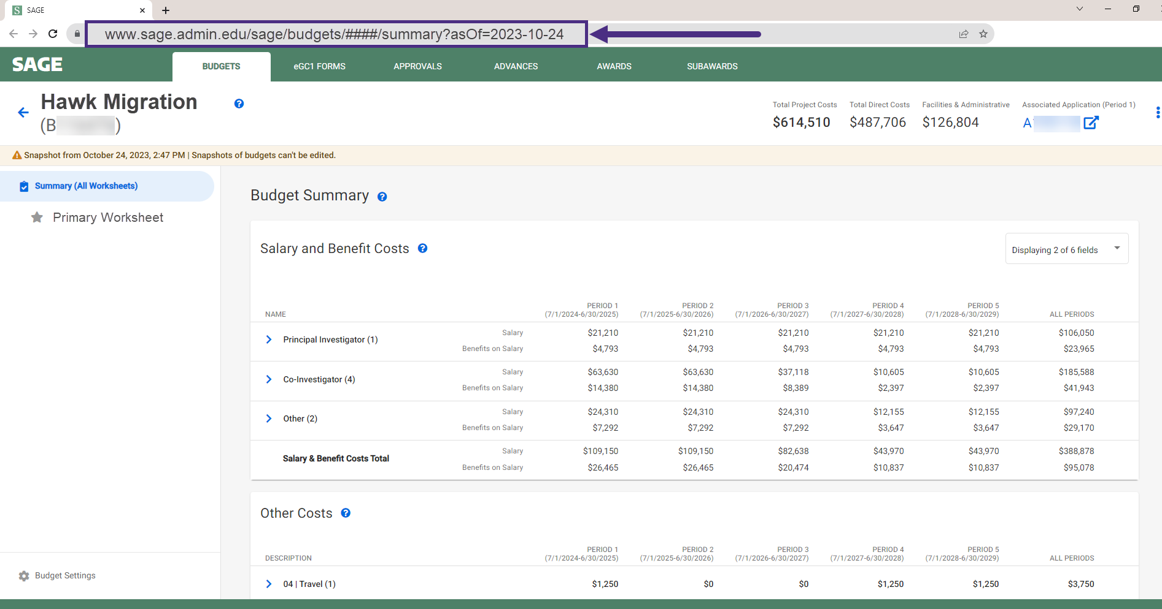
COMMUNICATING YOUR BUDGETS:
BUDGET SNAPSHOT EXAMPLE
Notes:
Vince

Slide 13
COMMUNICATING YOUR BUDGETS:
PRIMARY WORKSHEET EXAMPLE
Reminder: Your Primary Worksheet title will be the name of the corresponding Award Line in Workday
Cost Center Receiving Funding
Workday Security Grant Hierarchy
Notes:
Vince

Slide 14
RESOURCES
Updated - Tips for Success: Award Setup & Modification Requests
New - What do I do when I receive an Award Setup Request from OSP?
SAGE BUDGET SNAPSHOTS
How to Make a SAGE Budget Snapshot
How to Include Your SAGE Budget Snapshot on a SAGE Modification Request
Notes:
Vince

