Slide 1
Subaward Update
September 14, 2023 MRAM
Amanda Snyder, Josy Combs, Bruce Havelock
Office of Sponsored Programs & Procurement Services

Slide 2
Cross-functional Subaward Work Group
Established to address the variety of issues that have been delaying subawards.
Includes OSP, Procurement, GCA, UW-IT Integrated Service Center
Notes:
Amanda

Slide 3
Challenges
New Subawards that did not convert and still need Award Lines
Supplier Contracts Converted without PO
Supplier Contracts missing PO post-conversion
Subawards Finalized After Performance Period
PO Conversion Errors - Dates & Dollars
Notes:
Amanda

Slide 4
Getting the Award Lines in Place
Award Setup Requests & Subawards
When campus creates or receives an Award Setup Request from OSP and there needs to be subaward award lines:
Campus award preparer must set up a separate SAGE Budget Worksheet for each subaward.
GCA will create separate award lines based on SAGE Budget worksheets
Award line for subawards will show status of “open”, but no spending until PO approved
Notes:
Amanda

Slide 5
Getting the Award Lines in Place
Adding New Subawards for Existing Awards
When you need to add a subaward to an existing Award.
Submit an Award Modification (MOD) to OSP/GCA
Select “Funding & Budgeting Change” category
Include a comment the MOD is to “Add New Subaward”
Include SAGE Budget Worksheet for each subaward being added
OSP reviews for sponsor approval requirements
OSP sends MOD to GCA upon approval
GCA will create Award Line for subaward based on SAGE Budget worksheets included with the MOD
Do not send a SAGE subaward or subaward modification request until the Award Line exists in Workday
Notes:
Amanda

Slide 6
Conversion Issue:
New Subawards that did not convert and still need Award Lines
At go-live, some subawards missing award lines
In-Process subawards: OSP subaward team emailing Department contacts to identify associated Award Modification Numbers
OSP shares list of these MODs with GCA
GCA is pulling these MODs out of the backlog to create award lines
Once award line is created, OSP sends request for new Supplier Contract and PO to Procurement
After PO number created, OSP Administrator adds to agreement, signs, returns to subrecipient
Notes:
Amanda
GCA MOD pull for subawards as of 9/26
missing award lines is a stop on moving forward

Slide 7
Supplier Contracts Converted without PO
287 instances for OSP to analyze
Some may not need POs because subaward is not continuing
If new PO needed, Send an email to ospsubs@uw.edu including:
Subject Line: Converted without PO
UWSC#
PO Start and End date
Advance Payment - Yes or No
Main PO Amount (lees Advance, if applicable)
Advance Amount
PO Grand Total
Campus point of contact
Notes:
Josy

Slide 8
Supplier Contracts missing PO Post-Conversion
We do not anticipate this issue occurring beyond conversion
OSP requests new supplier contract and PO in same request for new subawards
Notes:
Josy

Slide 9
PO Conversion Errors - Dates & Dollars
Send an email to ospsubs@uw.edu including:
Subject: PO Conversion Error
UWSC#
Workday PO Number
PO Start and End date
Advance Payment - Yes or No
Main PO Amount (less Advance, if applicable)
Advance Amount
PO Grand Total
Campus point of contact
Notes:
Josy

Slide 10
Subaward Agreement Modifications
If you have a Subaward Agreement Modification to an existing subaward in process, let your OSP administrator know the remaining balance from Ariba
OSP administrators will send a PO change request to Procurement, including the remaining balance
Include the Grant ID for subaward line, or the Award MOD #
Notes:
JJosy

Slide 11
Subawards Finalized After Performance Period
Workday does not allow PO set up when the end date of a supplier contract is in the past
Workaround identified, this issue no longer holding us up & POs are now being created
This situation occasionally occurs in normal course of business, due to delays.
This workaround will be standard practice moving forward for future situations
Notes:
Amanda

Slide 12
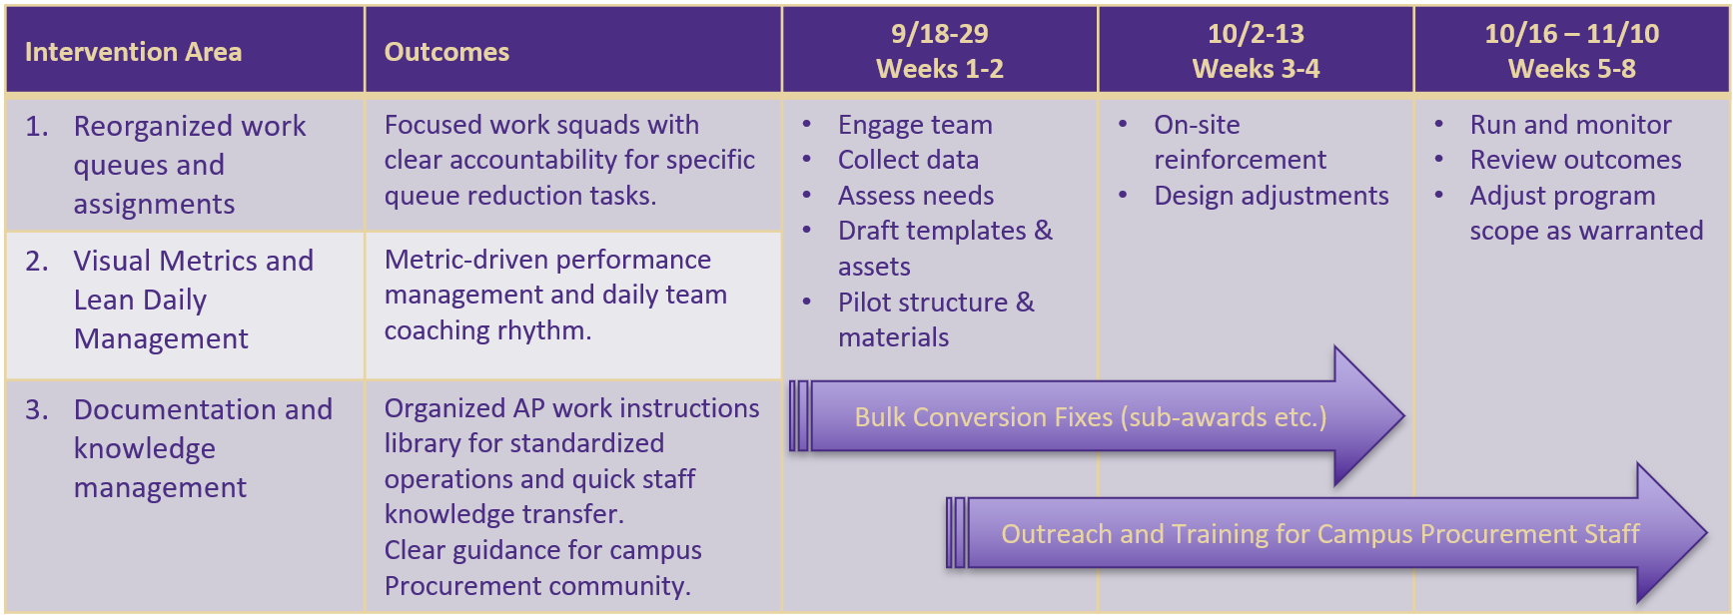
AP Recovery Plan
An initial 8-week intervention plan to establish work management queues & assignments, activate metrics, and standardize AP processes while engaging team for success.
Notes:
Bruce

Slide 13
Resources
How to begin subaward setup
Request changes to a subaward
Add a subaward - Award Changes
Procurement Services: For Suppliers
Notes:
Amanda

