Slide 1
NATIONAL BIOSAFETY
MONTH 2023
The Value of Written Procedures
Lesley Decker, Biosafety manager
Haris Malik, Biosafety officer
October 2023
Notes:
Welcome to biosafety month everyone!
Each year for biosafety month we highlight our role in the university and a topic in biosafety.
Presentation by Lesley Decker and Haris Malik

Slide 2
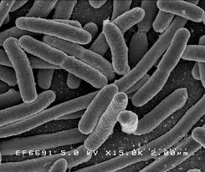
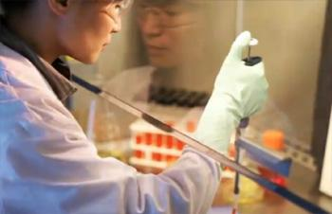
WHAT IS BIOSAFETY?
Framework for containment of biohazards
Includes safe practices, safety equipment, facilities and training
Protects the worker, community and environment
Protects the research product
Notes:
Biosafety is the safe handling of biohazards. Quickly define biohazard.
The purpose of biosafety is to protect the worker community and environment, by extension the safe work practices protect the product and improve research quality.

Slide 3
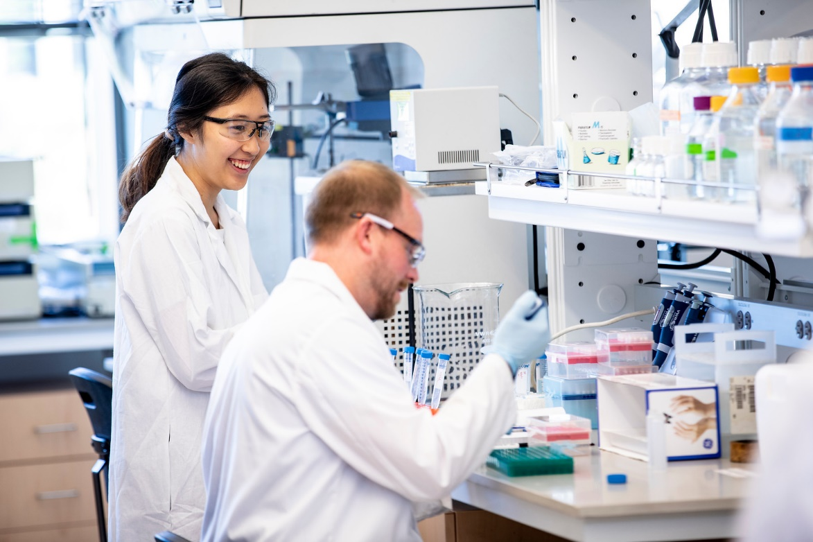
ABOUT EH&S BIOSAFETY
671 active Biological Use Authorizations (BUAs)
540 principal investigators
FY23:
371 BUAs reviewed
392 biosafety lab inspections (598 rooms)
Online trainings completed:
Biosafety: 2,694
Bloodborne pathogens (BBP): 3,783
Notes:
Here are some of our prominent metrics to summarize our 2023 fiscal year.
We have processed 371 biological use authorizations including 20 clinical trial BUAs involving recombinant DNA in humans.
Our team has conducted almost 400 inspections for almost 600 rooms.
Additionally, we have tracked the number of users completing our trainings each year. Over 2.5 thousand biosafety trainings, nearly 4 thousand bloodborne pathogen. And over 200 shipping medical waste trainings.

Slide 4
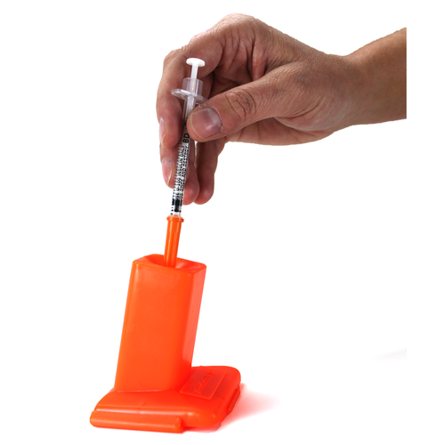
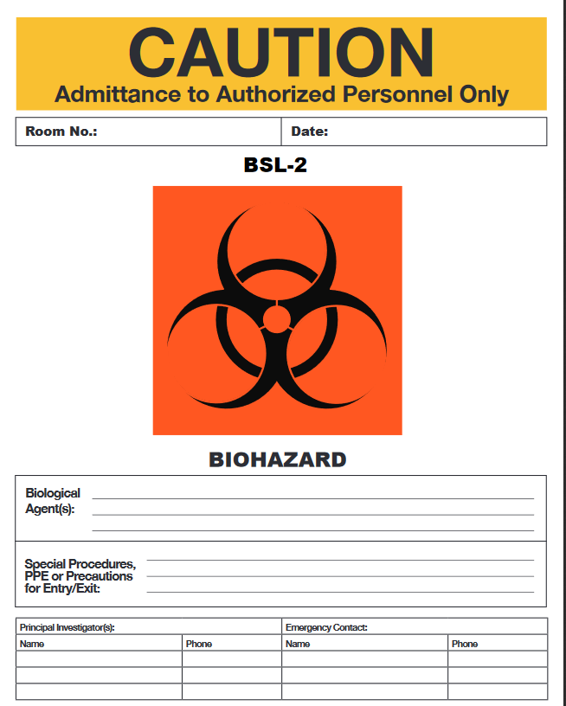
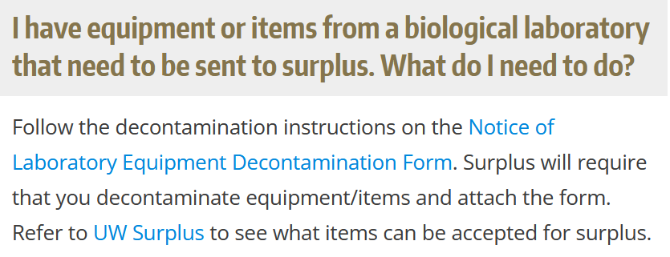
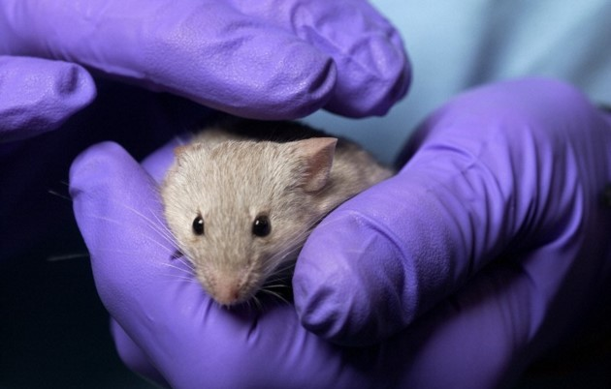
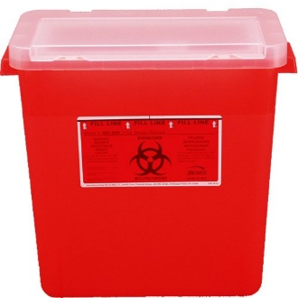
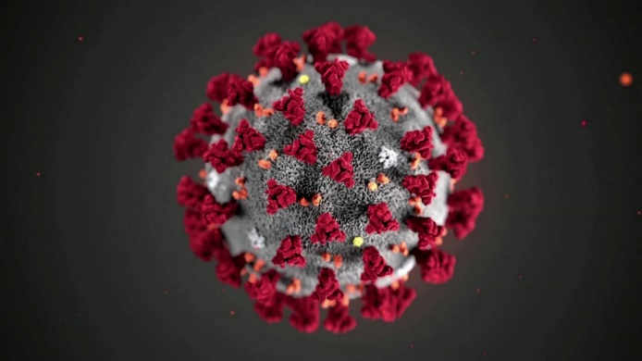
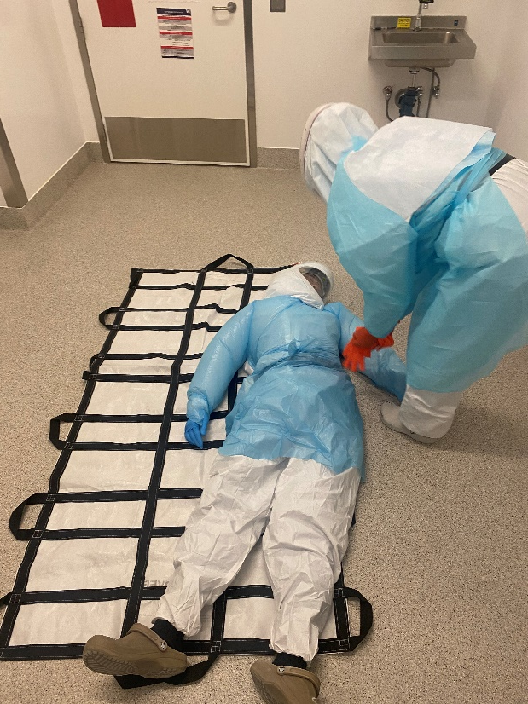
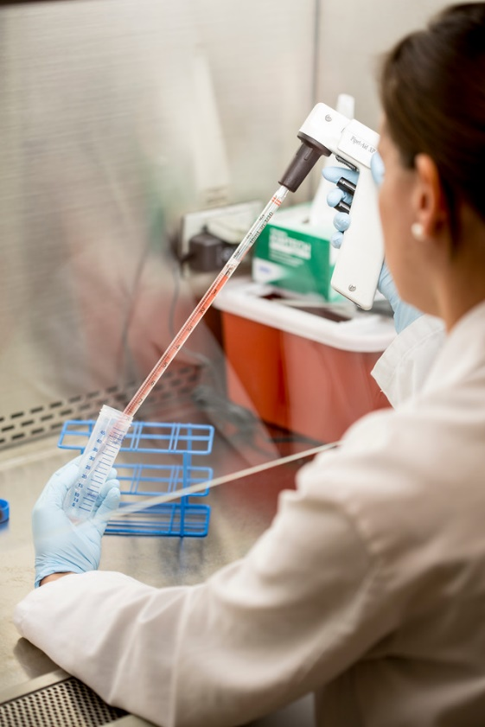
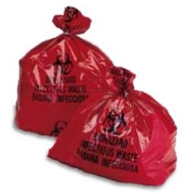
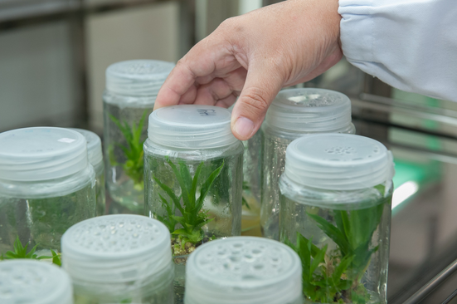
ABOUT EH&S BIOSAFETY
Notes:
The UW EH&S biosafety day to day and specialized work across all UW locations where biohazards are used:
Review and approve research with IBC
Train labs on proper use of PPE and decontamination
How to handle and treat biohazardous waste
Sharps safety
How to work safely inside a biosafety cabinets
Transgenic plants and animals, different types of facilities
Incident response
And BSL-3 and select agent programs

Slide 5
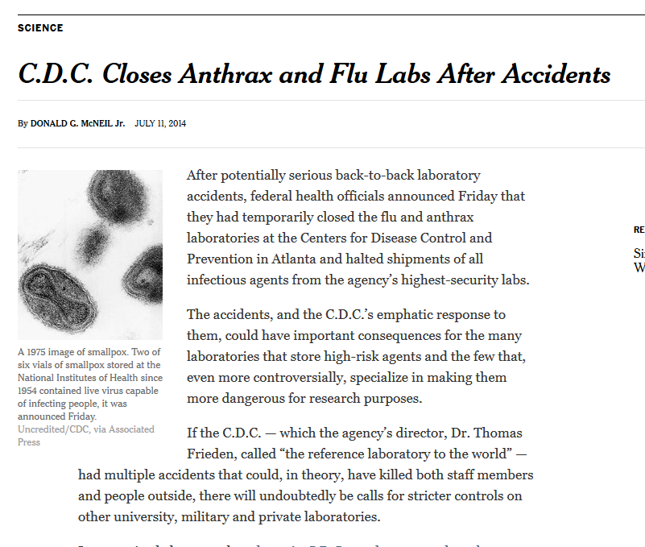
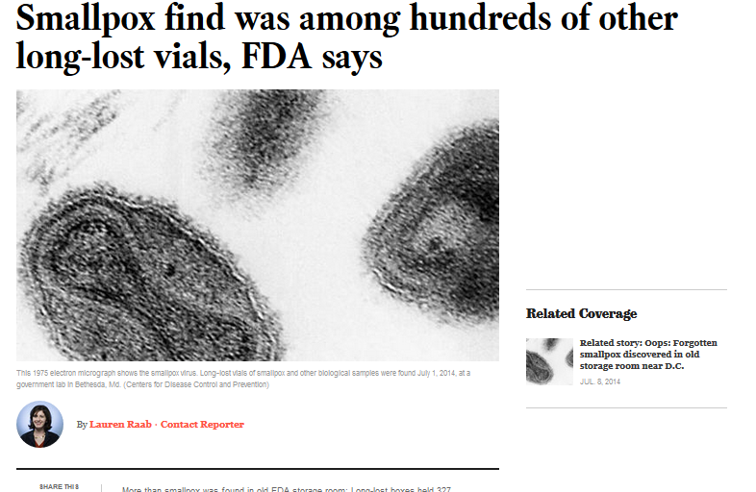
NATIONAL BIOSAFETY MONTH
Started in 2014 by the NIH Office of Science Policy
Time to focus attention to biosafety practices, policies, procedures and inventory
Notes:
About a decade ago there were several incidents in the news that highlighted gaps in biosafety programs. The FDA found smallpox vials in a cold room that were unaccounted for.
The CDC failed to inactivate anthrax samples that were sent out to labs that did not have the ability to handle them appropriately.
In response the white house ordered all federally funded labs to stop work and review inventories and procedures. From these incidents biosafety month was born.

Slide 6
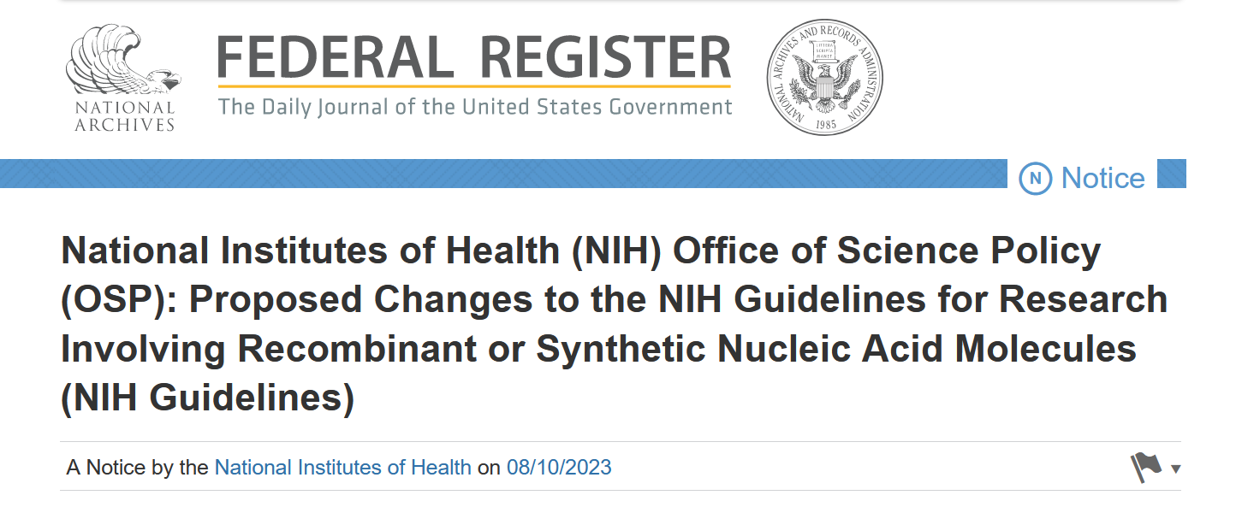
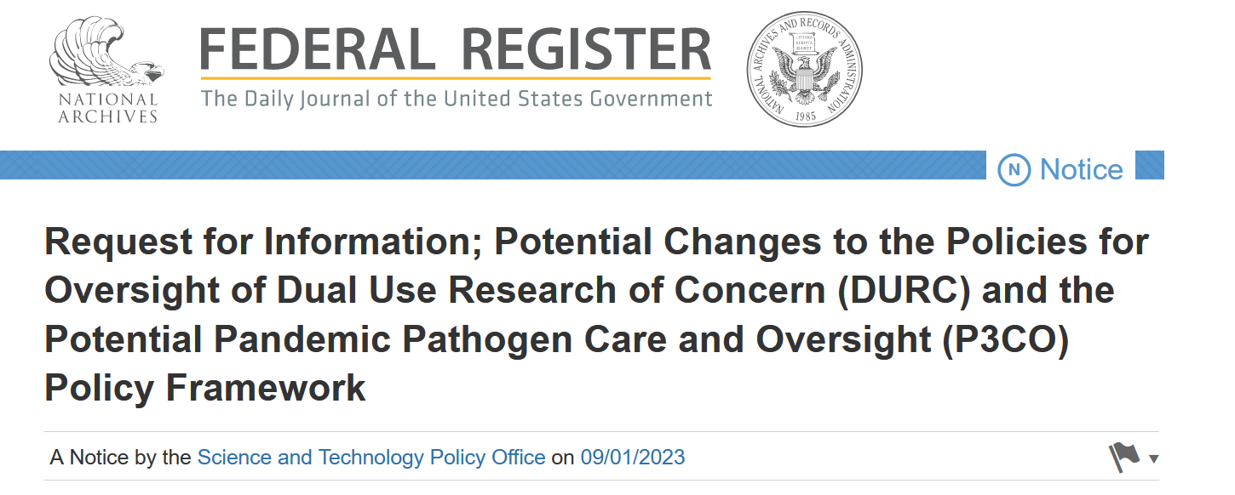
BIOSAFETY AND BIOSECURITY IN 2023
Notes:
Still prominently in the news with emerging diseases and potential threats.
COVID-19 put a spotlight on biosafety and biosecurity. Did the virus emanate from a lab or not? Either way funding has been impacted.
Efforts throughout government to potentially regulate biological research involving potential pathogens.
Two Federal Register publications with proposed changes to research regulations.

Slide 7
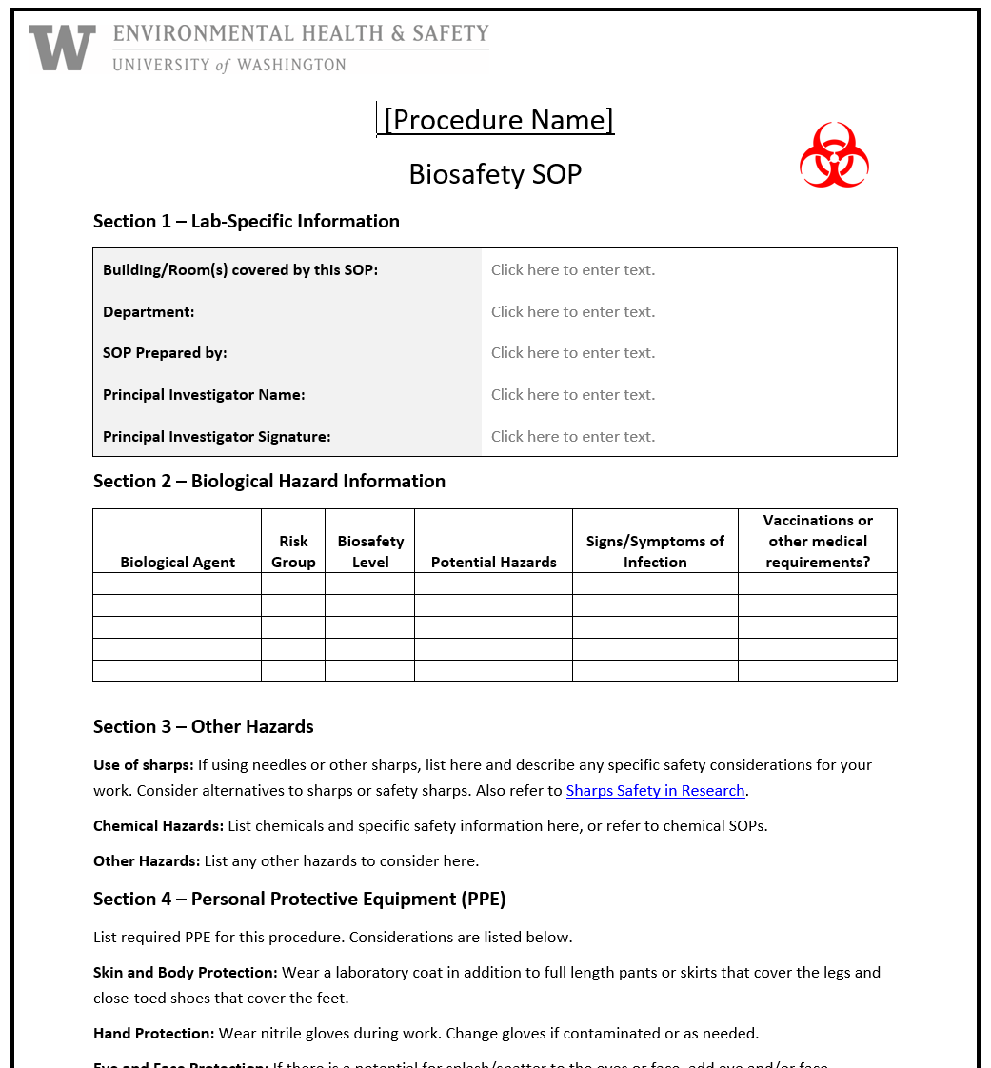
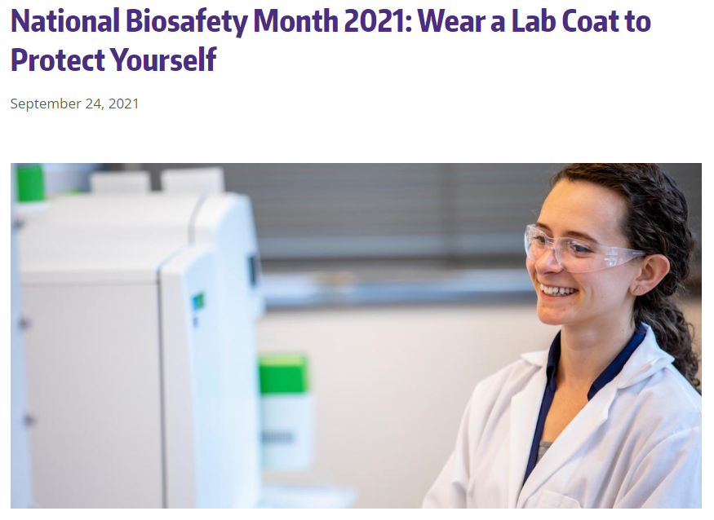
NATIONAL BIOSAFETY MONTH AT UW
Notes:
We have had numerous topics featured in our biosafety month from its start in 2014 including substituting hazards with safer alternatives, biological inventories, sharps safety, exposure response, and wearing appropriate PPE. This year we are putting the emphasis on SOPs, when do you need them and how to make them effective.

Slide 8
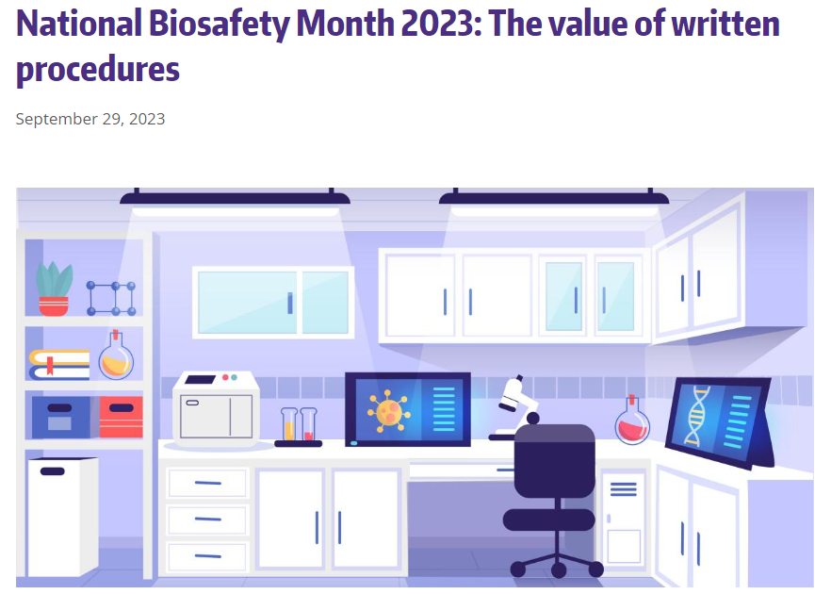
2023 BIOSAFETY MONTH AT UW: THE VALUE OF WRITTEN PROCEDURES
SOPs are step-by-step written instructions for how to perform a procedure.
Include information about potential hazards involved and ways to mitigate the hazards.
Can help improve consistency and quality across work.
https://www.ehs.washington.edu/about/latest-news/national-biosafety-month-2023-value-written-procedures
Notes:
SOPs are written instructions on how to do a procedure involving hazards from start to finish and should include all information regarding hazard mitigation including tips and tricks that are picked up along the way.
Include hazard mitigation and decontamination information
Help improve

Slide 9
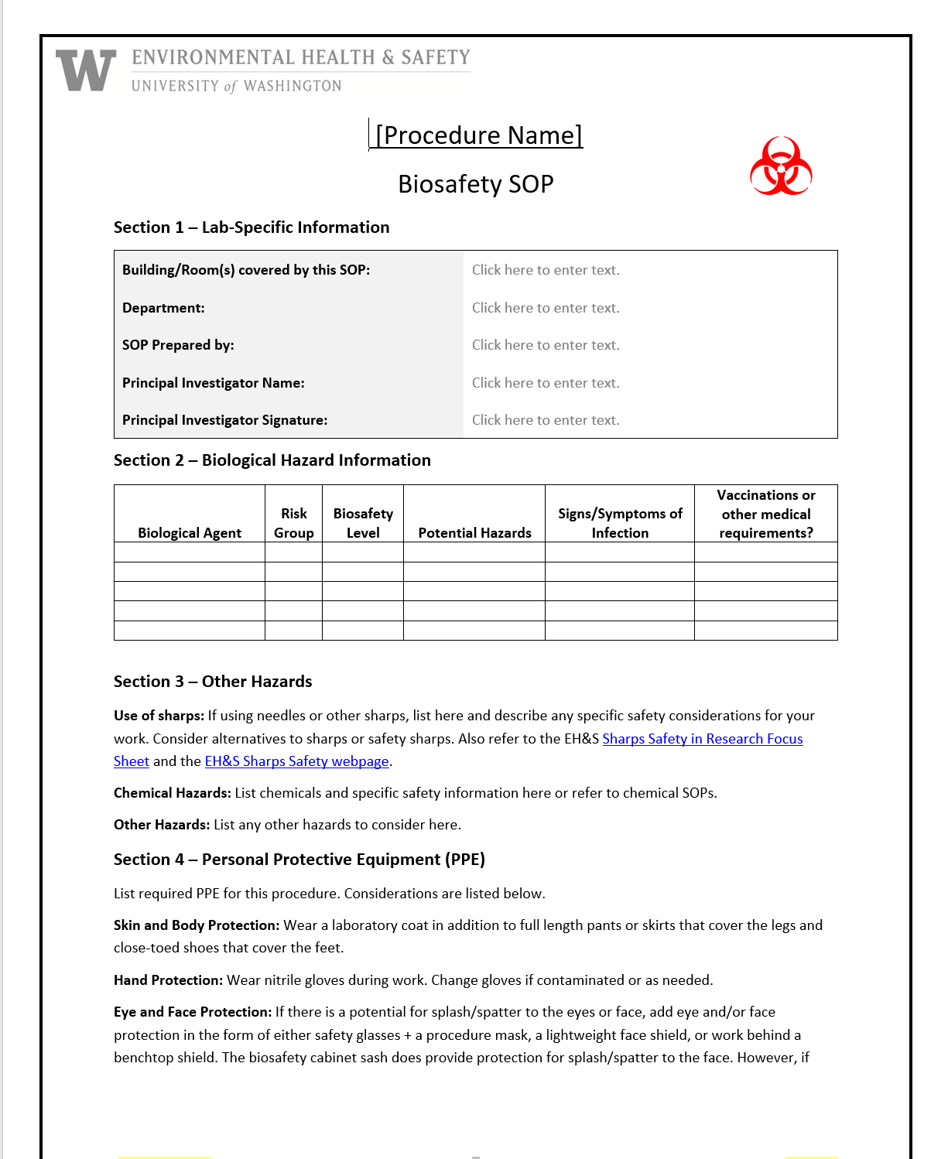
2023 BIOSAFETY MONTH AT UW: THE VALUE OF WRITTEN PROCEDURES
Use SOPs as training tools for new personnel, and document training.
Learn from the past. Share lessons learned, effective techniques, and avoid repeating mistakes.
Sometimes SOPs are a regulatory requirement (e.g., bloodborne pathogens).
Template biosafety SOP available on EH&S website.

Slide 10
CURATED TIPS TO IMPROVE SOPS
Treat your SOPs as a living document of accumulated knowledge and review regularly.
Avoid the “we’ve always done it this way” mindset. Solicit feedback from others who may view through a unique lens.
Use clear, concise, plain language to ensure content is accessible and steps are easy to follow.
Notes:
Labs are dynamic not static

Slide 11
BIOSAFETY MONTH OUTREACH
Email to principal investigators and lab managers with BUAs
A news post featured on the EH&S website and in EH&S newsletter
Featured on the Office of Research webpage
Present to U-WIDE Health and Safety Committee, MRAM (research administrators) and the IBC

Slide 12
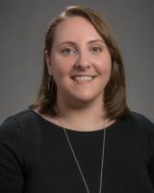
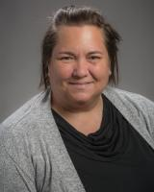
HAPPY BIOSAFETY MONTH!
Questions? ehsbio@uw.edu
Thanks to the biosafety team:
Lesley Decker
Zara Llewellyn
Kristi Kilgore
Esther Pellham
Haris Malik
Devon McMenimen
Jennifer Cabarrus
And our occupational health nurse:
Judy Cashman

