Slide 1
BONUS SESSION Monthly Research Administration Meeting - MRAM
October 4, 2023, 9:00 AM – 10:00 AM Click “CC” to Show Captions in your Zoom Controls
TOPIC | PRESENTER | EMAIL | MIN
Welcome | Carol Rhodes Office of Sponsored Programs | carhodes@uw.edu | 2
Subaward Update | Amanda Snyder, Josy Combs, Procurement Services Office of Sponsored Programs & Procurement | acs229@uw.edu | 15
Award Setup & Modification Requests Updates | Judy Chung Office of Research Information Services | sagehelp@uw.edu | 20
Training & Resources | ORIS/OSP/GCA | sagehelp@uw.edu | 5
NEXT MRAM October 12, 2023, 9:00 AM - 10:00 AM

Slide 2
Subaward Update
September 14, 2023 MRAM
Amanda Snyder, Josy Combs, Bruce Havelock
Office of Sponsored Programs & Procurement Services

Slide 3
Cross-functional Subaward Work Group
Established to address the variety of issues that have been delaying subawards.
Includes OSP, Procurement, GCA, UW-IT Integrated Service Center
Notes:
Amanda

Slide 4
Challenges
New Subawards that did not convert and still need Award Lines
Supplier Contracts Converted without PO
Supplier Contracts missing PO post-conversion
Subawards Finalized After Performance Period
PO Conversion Errors - Dates & Dollars
Notes:
Amanda

Slide 5
Getting the Award Lines in Place
Award Setup Requests & Subawards
When campus creates or receives an Award Setup Request from OSP and there needs to be subaward award lines:
Campus award preparer must set up a separate SAGE Budget Worksheet for each subaward.
GCA will create separate award lines based on SAGE Budget worksheets
Award line for subawards will show status of “open”, but no spending until PO approved
Notes:
Amanda

Slide 6
Getting the Award Lines in Place
Adding New Subawards for Existing Awards
When you need to add a subaward to an existing Award.
Submit an Award Modification (MOD) to OSP/GCA
Select “Funding & Budgeting Change” category
Include a comment the MOD is to “Add New Subaward”
Include SAGE Budget Worksheet for each subaward being added
OSP reviews for sponsor approval requirements
OSP sends MOD to GCA upon approval
GCA will create Award Line for subaward based on SAGE Budget worksheets included with the MOD
Do not send a SAGE subaward or subaward modification request until the Award Line exists in Workday
Notes:
Amanda

Slide 7
Conversion Issue:
New Subawards that did not convert and still need Award Lines
At go-live, some subawards missing award lines
In-Process subawards: OSP subaward team emailing Department contacts to identify associated Award Modification Numbers
OSP shares list of these MODs with GCA
GCA is pulling these MODs out of the backlog to create award lines
Once award line is created, OSP sends request for new Supplier Contract and PO to Procurement
After PO number created, OSP Administrator adds to agreement, signs, returns to subrecipient
Notes:
Amanda
GCA MOD pull for subawards as of 9/26
missing award lines is a stop on moving forward

Slide 8
Supplier Contracts Converted without PO
287 instances for OSP to analyze
Some may not need POs because subaward is not continuing
If new PO needed, Send an email to ospsubs@uw.edu including:
Subject Line: Converted without PO
UWSC#
PO Start and End date
Advance Payment - Yes or No
Main PO Amount (lees Advance, if applicable)
Advance Amount
PO Grand Total
Campus point of contact
Notes:
Josy

Slide 9
Supplier Contracts missing PO Post-Conversion
We do not anticipate this issue occurring beyond conversion
OSP requests new supplier contract and PO in same request for new subawards
Notes:
Josy

Slide 10
PO Conversion Errors - Dates & Dollars
Send an email to ospsubs@uw.edu including:
Subject: PO Conversion Error
UWSC#
Workday PO Number
PO Start and End date
Advance Payment - Yes or No
Main PO Amount (less Advance, if applicable)
Advance Amount
PO Grand Total
Campus point of contact
Notes:
Josy

Slide 11
Subaward Agreement Modifications
If you have a Subaward Agreement Modification to an existing subaward in process, let your OSP administrator know the remaining balance from Ariba
OSP administrators will send a PO change request to Procurement, including the remaining balance
Include the Grant ID for subaward line, or the Award MOD #
Notes:
JJosy

Slide 12
Subawards Finalized After Performance Period
Workday does not allow PO set up when the end date of a supplier contract is in the past
Workaround identified, this issue no longer holding us up & POs are now being created
This situation occasionally occurs in normal course of business, due to delays.
This workaround will be standard practice moving forward for future situations
Notes:
Amanda

Slide 13
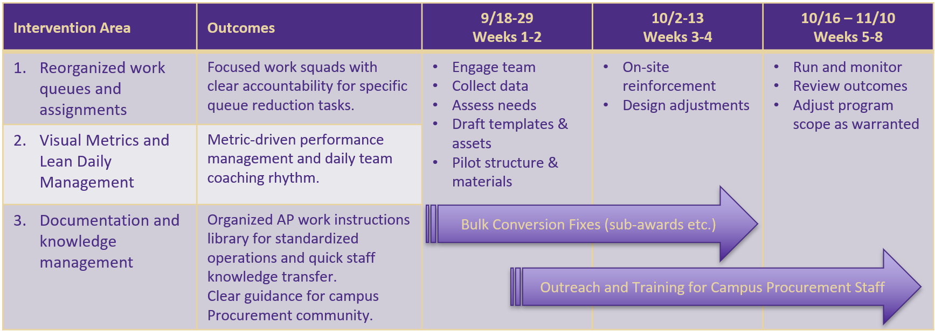
AP Recovery Plan
An initial 8-week intervention plan to establish work management queues & assignments, activate metrics, and standardize AP processes while engaging team for success.
Notes:
Bruce

Slide 14
Resources
How to begin subaward setup
Request changes to a subaward
Add a subaward - Award Changes
Procurement Services: For Suppliers
Notes:
Amanda

Slide 15
AWARD SETUP & MODIFICATION REQUEST UPDATES
October 4, 2023
Judy Chung
Office of Research Information Services

Slide 16
AWARD SETUP: TOP QUESTIONS WE HEAR
Who initiates the Award Setup Request (ASR)?
How do permissions and access work?
What information is required?
How much detail should I enter into SAGE Budget?
What do I do when an Award Setup Request is returned?
When should I begin an Award Setup vs. a Modification Request?
When can I delete a request?

Slide 17
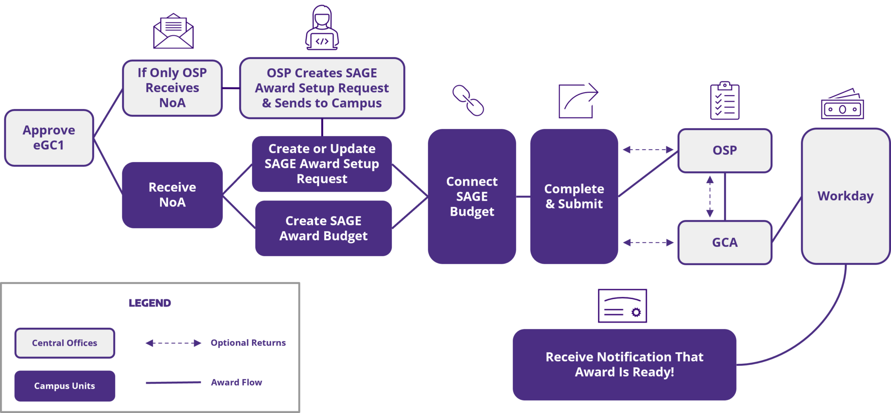
AWARD SETUP REQUEST WORKFLOW REVIEW: RECEIVING AN NoA

Slide 18
WHO INITIATES AWARD SETUP REQUESTS?
When… | ASR Created By | Notes
NoA is sent to the PI and/or unit (with or without OSP copied) | Campus Unit | Campus unit completes the Award Setup Request
NoA is sent to OSP but not to the PI or other unit contact | OSP | OSP completes basic information and sends to campus Email notification that the award has been set up by OSP is sent to the owners on the proposal eGC1 assigned to the Award Setup Request

Slide 19
EGC1 SEARCH TIPS FOR AWARD SETUP REQUESTS
If you do not find your eGC1 in the Create a Request search, that means either:
There is already an award started or processed for that eGC1
The eGC1 is not in “Approved” status
Note: You must also be listed as an eGC1 contact to initiate a request.

Slide 20
PERMISSIONS & ACCESS
Permissions are shared between the eGC1 and the Award requests
You can add new user permissions from either location
ASR/MOD Access & Roles – eGC1 Contacts & Access
All prior permissions issues are now fixed!

Slide 21
AWARD SETUP REQUEST WORKFLOW REVIEW: CREATING AN ASR

Slide 22
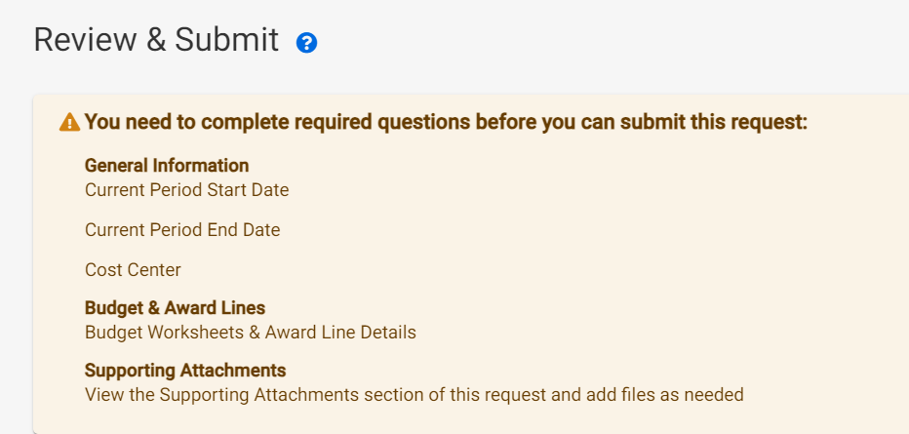
AWARD SETUP REQUEST REQUIRED ENTRY
All missing required entry by campus is highlighted in the yellow header of the Review & Submit page
Refer to OSP guidance on which attachments are needed, since that is award-specific

Slide 23
AWARD SETUP REQUEST WORKFLOW REVIEW: SAGE BUDGET CREATION & INFORMATION ENTRY

Slide 24
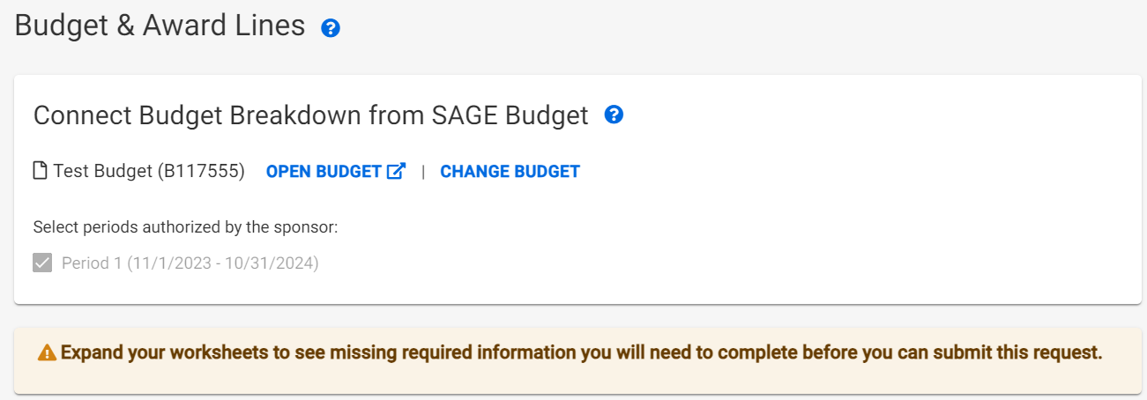
AWARD SETUP REQUEST REQUIRED ENTRY: BUDGET FIELDS
All missing required SAGE Budget entry is noted on the ASR Budget & Award lines page, by expanding the award line where you see the yellow indicator
Recent Updates!
Recent Updates!
Notes:
Note that there is still a backlog of items in GCA that will have missing information, and will still need to be returned for update, until caught up.

Slide 25
COMING SOON! SAGE BUDGET:
REQUIRED FIELD INDICATORS
Required indicators will be added to Worksheet Settings for:
Cost Center
Security Grant Hierarchy
Activity Location
Sponsored Program Activity Category
Sponsored Program Activity Type
Notes:
These will be soft alerts only on the SAGE Budget side, since these are not required for proposal budgets. The validations on the ASR will be what prevents submission until the fields are updated.

Slide 26
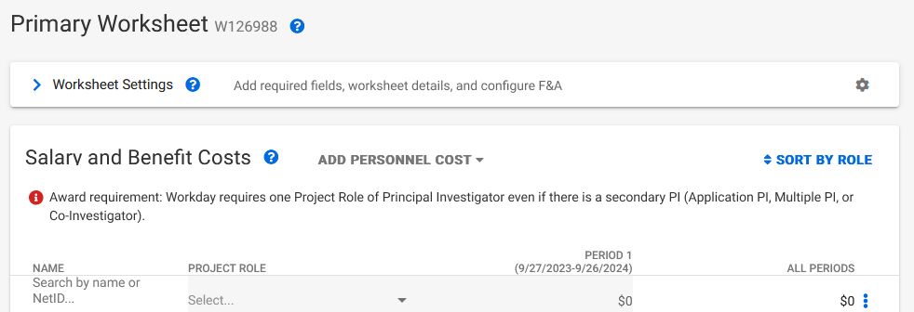
COMING SOON! SAGE BUDGET
REQUIRED FIELD INDICATORS (CONT.)
Instructional text will be added to Salary and Benefit Costs section for PI Project Role requirement

Slide 27
SAGE BUDGET: HOW MUCH DETAIL
IS REQUIRED?
Quick answer:
As much as the sponsor requires for reporting or invoicing
Can I enter a total “unallocated” amount?
YES, if detail not required by sponsor
Can I enter all salary & benefit totals in one row?
YES, but we don’t (yet) make it easy
PI entry & role needed separately, to send to Workday (even if no effort)
Future enhancements targeted to allow lump sum entry of salary & benefits

Slide 28
AWARD SETUP REQUEST WORKFLOW REVIEW: RETURNS

Slide 29
AWARD SETUP REQUEST RETURNS:
COMMON REASONS
Budget updates needed
Missing fields (New validations will help!)
Periods or amounts don’t match the NoA
Incorrect F&A
Review: Guidelines for a Budget Difference Between the SAGE Award Budget and the Sponsor Award
Attachments needed
Award Document & supporting correspondence
Documentation when there is a sponsor deadline for accepting an award
Compliance documentation (IRB/IACUC)
Tips for success- ASRs & MODs
Notes:
SAGE Budget class is offered today, 10/4, from 1 - 3 p.m.

Slide 30
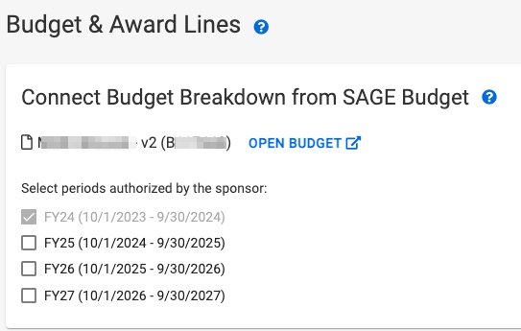
AWARD SETUP REQUEST RETURNS:
COMMON REASONS
Authorized Periods selected on Award Setup Request form do not match the NoA
Note: If you know you routed an ASR with missing budget information, GCA would suggest to let it route and they’ll address it with you when they review

Slide 31
AWARD SETUP REQUEST
RETURNS: WHAT DO I DO?
Look for a comment from OSP or GCA in the Comments & History section of the ASR

Slide 32
ASR VS. A MOD REQUEST?
Submit an Award Setup Request when:
New funding to initiate a project
Competing renewal funding
Submit a OSP/GCA Modification Request when:
Change to an existing award requires sponsor approval
Temporary internal extension
Submit a GCA Only Modification Request when:
Change to an existing award doesn’t require sponsor approval

Slide 33
WHEN CAN I DELETE A REQUEST?
You can delete an ASR or MOD request:
When you (campus) create it, and
Request has not been routed to OSP/GCA yet
OSP & GCA can deny a request:
If it’s already been submitted by campus
Notes:
Mention why we protect items OSP setup. Don’t want to lose attachments, history.

Slide 34
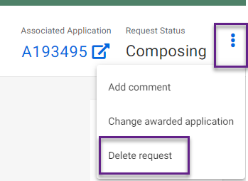
DELETING A REQUEST
Click 3 dots in upper right of request

Slide 35
FILTER TIPS
Use status filters to focus in on just your Composing or Returned items
To retain filters as you go in and out of requests, open the request in a new tab by:
Right clicking the Request ID or Short Title and selecting “Open link in a new tab”
Holding down CTRL then clicking on the Request ID or Short Title

Slide 36
REMINDER: RECENT UPDATES
Reminder that the following updates have been released for Award Requests:
Ability to delete a request
Ability to change an eGC1
Ability to change the connected budget
Validations for all campus-required fields

Slide 37
OCT/NOV RELEASE PRIORITIES
Search & filter enhancements
Restructuring to avoid performance issues
Display more data on Award Requests list
Modifications in particular
Apply holds (OSP & GCA)
Subaward request updates to connect to Workday awards
Priority bug fixes

Slide 38
TRAINING RESOURCES
October 4, 2023
Grant & Contract Accounting
Office of Sponsored Programs
Office of Research Information Services

Slide 39
VIRTUAL INSTRUCTOR-LED
CORE TRAINING
Today, 1 - 3 p.m.: SAGE Budget
Thursday, 10/19: Understanding Your New Award
Tuesday, 10/24: Reading the Notice of Award
New! Wednesday, 11/15: SAGE Awards
Notes:
The SAGE Awards course provides an overview of the award and modification process in SAGE. Prior knowledge in creating SAGE eGC1s, sponsored project proposal budgets, and SAGE Budgets is recommended for this course

Slide 40
AWARD SETUP REQUEST RESOURCES
OSP Setup Financials includes:
How to get an Award set up at the UW
What is a Complete Award Setup Request?
Communicating Compliance Information
GCA Award Setup includes:
New Awards
How to Review Your New Award
Award Line Setup (Formerly Sub Budgets)
Tips for Success - Award Setup & Modification Requests
SAGE Awards: Setup. Tracking & Modifications eLearning

Slide 41
MODIFICATION RESOURCES
OSP Award Changes OSP/GCA Modification guidance & required forms (extensions, change of PI etc.)
When will I need an eGC1 vs. a Modification request?
GCA Modifications includes:
SAGE Modification Request Checklist
How to Submit a GCA Only Modification
Tips for Success - Award Setup and Modification Requests

Slide 42
MODIFICATION JOB AIDS
Award Modifications in SAGE
Review a walkthrough on creating a Modification.
What Workday Grant Worktag ID Information Do I Need for a SAGE Modification Request?
View a roadmap of what worktag information is needed to process a Modification.
How to Include Your SAGE Budget Snapshot on a SAGE Modification Request
Temporarily, requested budget Award Modification require SAGE Budget snapshots to be sent to GCA.

Slide 43
SAGE OFFICE HOURS
SAGE Office Hours Schedule
Thursday, October 5, 11 a.m. - noon
Wednesday, October 11, 11 a.m. - noon
Thursday, October 19, 1 - 2 p.m.
Wednesday, October 25, 11 a.m. - noon

