Slide 1
GCA AWARD SETUP UPDATE
Juan Lepez
Director, Grant & Contract Accounting
September 14, 2023 MRAM

Slide 2
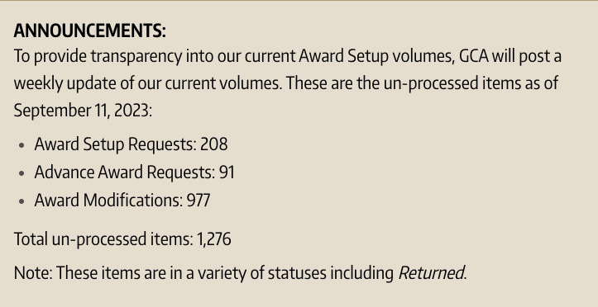
GCA BACKLOG UPDATE
GCA is posting a weekly update of un-processed items on our homepage:
https://finance.uw.edu/gca/
GCA is reviewing between 40-50 items each day and processed over 900 items in August
Notes:
Speaker notes:
GCA realizes that backlog is creating issues for campus partners.
Mention that we are posting volumes in response to campus feedback. Transparency is the goal.
“GCA is reviewing…” means processing or returning to OSP or returning to campus.

Slide 3
DEDICATED RESOURCES
Assembled new team to focus on Modifications
Team is focused on critical requests such as Extensions and Temporary Internal Extensions

Slide 4
NEW GCA FORMS
Request an non-primary Advance Award Line
Attach completed form as attachment to Award Portal ticket with topic “Award Setup”
Will be posted next week
SAGE Modification Request Form Checklist
Attach when there is no existing form
Demo
Will be posted next week
Forms are intended to provide all necessary information to process request timely
Notes:
Speaker note: email to MRAM list when forms are available

Slide 5
BACKLOG PLAN
Eliminating the backlog will require your help
GCA will strongly encourage MOD Checklist and continue to require existing forms
GCA will attempt to process existing MODs but if detail is missing, GCA will return MOD and suggest Checklist to be included
Notes:
GCA needs more detail in order to process requests more efficiently

Slide 6
USE OF EXISTING FORMS
MODs routing through OSP will continue to require the same forms (e.g. Extension, PI Changes, End of Award Changes, Cost Share, F&A Waiver)

Slide 7
QUESTIONS
Contact GCA for assistance by creating a ticket in
Award Portal or email gcahelp@uw.edu

