Slide 1
Scope of
UW Clinical Trial Office Budget Review
MRAM
May 11, 2023
Pavel Kruchek, Clinical Trials Office
Carol Rhodes, Office of Sponsored Programs

Slide 2
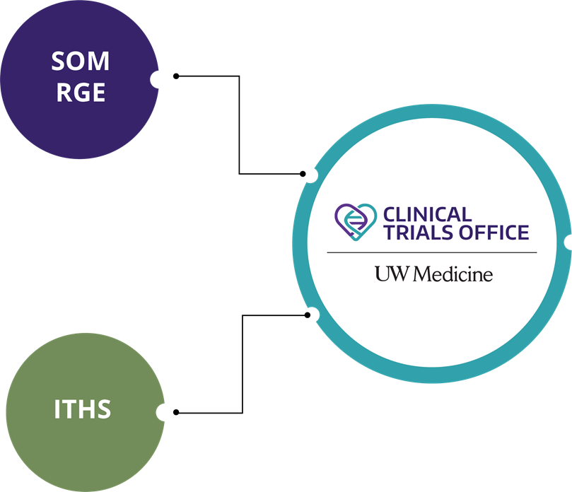
Clinical Trials Office: Background

Slide 3
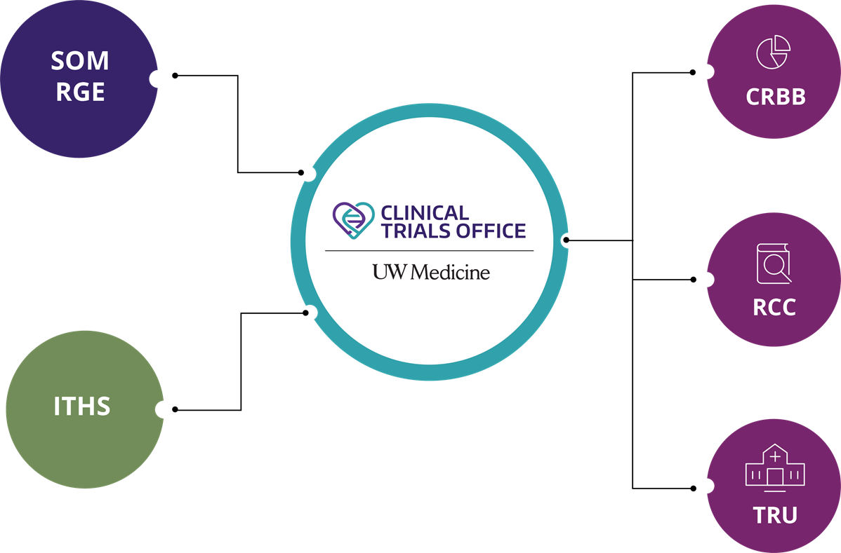
Clinical Trials Office: Background

Slide 4
CTO Services

Slide 5
CTO Compliance Functions

Slide 6
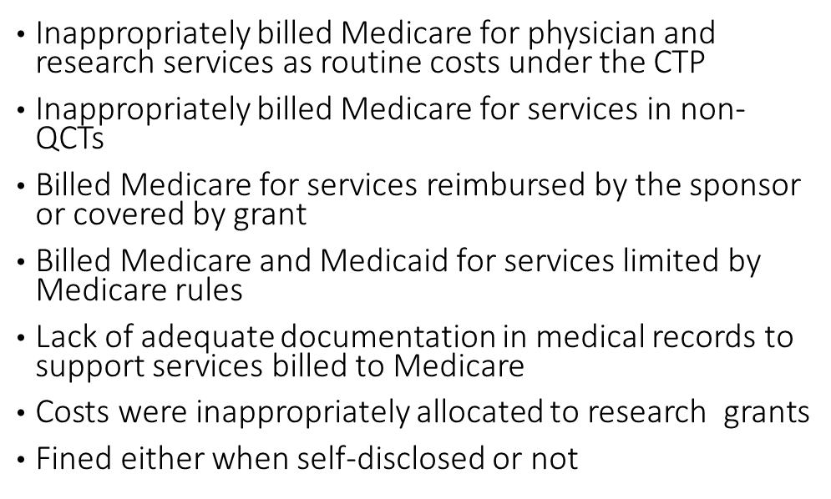
Institutional Financial Review: The Why
No one wants patients to be billed when they shouldn’t be
Consider these examples:
Rush UMC ($1.1M)
Emory ($1.5M)
USC Norris CC ($1.9M)
Beth Israel ($2.4M)
Johns Hopkins ($2.6M)
UAB ($3.4M)
Yale ($3.8M)
Cornell ($4.3M)
Northwestern ($5.5M)
Mayo Clinic ($6.5M)

Slide 7
Institutional Financial Review: The Why
Federal fines are not the only cost of non-compliance:
Monetary impact is at least double when adding legal fees
Criminal charges may be added in cases of deliberate fraud
Potential loss of federal funding
Severe reputational damage impacting jobs, patient trust, funding, subject enrollment, etc.

Slide 8
Institutional Financial Review
Billing compliance is governed by federal and state regulations and the institutional policy COMP.202 (https://depts.washington.edu/comply/docs/comp_202.pdf)
Coverage analysis and billing grid production
Document congruence (Summary Review):
Billing grid
Final budget
Informed consent form
Contractual terms
Final budget approval prior to contract execution

Slide 9
CTO Budget Approval Scope
Interventional trials or observational studies, where:
Services, items, or tests are provided by a hospital facility (UWMC, HMC, or FHCC) that bills through Epic; OR
Services, items, or tests are furnished by a provider who bills through UW Physicians regardless of the site of practice; AND
Funding is provided to UW via fixed-price contract
Additionally:
These studies are in scope for OnCore CTMS Financials
After 31 May 2023, all of these studies will generate sponsor invoices directly in OnCore
OnCore will integrate with Workday starting 6 July 2023

Slide 10
Future State - Workday Finance Go-Live
SAGE Budget required on all Award Setup Requests
Use SAGE Budget for all Award Setup Requests, including budgets reviewed by CTO
For study budgets that will run through CTO review and Oncore billing
Enter minimum information only in a single SAGE budget worksheet with $0 amount
This will help with Award Line and Award period setup in Workday Finance

Slide 11
SAGE Budget Entry for CTO Budgets
What is the minimum information?
Budget Settings
Budget Title
Budget Start Date
Total number of periods (defaults to 1)
Worksheet Settings
Create a single SAGE budget worksheet
Primary Worksheet Title
Cost Center
Activity Location
Sponsored Program Activity Category
Sponsored Program Activity Type
Base Type
Budget Entry
Add a Principal Investigator in personnel section for each worksheet, PI salary=$0
only one worksheet is needed for CTO budgets
No other line item entry required in the budget
Notes:
JC notes if helpful: It was originally conceived that CTO would be exempt from using SAGE Budget. In order to collect all of the line and period setup necessary for basic Workday awards for CTO, and given time constraints as we approach go-live, it was determined that pivoting to a SAGE Budget requirement for all ASRs would be the most stable approach going into 1st release. After go live, and with input from CTO budget preparers, we will re-asses whether an exemption would still be beneficial in the future or if data collection through SAGE Budget is acceptable. (Note that the fields of information needed are the same, regardless of whether SAGE Budget is used or an alternate approach to collecting the data).

Slide 12
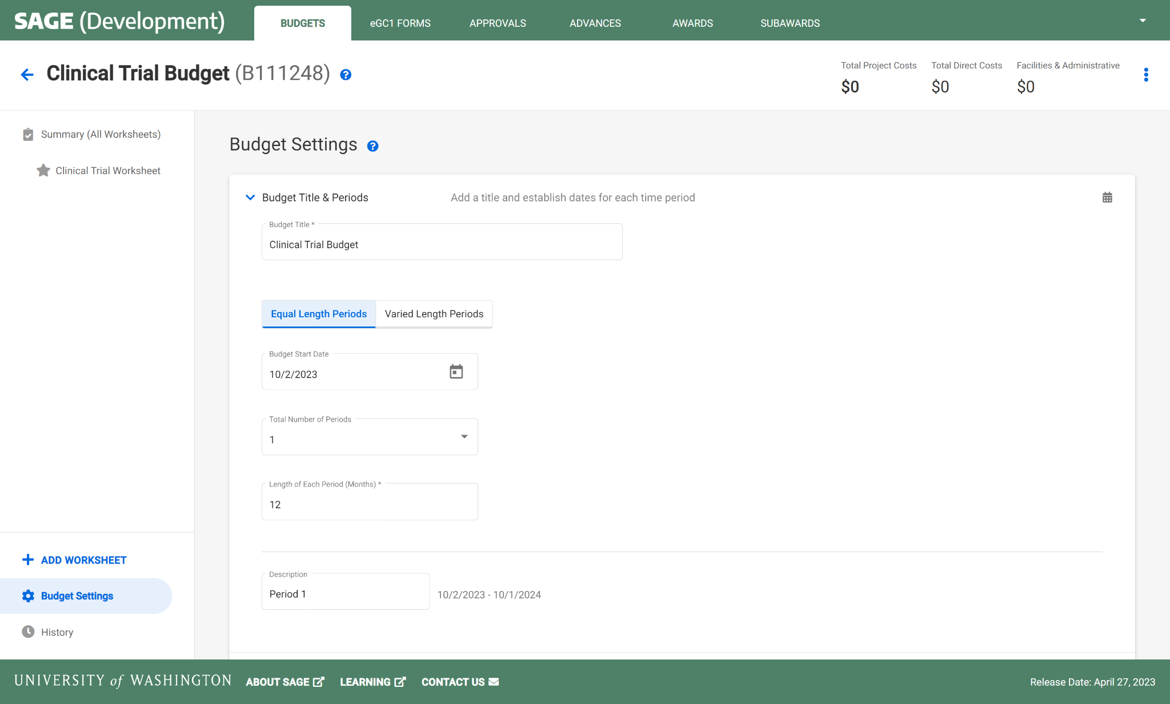
CLINICAL TRIALS | BUDGET SETTINGS
Budget Title
> Dotted fields are required for a Clinical Trials SAGE Budget
Budget Start Date
Total Number of Periods
Notes:
Naming conventions are in development.

Slide 13
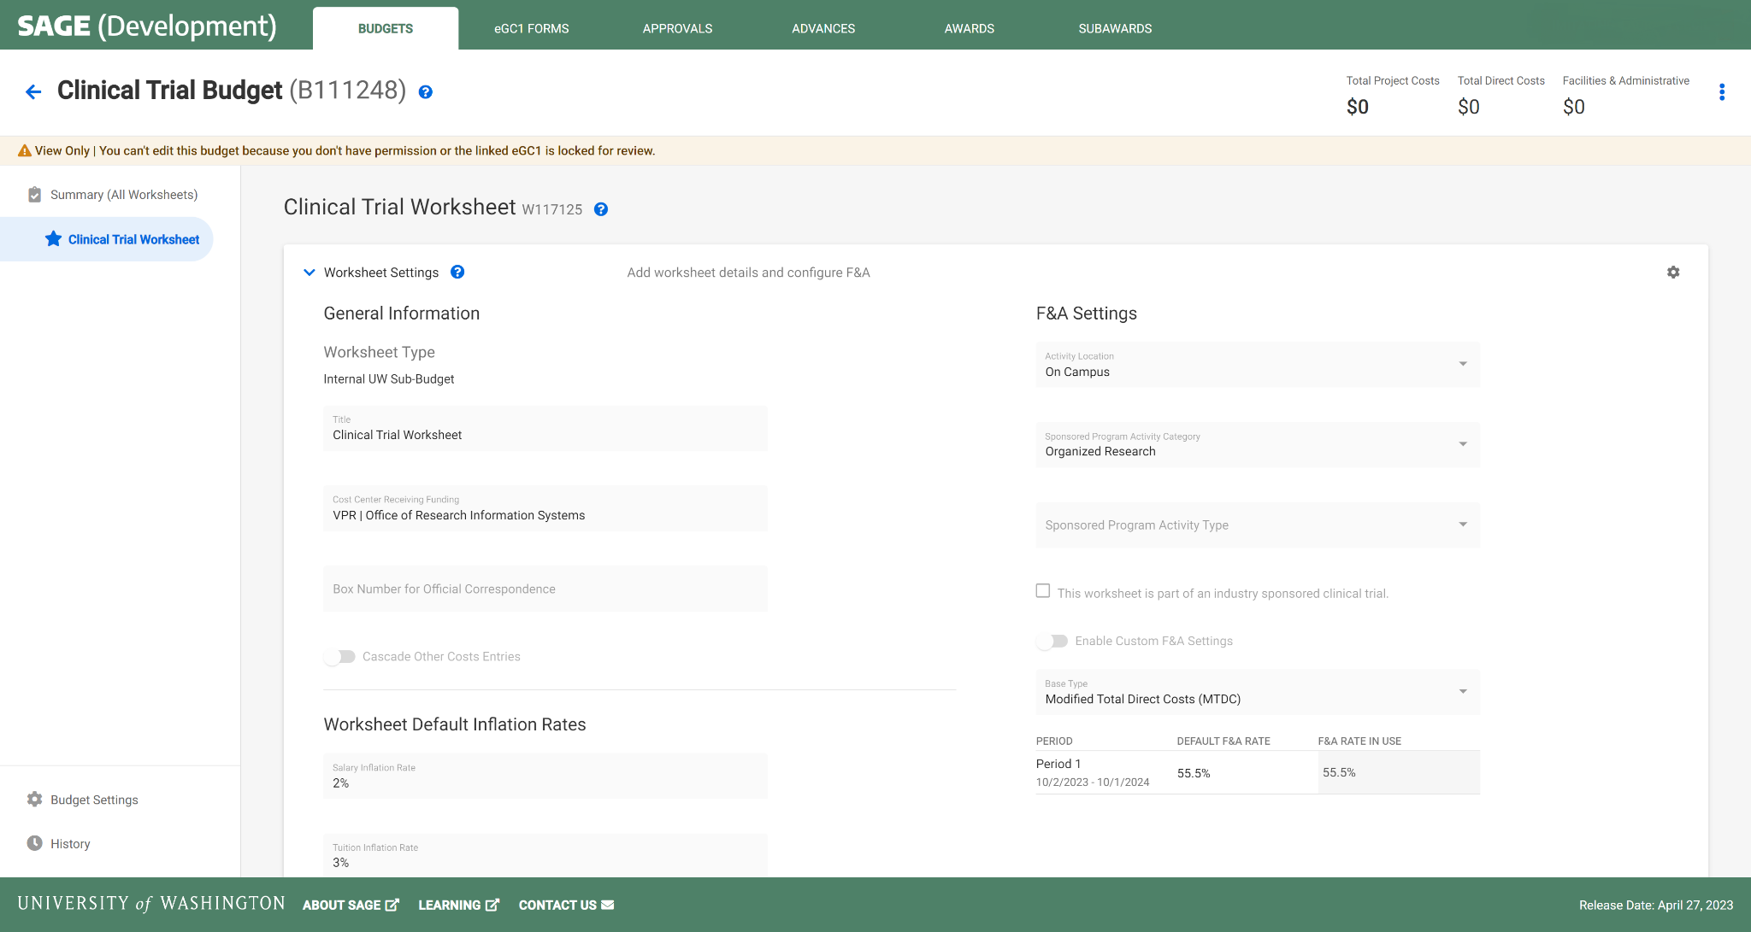
CLINICAL TRIALS | WORKSHEET SETTINGS
1 Worksheet
Activity Location
Primary Worksheet Title
SPA Activity Category
Cost Center
SPA Activity Type
Base Type
Notes:
Naming conventions are in development.
Note that the "view only" banner will not be there and that period 1 will be selected.

Slide 14
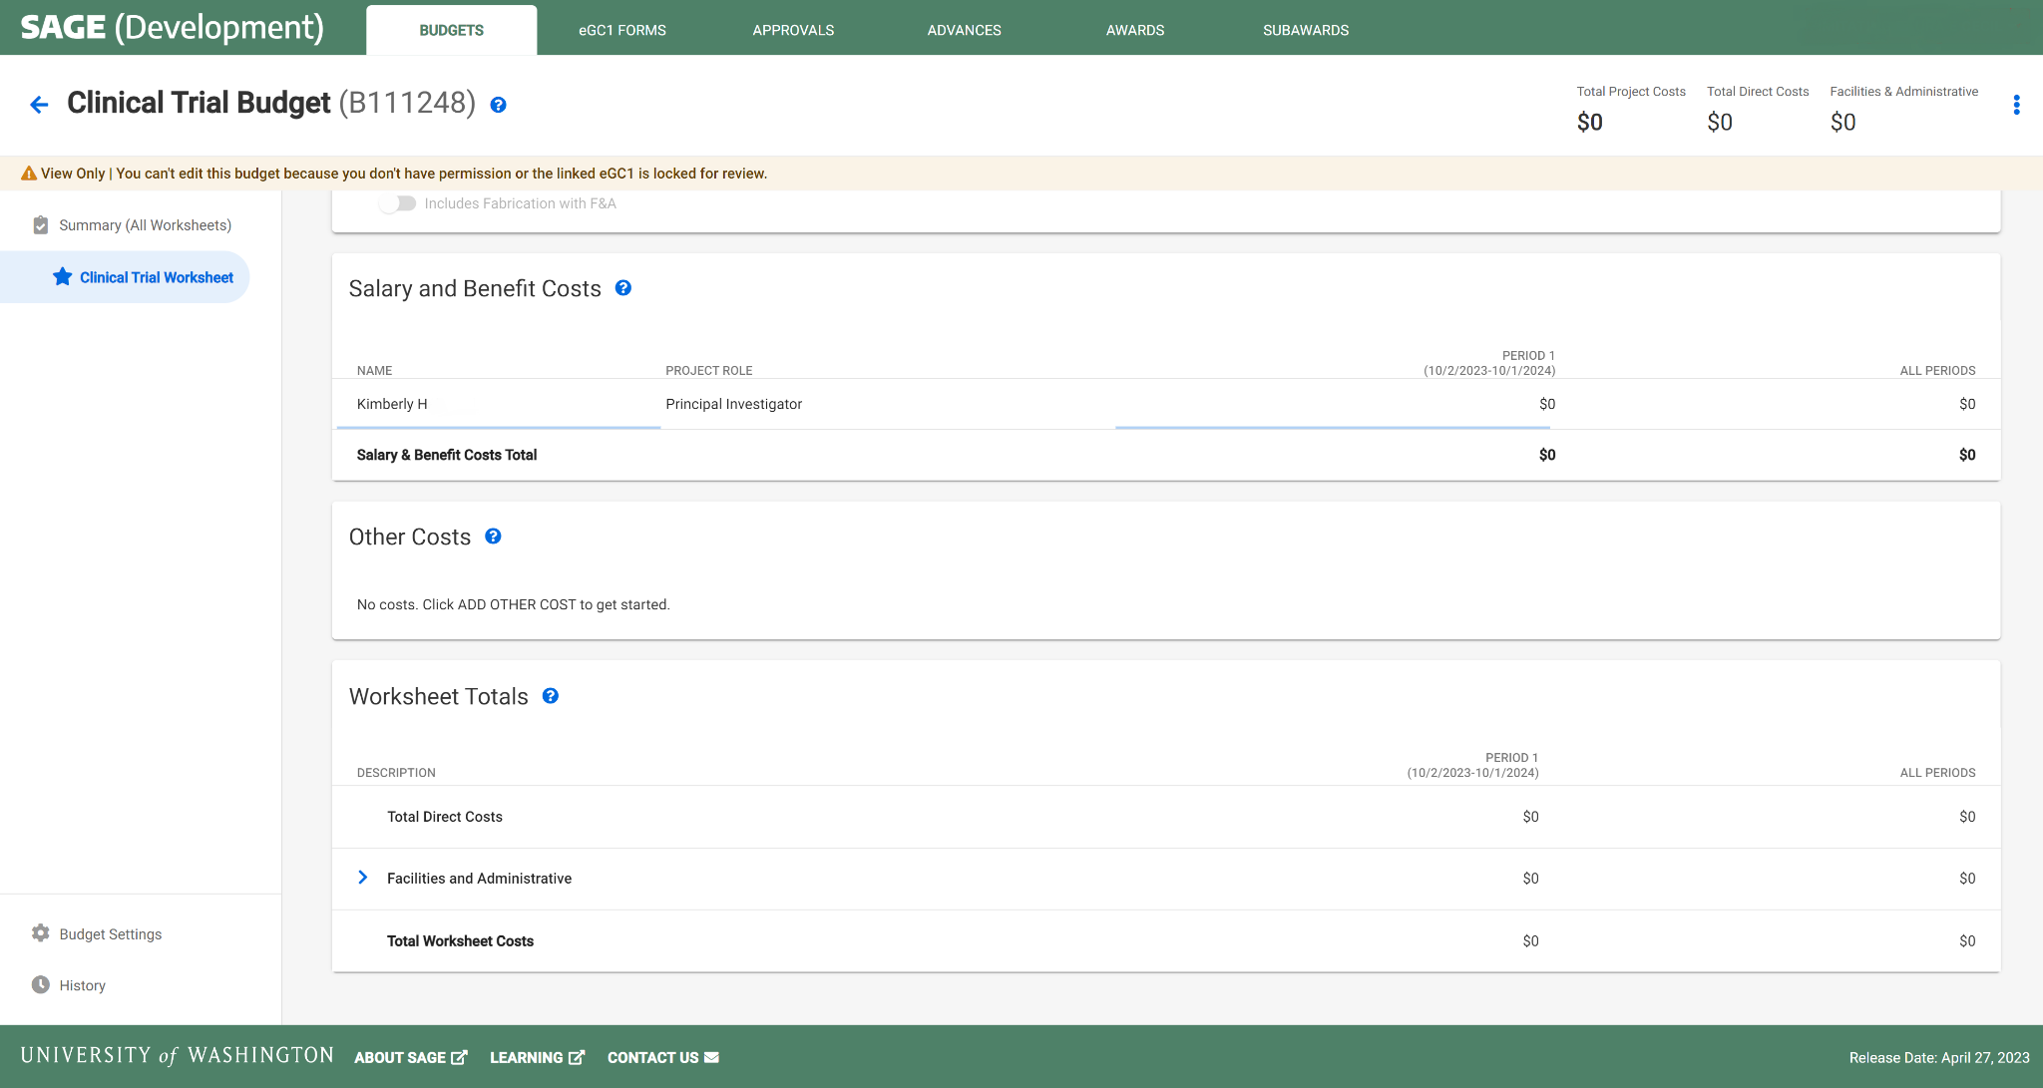
CLINICAL TRIALS | BUDGET ENTRY
1 PI per Worksheet
Leave default of $0 amount salary
No other line item entry required
Notes:
Each worksheet will need one row of personnel at minimum who is assigned as PI.

Slide 15
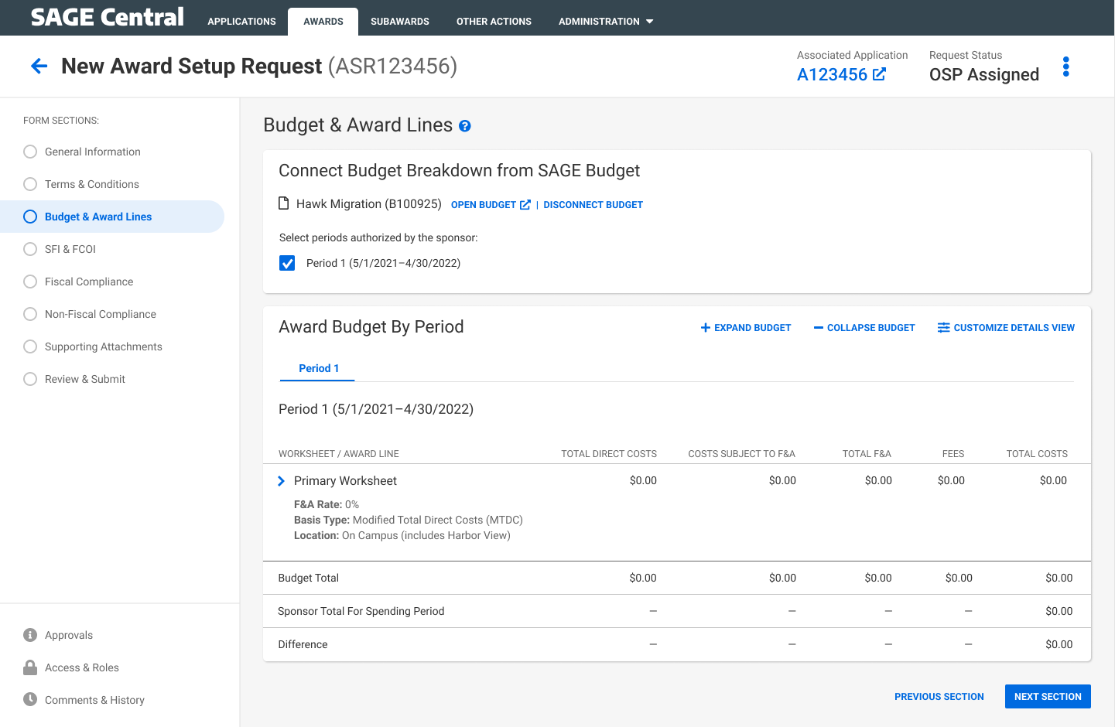
CLINICAL TRIALS AWARD SETUP | CREATE & LINK BUDGET
Select Period 1
Automatic display of budget setup flowing to the award request
Notes:
Period 1 will be selected

Slide 16
Notes on SAGE Budget Requirement
Allows necessary integration/mapping to Workday.
Setting up SAGE Budgets with basic information with $0 should take only a few minutes.
GCA will know budget detail is not needed & they will not handle invoicing.
If there are other SAGE Budget requirements we will let you know as soon as possible.

Slide 17
Resources
SAGE Budget Classes
Thursday, May 18, 1-3 p.m.
Thursday, June 13, 1-3 p.m.
Drop-in SAGE Office Hours
Twice a month, every other Thursday. All dates/Zoom links on UWFT for the Research Community webpage
UWFT for the Research Community Webpage
Important dates, information, and training resources!
Questions about SAGE Budget?
Contact sagehelp@uw.edu

