Slide 1
ORG CODE TO COST CENTER
May 19, 2023
Tom Watson
Office of Research Information Services
Notes:
If you have questions feel free to bring them up and there will also be time at the end.

Slide 2
ORG CODE TO COST CENTER | KEY CHANGES
Workday uses the term Cost Center instead of Org Code
Research departments applying for or receiving funding in SAGE will be represented by a numerical code and naming convention that differs from today’s Org Code
Cost Centers will replace Org Codes and Org Names in all areas where Org Codes are currently found in SAGE, FIDS, and AUMS
Item in SAGE | Pre-Workday Release | Post-Workday Release
Name of Org. Receiving Funding | Bioengineering | Engineering | Bioengineering - Research Administration
Numerical Code | 2600014000 | CC100950

Slide 3
ORG CODE TO COST CENTER | KEY CHANGES
Cost Centers will appear for:
SAGE eGC1 applications
SAGE eGC1 contacts and personnel
SAGE Advances
SAGE Awards
SAGE Subawards
FIDS
AUMS

Slide 4
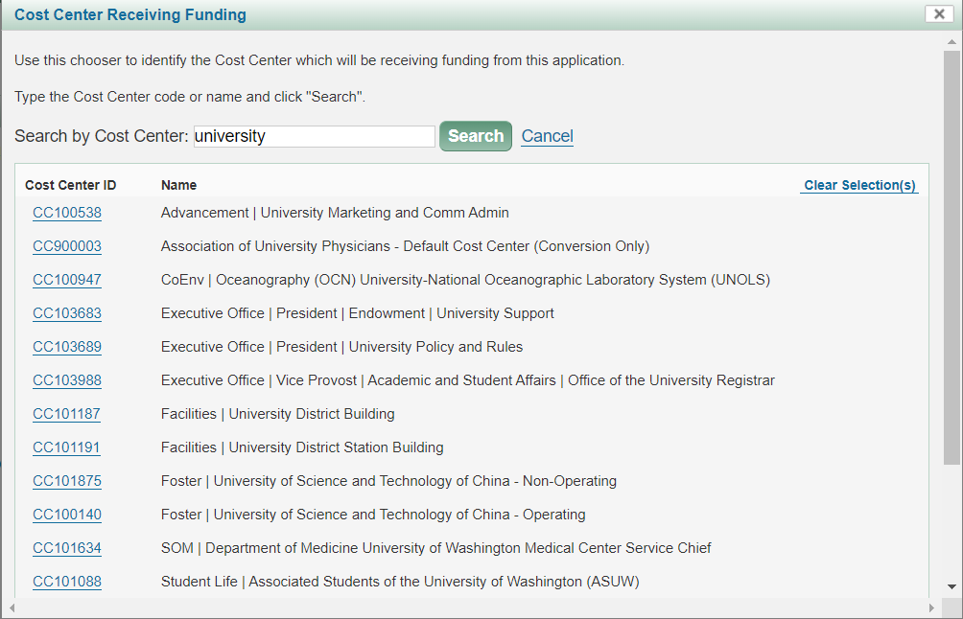
ORG CODE TO COST CENTER | KEY CHANGES
New Cost Center Chooser enables searches on both Cost Center ID and name
Cost Center names match to Workday

Slide 5
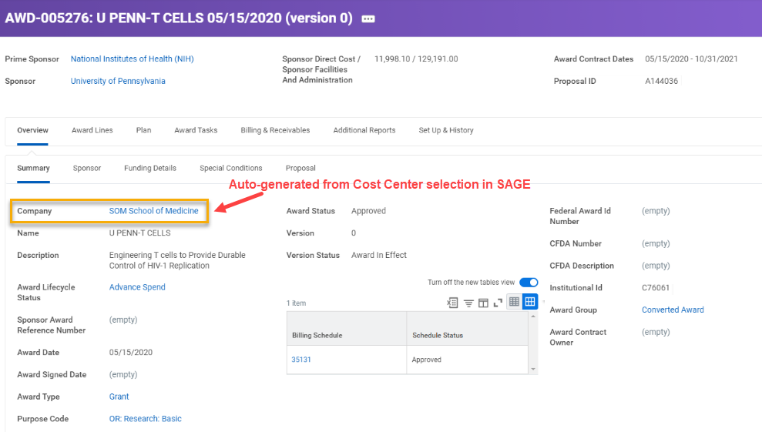
ORG CODE TO COST CENTER | KEY CHANGES
Cost Center defaults from the eGC1 to the Award Setup Request
Cost Centers in SAGE will be linked to the following records in Workday:
Award Contract
Award Schedule
Award Budget
Award Lines
Subawards
Billing Schedule
Grant and Award Roles

Slide 6
ORG CODE TO COST CENTER | CHANGE BENEFITS
Reporting hierarchies that allow all reporting on different levels, such as division, department, school, etc.
Transparent and flexible financial reporting and management
Efficient accounting and financial reporting
Automatic flow from pre- to post-award systems, including Workday, reducing the amount of manual data entry
Robust grant tracking across the enterprise, increasing ease of management and decision-making

Slide 7
ORG CODE TO COST CENTER | TIMELINE
End of April: System remediation to convert Org Code fields to Cost Centers begins for:
SAGE
MyResearch (MR)
RAD
FIDS
AUMS
June 2023: SAGE ASTRA role validation required from campus by launch
7/5 at 5:35 p.m. - 7/6: SAGE unavailable
7/7 at 6 a.m.: SAGE back online with Cost Centers integrated

Slide 8
ORG CODE TO COST CENTER | ACTION NEEDED
July 6: SAGE ASTRA roles will be aligned with Cost Centers
Existing roles in ASTRA that rely on Org Codes for authorization will change
June SAGE ASTRA role validation: Campus Authorizers will receive an email from ORIS by June 1 with an attached spreadsheet that includes
Your department’s current eGC1 ASTRA roles
Any SAGE ASTRA eGC1 roles that will be assigned at go-live
Confirm this information is accurate. Changes can be made after launch of the new Cost Centers.
For questions on SAGE ASTRA roles, contact sagehelp@uw.edu.
Notes:
Roles in ASTRA that use org code as SOC will change

Slide 9
ORG CODE TO COST CENTER | SAGE ASTRA Examples
SAGE roles Pre-Workday
SAGE roles Post-Workday
Role | Dept. | Org Code
Advance Reviewer | Physics | 2540574000
Dept. Reviewer | Physics | 2540574000
Global Edit | Physics | 2540574000
Role | Dept. | Research Hierarchy Identifier
Advance Reviewer | Physics | RSRCH:000171
Advance Reviewer | Physics | 2540574000 (legacy advances)
Department Reviewer | Physics | RSRCH:000171
SAGE Read-only | Physics | 2540574000 (legacy eGC1s)
Global Edit | Physics | RSRCH:000171
Global Edit | Physics | 2540574000 (legacy eGC1s)
Notes:
Roles in ASTRA that use org code as SOC will change

Slide 10
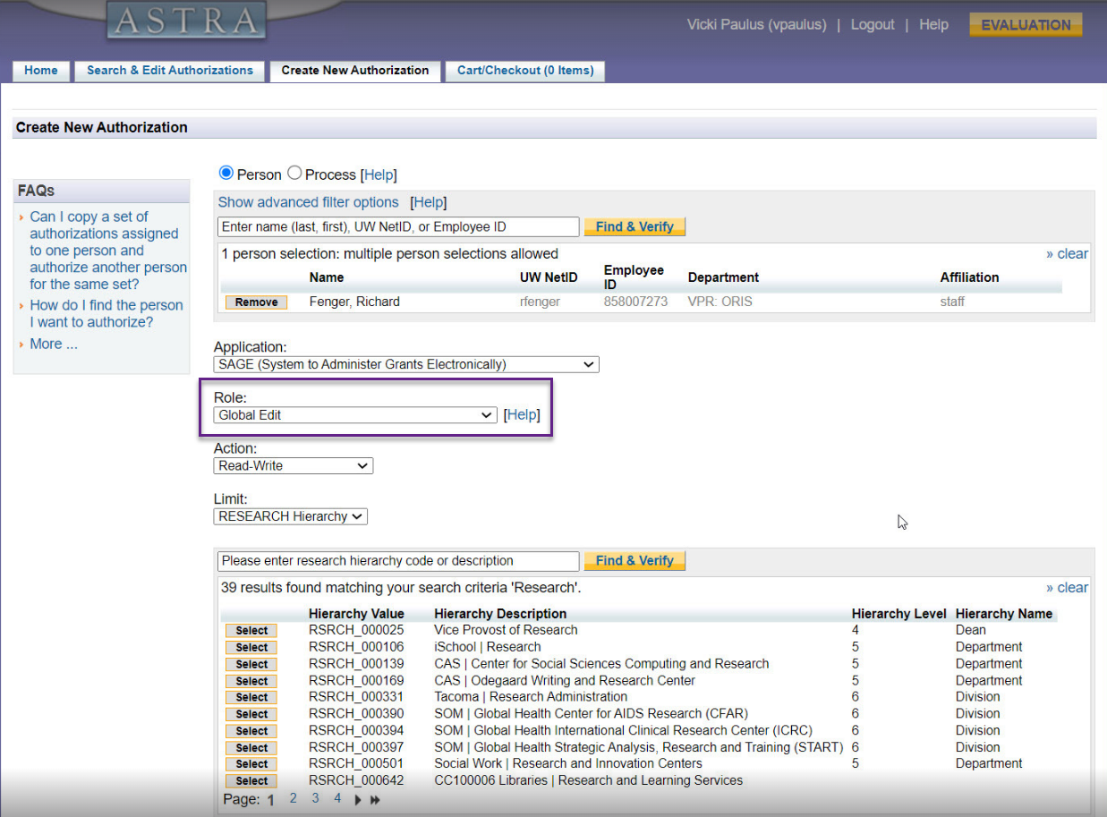
ORG CODE TO COST CENTER | ASTRA PREVIEW
“Global Edit” roles will be maintained
Cost Centers to assign roles to will display in the search
Notes:
Roles in ASTRA that use org code as SOC will change

Slide 11
ORG CODE TO COST CENTER | Training & Support
UWFT for the Research Community Newsletter
End of May: Reminder of changes
Job Aids & User Guides
June: Job aid (SAGE ASTRA roles validation required by campus)
By July: SAGE support & user guide updates
Notes:
Does not include details around existing outreach that has already taken place to power users

Slide 12
THANK YOU!
Notes:
If you have questions feel free to bring them up and there will also be time at the end.

