Slide 1
SAGE TRAINING RESOURCES
April 13, 2023
Kim Halstead
Office of Research Information Services

Slide 2
WHAT’S CHANGING IN SAGE? VIDEO
New!
Provides a high-level overview of changes coming to SAGE with UWFT, including:
SAGE Award Setup Requests
Cost Centers
SAGE Budget and Award Lines

Slide 3
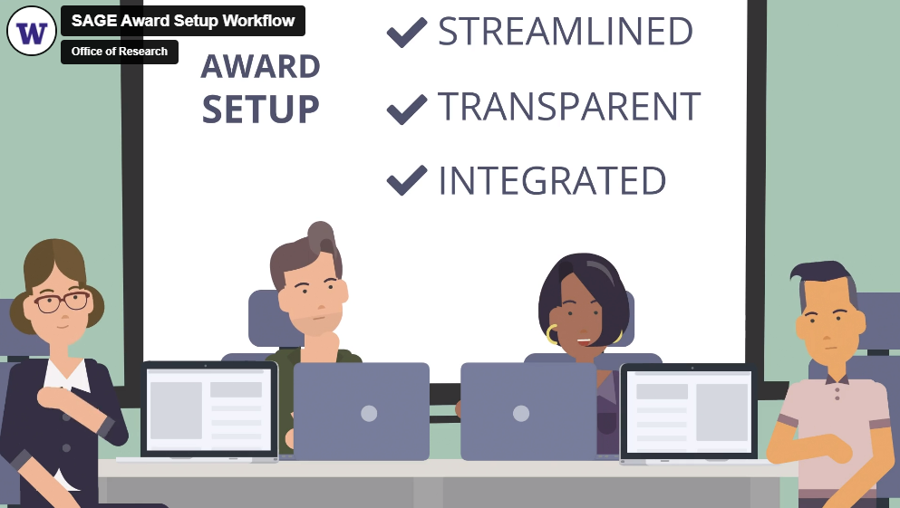
SAGE AWARD SETUP WORKFLOW VIDEO
New!
Provides an overview of the future of the award setup workflow in SAGE

Slide 4
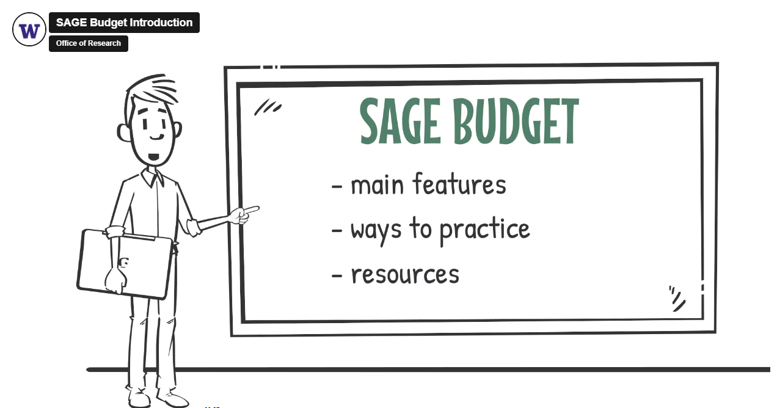
SAGE BUDGET ELEARNING
Launched January 2023
Provides on-demand instruction in SAGE Budget when you need it!
Notes:
This resource is not a substitute for the live course and does not count toward fulfilling certificate requirements.

Slide 5
ADDITIONAL SAGE TRAINING
Available Now
SAGE Budget Instructor-led Classes
04/11
05/18
06/13
SAGE Budget Virtual Office Hours
04/20
05/04
05/18
More SAGE resources are accessible through the UWFT for the Research Community webpage.
In Development
SAGE Awards eLearning and user guides

