Slide 1
SAGE Updates
Judy Chung
Office of Research Information Services (ORIS)
March 14, 2024

Slide 2
SAGE Budget Integration to WD Plans
Released in February!
For Award Setup Requests (ASRs), SAGE Budget data now flows to Workday Plans via integration
This reduces GCA manual entry and speeds up processing time!

Slide 3
Budget Integration | Campus & GCA Views
SAGE maps your budget sub-object codes to Workday codes
GCA previews the totals that will flow to Workday, within the ASR
SAGE Budget Costs
GCA’s View in ASR

Slide 4
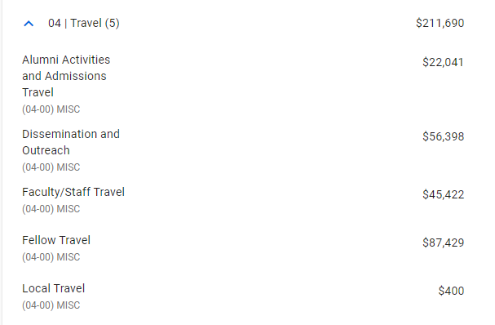
Budget Integration | Amounts
Amounts are totaled by: Ledger, object class, spend category for each worksheet/grant and period sent
5 Misc Travel entries in SAGE Budget
1 Travel entry in Workday Plan

Slide 5
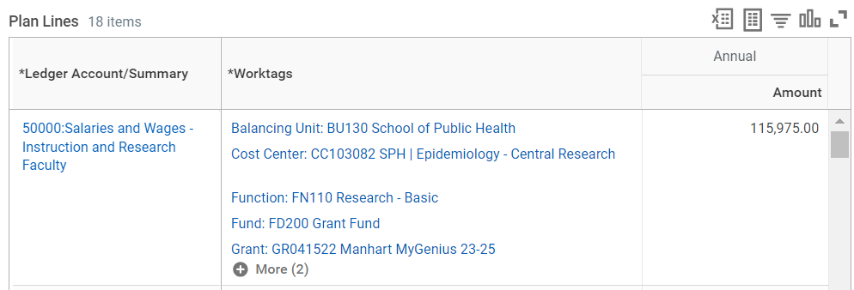
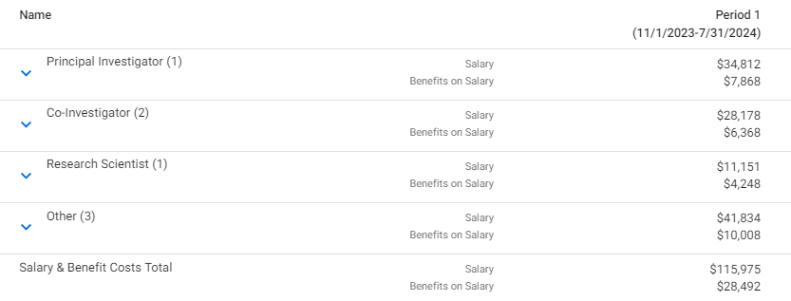
Budget Integration | Tips
Individual personnel are not sent to Workday Plans
Workday salary plan lines are summed up at the ledger level -- e.g. total faculty, total graduate students, etc.
1 Faculty salary plan line in Workday
7 Faculty listed in SAGE Budget
Takeaway: Higher-level, categorical budgets are just fine!

Slide 6
Quarter 3 | Pending March Release
Preliminary benefit rates in SAGE
PI escalation process - remediation (eGC1)
Award Notification content updates
Thank you to all who shared input!
More performance improvements
Error handling improvements
Bug fixes

Slide 7
Quarter 4 | Planned Work
Improve OSP & GCA flow of work
Advance Requests:
Add Workday required fields to Advance Requests
Integrate Advances to Workday
Integrate ASRs where Advances exist to Workday

Slide 8
Quarter 4 | Planned Work
Improve OSP & GCA flow of work
Automate OSP assignments
Modification Request updates
Adding sub-categories for modification type
Related award list updates for modification types & categories
Clarifying amounts
Others as time allows

Slide 9
Quarter 4 | Planned Work (cont.)
Prepare for SAGE Infrastructure Migration (2025)
Context: By June 2025, SAGE needs to migrate off of the existing infrastructure, as it will be retired
Migration goals: To ensure a more stable, secure, sustainable environment for SAGE long-term
Strategy: SAGE will move to cloud infrastructure (AWS), with upgraded servers and software
Near Term Impact: Expect feature work to slow down (but not halt) toward end of Q4, as more effort is shifted to migration to make the deadline

Slide 10
Reminder | SAGE Resources
SAGE Office Hours
Thursday, March 21, 11 a.m. – 12 p.m.
Wednesday, March 27, 11 a.m. – 12 p.m.
Resource Collections: Budget and Awards & Mods
Bookmark and review for the latest training, eLearning, and job aids:
SAGE Budget Resources
SAGE Awards and Modifications Resources
Notes:
An update on CORE classes will be presented following this presentation as well.

Slide 11
Reminder | Upcoming SAGE Classes
March
3/27, 1 - 3 p.m.: SAGE: Creating and Submitting eGC1s
April
4/2 & 4/23, 1 - 3 p.m.: SAGE: Budget
4/11, 1 - 3 p.m.: SAGE: Creating NIH Proposals in Grant Runner
May
5/1 & 5/8, 1 - 3 p.m.: SAGE Awards
5/23, 1 - 2:30 pm.: Subawards in SAGE
All SAGE Classes in CORE
Notes:
An update on CORE classes will be presented following this presentation as well.

