Slide 1
Subawards -
Foundational Steps &
OSP Updates
Amanda Snyder, OSP Associate Director
April 11, 2024 MRAM
Office of Sponsored Programs

Slide 2
Prime Award from sponsor available in Workday?
Award Line (GR#) for Subaward in Workday?
Is Subrecipient a Supplier in Workday?
Are they also a Subrecipient in Workday?
Begin Subaward Request in SAGE
SAGE Status = “Composing”
OSP requests Supplier Contract & Purchase Order
OSP Review & Negotiation
OSP Issues Subaward to Subrecipient
OSP Administrator Assigned
Submit Subaward Request in SAGE
SAGE Status = “Issued”
SAGE Status = “OSP Assigned”
SAGE Status = “IN OSP”
Procurement Creates Supplier Contract & Purchase Order in Workday
Campus Reviews & Approves PO
Subaward Signed & Activated in SAGE
Award Line Activated in Workday
Subrecipient Invoicing
SAGE Status = “Active”
WORKDAY Status changes from ”Pending Subaward" to "Open"
Campus
Invoice Approval & Subrecipient Paid
Central Offices: OSP, Procurement, GCA
Subrecipient

Slide 3
Setting the Foundation - Before sending subaward request in SAGE
Prime Award from sponsor available in Workday?
Award Line (GR#) for Subaward in Workday?
Are they also a Subrecipient in Workday?
Is Subrecipient a Supplier in Workday?
Campus
Central Offices: OSP, Procurement, GCA
Subrecipient

Slide 4
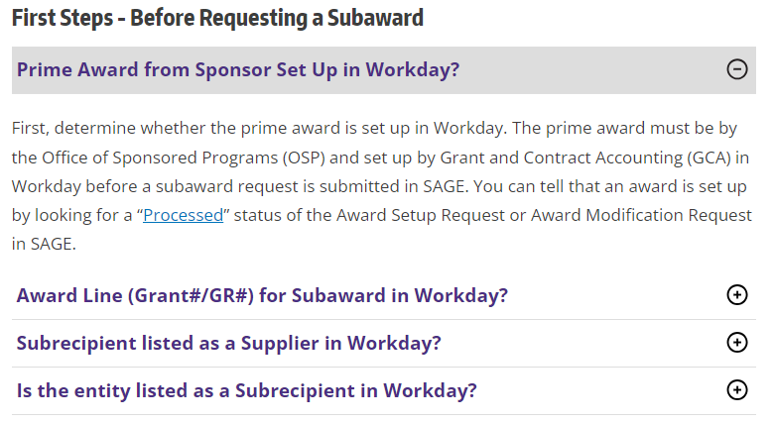
Research Website Resources
Two short videos walking through subaward process
Outgoing Subawards - First Steps - VIDEO
Next Steps to Establish and Set Up an Outgoing Subaward - VIDEO
Expandable web content for process steps

Slide 5
Subawards - OSP Updates
Extremely high volumes
Number of Subaward Actions in OSP is currently hovering around 850
CY23 Q1 - Between 175 and 244 items fully executed per month
Many escalation requests for items to be prioritized
Almost every item in OSP is urgent
Please note: We are not able to provide estimates of how long it will take review or issue items due to volumes and escalation requests.

Slide 6
Subawards - What is OSP doing?
Resources
2 Subaward Administrator Positions open
3 OSP staff from other teams working on subawards
Assoc. Director focusing on supporting subaward team
Working with the Office of Research on additional solutions
Priority is still being given to non-US, non-profit, and small business subrecipients
Request other IHE use their version of Advance Awards
Assurance emails to subrecipients when we are not in a position to prioritize their actions
Trying to assign items with the end date of the action taken into consideration, along with when the item arrived in OSP.

Slide 7
Resources
Research Website - Setup - Subawards
Outgoing Subawards - First Steps - VIDEO
Next Steps to Establish and Set Up an Outgoing Subaward - VIDEO
Subaward FAQ - Updated Nov 2023
OSP Volumes: Awards, Modifications, and Subawards
Urgent OSP Requests

