Slide 1
Introduction to Washington Sales and Use Tax
Presented by:
University of Washington’s Tax Office
Notes:
Hello my name is Mona El Souessy and I am a Tax Associate in the Tax Office here at UW. I’m here with Julia Shanahan, Tax Director, and Heather Nicolson from the AP Department to provide you an Introduction to WA State sales and use tax training. Feel free to ask questions as you wish thoughout the presentation. Does anyone have any questions before we go ahead and get started?

Slide 2
Agenda
Overview of Retail Sales and Use Tax
Exemptions and How to Take Them
Procard/eProcurement Systems
Case Studies
Questions
Notes:
Here are the topics we will be covering.
We will start off with an overview of WA sales & use tax.
Next we will go over some exemptions available to our university and how to take them.
Heather will briefly give an overview of the PAS, Procard, and eprocurement systems.
Lastly we will go over a couple of case studies and answer any additional questions you may have.

Slide 3
But, Why do I Have to Understand State Tax?
Not all sellers are registered in the state of Washington to collect sales tax
We pay about $6,000,000 in use tax every year
We collect and remit about $3,500,000 in sales tax
DOR audits our suppliers
DOR h as the right to audit us too
We are all responsible for maximizing the dollars we have to spend and making sure we are compliant with the law
Notes:
We need to know whether or not an item is taxable to determine if we will need to pay the use tax if the seller didn’t charge sales tax.
Not all sellers are registered in the state of Washington to collect sales tax, which is one of the main reasons why we need to pay use tax.
Just to give you an idea of how much use tax we pay….6 million in use tax vs 3.5 million in sales tax.
DOR may audit our suppliers or UW to make sure we are complying with the law.
We need to understand it because it is our responsibility.

Slide 4
Retail Sales Tax Defined
Collected and remitted to State by the seller
State (6.5%) and Local (varies) components
Seller is liable, even if not collected
Seller may come back to us to collect
Applies to tangible personal property, and labor and services on that property
Doesn’t apply to pure personal services
Notes:
Retail sales tax is Washington’s principal tax source. Businesses making retail sales in Washington collect sales tax from their customer.
Retail sales tax includes the state and local components of the tax. State portion is 6.5 percent and local varies, so for instance Seattle's local portion is 3%.
Sales tax amounts collected are considered trust funds and must be remitted to the Department of Revenue.
The seller is liable to the Department of Revenue for sales tax, whether or not it is collected. Which is why sometimes seller come back to us after the sale to collect the sales tax.
It doesn’t apply to pure personal services such as attorney services.

Slide 5
Sales Tax - Rate
Rate imposed depends on whether item will be shipped or picked up:
If shipped, then rate at customer location applies
If picked up, then rate at seller location applies
Example: Store is in Seattle. Customer is in Friday Harbor.
If shipped – 7.8%
If picked up – 9.5%

Slide 6
Reporting sales tax
UW reports sales based on location codes (local tax differences)
e.g.: Seattle – 1726 - 3.0%
Friday Harbor – 2801 – 1.6%
Department of Revenue allocates the tax to the appropriate city
UW Department needs to provide tax details to Cathy Sleipnes – sleipnes@uw.edu
Process for reporting sales tax collected:
http://f2.washington.edu/fm/tax/departments/wa-state-taxes/selling-gs

Slide 7
Use Tax Defined
Self-assessed, remitted to DOR by the UW
Buyer is liable for the tax
State (6.5%) and Local (varies) component
Doesn’t apply to pure personal services
Key point: If tax applies and sales tax has NOT been added, we should pay use tax, BUT pay either use tax or sales tax, NOT both.
Notes:
Use tax is paid by the consumer when the retail sales tax was not collected by the seller/service provider. For use tax, the buyer is liable for the tax. So, UW self assesses the use tax and then directly remits it to DOR.
It applies to tangible personal property and the labor and/or services on that property such as installation, repair, cleaning, altering, improving, construction, and decorating. Other taxable services include improving real or personal property, amusement and recreational activities, lawn maintenance, and physical fitness activities.

Slide 8
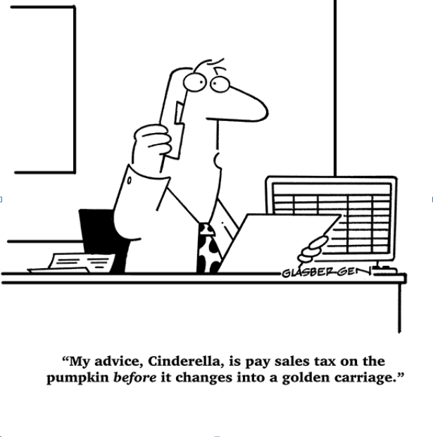

Slide 9
What the heck is “tangible personal property”
Under the RCW, tangible personal property means personal property that can be seen, weighed, measured, felt, or touched, or that is in any other manner perceptible to the senses. Tangible personal property includes electricity, water, gas, steam, and prewritten computer software.
Includes services related to the tangible property.
Many exemptions provided by statute
Eg. Some medical items used for patients are exempt. However, that exemption does not apply to medical items used in research.
HINT: If you’re buying on a research budget, probably not exempt
Notes:
Medical goods = exempt if not used in research

Slide 10
Common Examples
Retail Service: Installing, cleaning, repairing of tangible personal property even if property not sold in connection of services is taxable.
Examples:
Repairing any personal property, machines, radios, etc.
Laundering, dyeing and cleaning
Computers
Includes outright sales, leases, rentals, licenses to use, and any other transfer
Prewritten software – taxable
Installation of prewritten software – taxable
Maintenance on prewritten software - taxable
Notes:
Internet Service is not taxable, Custom software, written for UW, is not taxable, along with any digital products given away for free (such as any apps you download, free reports from online sites, etc). Also, remember digital goods can be included for M&E exemptions. So any goods used directly in manufacturing may qualify for M&E exemption. We cover more about Digital goods and computers in our advance tax class which we will be offering soon.

Slide 11
Services
Services related to tangible property are taxable
DOR lists services subject to sales tax: http://dor.wa.gov/Content/FindTaxesAndRates/RetailSalesTax/RetailServices.aspx
Personal services generally are not
Examples: Attorneys, Consultants, Doctors, Dentists, Engineers, Public accountants
Test: Is the purchaser buying the service itself or the property related to the service
Notes:
We mentioned a few earlier, some other taxable services include auto repairs, seamstresses, and laundry services. DOR has a longer list on their website. Here is the link to that list.
As mentioned, personal services are not taxable. This includes services by attorneys, consultants, doctors, dentists, engineers and public accountants.
One way to help figure this out is to ask yourself am I buying the service itself or the property relating to service.

Slide 12
Taxability Table
Tax Office maintains a list of items commonly purchased at the UW with their sales/use taxability indicated. Also listed are possible object codes that could be used to identify the purchase: http://f2.washington.edu/fm/tax/taxability
Let’s take a quick look at the grid.
Notes:
Show table on site. Mention that we will continue to add more to the grid.

Slide 13
So what EXACTLY are we taxed on?
Tax is applied to the FULL sales price
Includes freight and other delivery charges
Excludes discounts & finance charges/fees
Generally, if the invoice itemizes the items and separates the services from the product portion, then only the product portion will be taxable
e.g. live webinar (not taxable) + CD (taxable)
BUT, pre-recorded webinar and CD – both taxable
Notes:
Often we get asked the question is shipping taxable. If we purchase an item with shipping then yes, if it is stand alone such when you go to UPS and buy the service of having them ship the item, then it is not taxable.
Tax is assessed after the discount has been taken.
Separate the service from the tangible property:
For example: if you want to attend a webinar that charges a price that includes the live webinar and a CD. Only the CD would be taxable, because the live webinar is not taxable.
On the other hand, if the webinar was pre-recorded and not live, then both would be taxable because you would not be able separate the service portion from the tangible portion.

Slide 14
Delivery Charges
Delivery charges
Charges for preparation and delivery of tangible personal property or services
Includes transportation, shipping postage, handling, crating and packing
Shipping/delivery, if sold by itself, is exempt from sales tax BUT if sold in conjunction with a taxable item, the shipping is considered part of the sales price and subject to tax
Separately itemized charges still taxable

Slide 15
Goods going outside of WA
Goods received in WA are taxable even if the property will be used elsewhere
Dep’t orders something that will be used in another country, receives the goods in WA, opens box, checks to make sure they are ok, then ships
But, not taxable if freight forwarder is used
WA sales tax doesn’t apply when the seller delivers the goods to the purchaser who receives them outside of Washington
Notes:
If the product is stored or inspected in WA, it is taxable in WA.

Slide 16
Goods going into WA
Companies not registered in Washington DO NOT have to collect sales tax on sales in WA.
All goods received in WA are subject to sales/use tax unless specifically exempt.
In some situations, out of state company may charge their state sales tax. In this case, check to see if we can supply an exemption certificate. Remember, WA still expects their tax.
Tool: Sales Tax Exemption Certificates for purchases made out of state. https://f2.washington.edu/fm/tax/Departments/exemption-grid
Notes:
WA use tax still applies on taxable items.

Slide 17
Foreign Purchases
Foreign purchases of tangible goods, if not brought into Washington are not subject to Washington state sales or use tax
Value Added Tax may be applied when purchasing in foreign countries
If possible purchase items through the internet in Washington to avoid VAT
Keep in mind – there are sanctioned countries. You should avoid purchasing items from these countries.
Eg. Iran, North Korea
Notes:
Another side note, if you plan to ship an item to Canada, keep in mind that using UPS or FedEx may result in us having to pay custom charges. It may be better to ship through USPS, because there is an agreement between both Postal Agencies and they do not add custom charges.

Slide 18
Exemptions we see
Items purchased for resale
Items for use outside of the state and not brought into the state
Machinery and Equipment Exemption for Public Research Institutions

Slide 19
EXEMPTIONS: Items Acquired for Resale
Purchasers may be eligible for a sales tax exemption on items acquired for resale to a third party
UW has a reseller’s permit
Currently need to supply a copy of the reseller’s permit to be able to purchase for resale
Contact the Tax Office (taxofc@uw.edu) to request a copy of the UW’s reseller’s permit

Slide 20
EXEMPTIONS: Items Acquired for Resale
Use reseller’s permit for:
Resale in the regular course of business without intervening use by the reseller, or
Use as an ingredient or component part of a new article of tangible personal property to be produced for sale, or
Use as a chemical used in processing a new article of tangible personal property to be produced for sale
Intended to be used for a particular purchase – not as a blanket exemption

Slide 21
Subsequent Sale of Items Acquired for Resale
Tax upon resale
Department selling item responsible for collecting the sales tax
If the product stays at the UW for the university’s own use, use tax is due

Slide 22
Exemptions: Items Acquired for Out-of-State Use
Goods for use outside the state of Washington, inform the seller no WA sales tax
On purchases made via purchase order - buyer will flag the order as exempt as it is processed and include the appropriate language on the purchase order (PO)
Ordering department must state in the comments that the order should be flagged as exempt and that the goods are for use outside of Washington

Slide 23
Exemptions: Machinery and Equipment
Applies to purchases by public research institutions of machinery and equipment
Directly in a research and development operation
More than 50% of the time for a qualifying use
Useful life of more than 1 year
Cost of $200 or more
UW Equipment Inventory Office is key player in M&E purchases

Slide 24
Quiz Time!
#1
Department buys books from vendor. Vendor lists shipping separately – is the shipping subject to sales tax?
Can you put the shipping under a tax exempt object code?
#2
Department purchases a maintenance agreement on equipment in the department – taxable?
What if the equipment is M&E exempt?
#3
Department hires a consultant to help with a project – taxable?
Can the department hire a consultant or do they have to hire an employee?
Notes:
1- Yes shipping is subject to sales tax, no cannot put shipping under a tax exempt object code?
2- Yes, M&E then still yes. Maintenance agreement taxable no matter what.
3- Consultant usually service, no sales tax. Depends on what the consultant does.

Slide 25
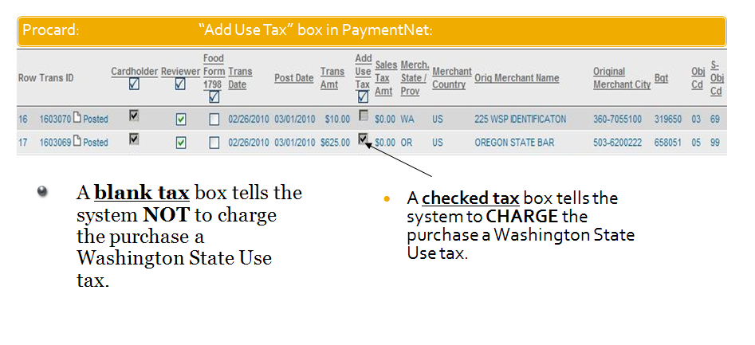
Procurement Card
Receipt/invoice should be reviewed to determine if the merchant charged sales tax. If not and purchasing taxable item, check the “Add Use Tax” box.
Notes:
Amazon is a vendor to look out for

Slide 26
eProcurement PO / Non-PO
When an invoice is paid through eProcurement, the system looks at:
the sales tax entered
the item(s) being purchased
the delivery address.
Based on these factors, the system estimates what the tax should be.
If what is entered on the invoice conflicts with that estimation, the transaction will be flagged for review and reconciliation.
Key point: If purchase is taxable and sales tax has NOT been billed, we should apply use tax.

Slide 27
eProcurement PO / Non-PO
If the supplier billed less tax than the expected amount:
The supplier will receive payment for what they invoiced
The remaining tax amount will be paid to the State of Washington as Use Tax
If the supplier billed more tax:
eProcurement will short-pay the invoice to the correct tax rate and only that amount will be paid to the supplier.
Specific to Non-PO Invoice-
Must include a header tax amount.
Always enter the tax amount provided by the supplier on the invoice, even if it is $0. The system will calculate the proper tax amount to be paid and add as needed.

Slide 28
Use Tax Corrections
Budgets should be reconciled regularly (monthly is best, quarterly at a minimum) to resolve any discrepancies in a timely manner
If transactions are discovered in which use tax was incorrectly applied, or not originally applied and should have been, correction requests can be submitted to Procurement Services
Tool: There is a Web Form in Procurement Desktop Reports where correction requests can be submitted electronically
This file describes the steps to submit a use tax correction: https://f2.washington.edu/fm/ps/sites/default/files/Use%20Tax%20walkthrough_2.pdf
Notes:
Generally will not reverse tax on transactions older than 3 months

Slide 29
ProCard Case Study
Card holder has split the transaction to separate shipping, and handling into 03-24. Item being purchased is under 05-99.
Reconciler reviews the account and makes no modification.
ProCard staff has already made the monthly payment to JP Morgan and the transaction is now posted to MyFinancial Desktop.
What is the problem and how do you correct it?

Slide 30
Answer
Reconciler can change it in payment net before the payment is made to the bank to make shipping taxable.
If payment is already made, though, have to go through Procard department and request a correction.

Slide 31
Audit Case Study
The vendor has asked us for documentation that we paid the use tax on specific invoices because they did not charge sales tax.
Are we obligated to provide this information to the vendor?
What kind of documents can we provide?
If use tax wasn’t paid what happens?

Slide 32
Answer
Work with Procurement Services if a vendor contacts you about this
Check that use tax actually was paid
Terms and conditions in contracts often say we will pay use tax if sales tax not charged.
We may be required to provide the DOR use tax form at some point.
If no tax paid and tax is due, then department will have to pay it and may owe penalties and interest.

Slide 33
Can you give me a list of non-taxable object codes, pleeaassee?
NO because…
Taxability is not driven by the object code, but by the underlying item that is being purchased
But,
http://f2.washington.edu/fm/tax/taxability

Slide 34
Questions and contacts
Tax Office
taxofc@uw.edu
Julia Shanahan, 616-3003, jeshana@uw.edu
Mona El Souessy, 221-3342, msouessy@uw.edu
Procurement Customer Service
PCS Team, 543-4500, pcshelp@uw.edu
Pramilla Chand, 616-9021, pchand@uw.edu

