Slide 1
Disclaimer
The GCA Forum will be recorded and retained for the legally approved retention period under Washington State Policy
It is subject to release under the Washington State Public Records Act or Federal Freedom of Information Act (FOIA)
It will be posted publicly on our GCA YouTube channel
Slide decks and recordings for this and past Forums are linked on our GCA Forum web page: https://finance.uw.edu/gca/resources/gca-forum

Slide 2
GCA Forum
Fall Quarter 2022

Slide 3
Welcome!
Please make sure you are muted in order to reduce background noise during the presentation.
Please ask us questions using the Chat feature in Zoom. We will pause after each segment to answer them.
We want you to be engaged. This meeting is for you!

Slide 4
Agenda
Grant Tracker to Award Portal
Carryover Deep Dive
Budget Period vs. Project Period
Extensions
Indirect Cost Calculation
Tips & Tricks

Slide 5
Grant Tracker to Award Portal
Cheryl Haycox

Slide 6
What’s Happening?
Grant Tracker will be retired once we go live to the new Workday system
Grant Tracker will be available for reference post go-live
Award Portal will replace Grant Tracker as the At a Glance view of award
We’re modeling Award Portal after Grant Tracker as much as possible

Slide 7
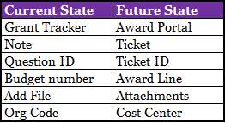
New Terms to Learn-here are a few

Slide 8
Informational Sections

Slide 9
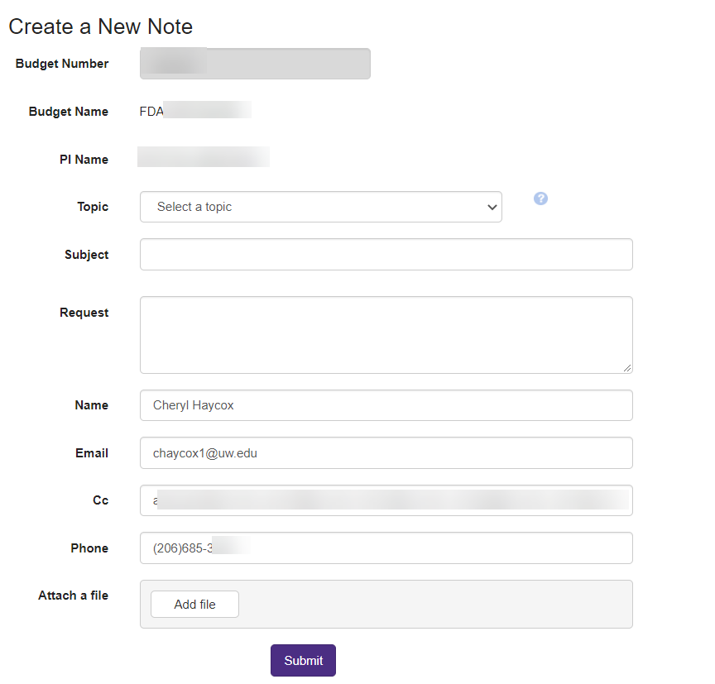
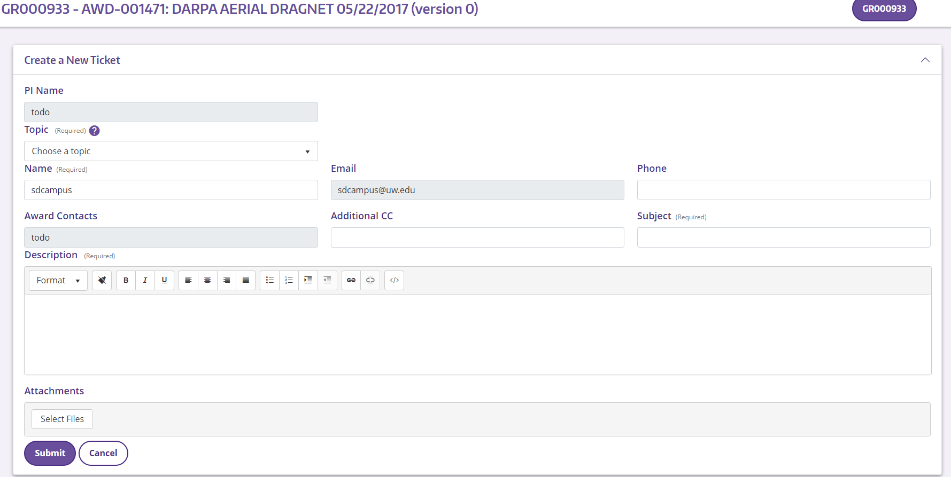
Contacting GCA

Slide 10
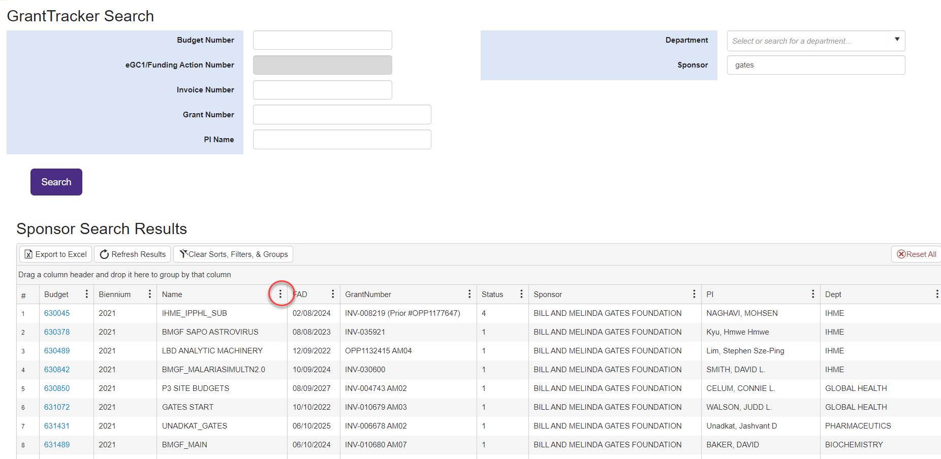
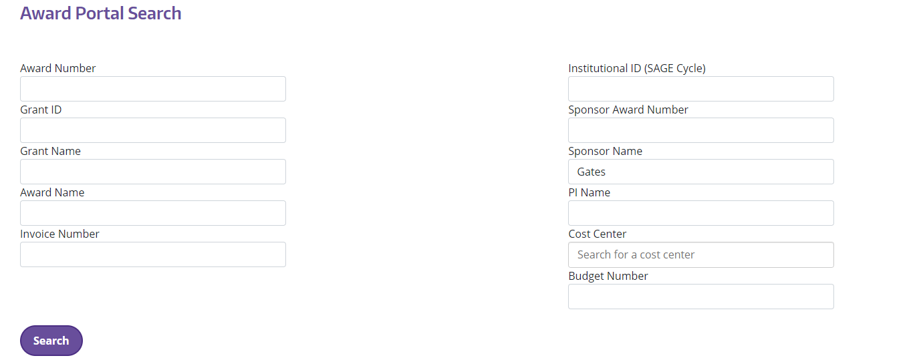
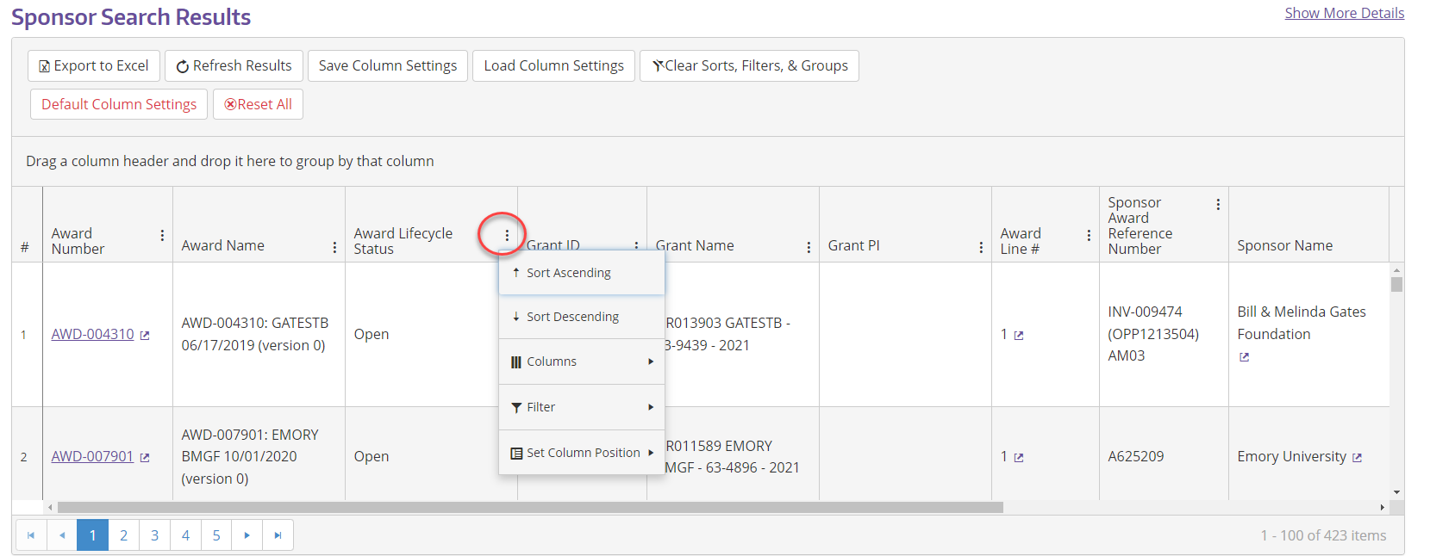
Search by Sponsor

Slide 11
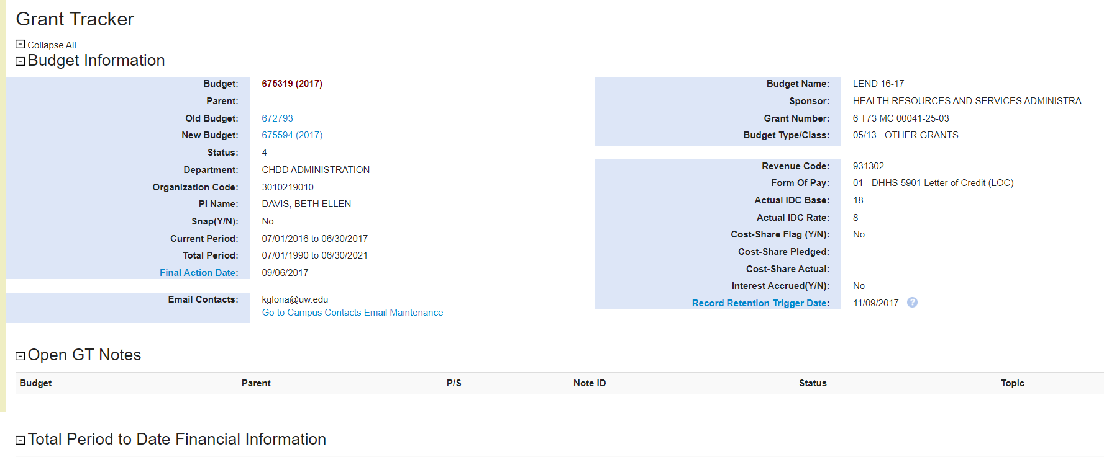
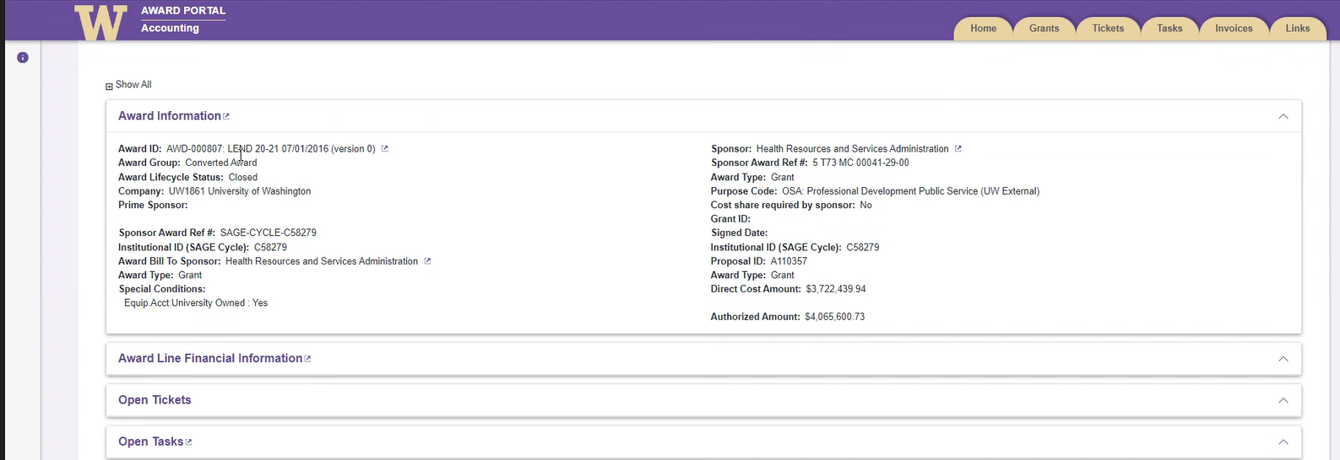
Award Landing Page-higher level​

Slide 12
Questions?

Slide 13
Carryover – Deep Dive
Jonathan Nagle

Slide 14
Part 1 - Definitions
The NIH defines carryover as:
“a process through which unobligated funds remaining at the end of the budget period may be carried forward to the next budget period. The carryover of funds allows the Grantees to use the unused prior year funds in the current budget period.”

Slide 15
More Definitions
Unobligated Funds
Money we have been awarded that we have not spent or committed to spending.
Budget Period
A subsection of the total award period during which you are authorized to spend funds.

Slide 16
Types of Carryover
Automatic
We are allowed to move funds between budget periods without additional approval from the sponsor.
Restricted (Requires Sponsor Approval)
We must get specific approval from the sponsor each time we want to move unobligated funds from one period to the next.
Other (Subject to Sponsor Limitations)
Situations such as Separate Year Accountability where we are authorized to move funds between budget periods as long as we meet certain criteria.
None
We cannot move funds from one budget period to the next. Any unobligated funds must be returned to the sponsor after each budget period.

Slide 17
Part 2 – The Mechanics of Carryover
Period
Automatic
Restricted
SYA
Year 1
Budget 1
Budget 1
Budget 1
Sub 1
Carryover
Year 2
Budget 2
Sub 2
Carryover
Year 3
Budget 3
Sub 3

Slide 18
How GCA Processes Carryover
Carryover happens at the end of a budget period as part of the closeout process.
After the final invoice and/or report has been submitted
The mechanics of the transfer are different depending on whether the funds are carried over as available or restricted.

Slide 19
Carried Over As Available
When carryover is not automatic but we do have approval from the sponsor to spend unobligated funds in future budget periods.
By default, funds are moved into object codes 38-00 and 25-99
38-00 is for unallocated direct costs
25-99 is for indirect costs
Complete the Request for Rebudgeting form from the GCA website and submit it to GCA via GrantTracker

Slide 20
Carried Over As Restricted
When carryover is not automatic and we do not have approval from the sponsor to spend the funds in future budget periods, but the sponsor has not requested a refund or deobligated the funds.
Restricted funds are moved into object code 37-99
Funds are also encumbered with encumbrance code BB0035000
Restricted funds can be released with sponsor approval in writing, at which time the funds will be transferred out of 37-99 and the encumbrance will be reduced.

Slide 21
Part 3 – Special Cases

Slide 22
Carryover Between Awards
Can you carry funds between award periods?
Can you carry funds between different awards?
Maybe! Talk to your sponsor.

Slide 23
When In Doubt…Ask!
Carryover is complicated!
GCA is happy to answer any questions you have about your award’s carryover process.

Slide 24
Questions?

Slide 25
Budget Period vs. Project Period
Susan Wilbanks

Slide 26
A frequently asked question…
“This is a multi-year award, and it doesn’t end until 6/30/26. How come the end date in MyFD is 6/30/23?”

Slide 27
Budget Period vs. Project Period
Project Period
Budget period
The full lifespan of an award (or, in some cases, a three-year or five-year cycle within a long-running project)
Can contain multiple budget periods
Also referred to as “Total Period”
The time period authorized for spending a specified block of award funding
Also referred to as “Current Period”

Slide 28
Grant Tracker lists budget & project periods for all budgets
Budget period matches project period
Budget period within larger project period

Slide 29
But why doesn’t my budget period match my project period?
Depends on the terms of the award agreement
If GCA needs to issue a final invoice and/or a final financial report before the award as a whole ends, the award will be set up with multiple budget periods
Separate accountability
Renewal budgets
In some cases careful reading of the agreement for a large award with a long project period reveals that they are only authorizing UW to spend a fraction of the funds over a subset of the award period.
GCA will set up the funding level and budget end date based on what is currently authorized.
When the sponsor authorizes additional funding and/or time, GCA will extend the budget period accordingly.

Slide 30
Example 1

Slide 31
Example 2

Slide 32
Example 2 continued

Slide 33
Questions?

Slide 34
Extensions
Patrick Carney

Slide 35
What are we looking at?
No Cost Extensions
Temporary Extensions
Supplement/Extensions
Advance Renewals
Advance Budget Extensions

Slide 36
No Cost Extension
Sponsor is adding additional time to an award, but no new money is added. These are routed as a PAC (Post Award Change)and are the simplest of all the variances.

Slide 37
Temporary Extensions
Often used when an extension is expected but we don’t have the amendment yet, and it looks like it may take some time to get the signature process. You can request a temporary extension and we will extend the end date and keep the budget open.
Important to note that the sponsor is NOT responsible to reimburse for expenses that post during a temporary extension should the amendment not come through. This is why a guarantee budget is required.

Slide 38
Supplement/Extensions
Used when the sponsor is adding funds and extending the period. These get tricky when comparing to renewals.
Carryover is automatic, or prior funds are not distinguished from new funds and can be invoiced together.
No requirements for final financial reports or invoices for each period.
Grant number does not change.

Slide 39
Advance Renewals
Can be used to establish a renewal budget when the sponsor is going to fund a new period.
These are used in place of supp/ext if:
Carryover is NOT automatic
The award requires separate financial reports and/or invoices at the close of each period
A new PO or grant number is issued for the new period.

Slide 40
Advance Budget Extensions
Used to add more time to a budget that is in advance status.
Please note that advance budget periods may not exceed 18 months.

Slide 41
Questions?

Slide 42
Indirect Costs: Auto and Manual Calculations
Azalea Vasquez

Slide 43
What are Indirect Costs?
As defined in Uniform Guidance (2 CFR § 200.56), “Indirect (F&A) costs means those costs incurred for a common or joint purpose benefitting more than one cost objective, and not readily assignable to the cost objectives specifically benefitted, without effort disproportionate to the results achieved. To facilitate equitable distribution of indirect expenses to the cost objectives served, it may be necessary to establish a number of pools of indirect (F&A) costs. Indirect (F&A) cost pools must be distributed to benefitted cost objectives on bases that will produce an equitable result in consideration of relative benefits derived.”

Slide 44
How are Indirect Costs Calculated?
Indirect costs are calculated by taking a rate and multiplying it with a base:
•The IDC rate is essentially an overhead rate.
•The IDC base is the direct costs to which the IDC rate is applied.
•The most common IDC base used is Modified Total Direct Costs (MTDC)
IDC Rate (%) X IDC Base (direct costs less any exclusions) = Indirect Costs

Slide 45
Auto Calculated Indirect Costs
Most indirect cost calculations are performed by our financial system
Base is Modified Total Direct Costs (MTDC)
Or indirect cost base used is one of the 31 programmed bases in our system
The indirect costs will post to the budget at the same time as the direct costs

Slide 46
Indirect Costs – Automated IDC JV Process
What happens if we use the wrong standard rate and/or base on your budget?
We will update the rate and/or base in the financial system
The budget will go through our Automated IDC JV Process
IDC JVs are set to post every Monday
An automated GrantTracker notification will be sent out to the department contacts that are set up in GrantTracker
If no department contacts are set up the notification will go to the Principle Investigator (PI) of the budget

Slide 47
Indirect Costs – Automated IDC JV Process
Grant Tracker notification:
“An automatic Indirect Cost Adjustment journal voucher for $-15119.62 has been posted to this budget and will be reflected in MyFinancial.desktop in the next few days. Please open the attached Excel file to view the documentation for the adjustment.”

Slide 48
Indirect Costs – Automated IDC JV Process
Spreadsheet summary:

Slide 49
Indirect Costs – Automated IDC JV Process
MyFD view:

Slide 50
Indirect Costs – Manual Process
Budgets that are excluded from the automated IDC JV process
Budgets with subcontract expenditures
Other direct costs will have IDC charged at the same time
Subcontract IDC reconciliation is a manual process (cannot be automated)
Budgets with non-standard bases
Sponsor terms and conditions do not fit any preset IDC bases
IDC bases with technical bugs
Base 4
Base 24

Slide 51
Indirect Costs – Manual Process
What is the manual process for these exclusions?
Budgets with subcontract expenditures
Reviewed quarterly
Run exception reports to identify budgets
Prioritized by budget end date
Budgets with non-standard bases
Add Grant Control Flag 11
Reviewed quarterly
Run exception reports to identify budgets
IDC bases with technical bugs (Base 4, 24)
Add Grant Control Flag 11
Reviewed quarterly
Run exception reports to identify budgets

Slide 52
Indirect Costs – Questions or Concerns
If you believe your IDC is incorrect, please contact GCA via Grant Tracker using the Indirect Costs topic.
Please give us time to process your request! These can be complex and time consuming.

Slide 53
Questions?

Slide 54
Tips and Tricks
Michelle Davis

Slide 55
Selecting a Topic for your Grant Tracker note
TIP!
When you create a new note, select the topic that best aligns with your request
Some Examples!
“Rebudgeting request” → Budget Setup
“Place budget in status 3” → Closing
“Invoice payments” → Either Invoicing or Sponsor Payments
“General question about award terms” → Either Compliance or Other

Slide 56
When in doubt…
Refer to the Grant Tracker topic glossary, which can be accessed by clicking on the Icon next to the topic drop down
If you’re still not sure, no worries - when GCA reviews your request, we will change the topic if there is one that fits better!

Slide 57
Transpasu forms: “PI name” clarification
TIP!
Who you list as the PI depends on the budget type!
For award budgets: list the PI’s name and EID
For gift budgets: the “PI name” should be a position title, such as Chair, Director, Dean – whoever oversees the department’s budgets

Slide 58
Surplus budget restrictions?
TIP!
Surplus funds are unrestricted, but they aren’t discretionary funds either!
Expenditures should still support research and comply with the four cost principles:
Examples of charges include salary/fringe, travel, lab supplies/equipment, or deficits from other award budgets

Slide 59
Additional Reading!
Creating a new Grant Tracker note:
https://finance.uw.edu/gca/training-outreach/grant-tracker-communicate-gca
Transpasu instructions:
https://finance.uw.edu/gca/award-lifecycle/budget-setup/sub-budget-setup-and-changes/transpasu-instructions
Surplus budget overview:
https://finance.uw.edu/gca/award-lifecycle/budget-setup/surplus
Four cost principles: https://finance.uw.edu/pafc/four-cost-principles

Slide 60
Questions?

Slide 61
Future Forum
February
2023
VIA ZOOM
https://finance.uw.edu/gca/training-outreach/gca-forum
Survey about today’s forum will be sent out soon!

Slide 62
Thank you
Email gcahelp@uw.edu
GCA Help Hotline 206-616-9995 (9:00 am to 12:00 pm and 1:00 pm to 4:00 pm)
Grant Tracker https://www.washington.edu/research/gca/budget/granttracker.html

