Slide 1
Disclaimer
The GCA Forum will be recorded and retained for the legally approved retention period under Washington State Policy
It is subject to release under the Washington State Public Records Act or Federal Freedom of Information Act (FOIA)
It will be posted publicly on our GCA YouTube channel
Slide decks and recordings for this and past Forums are linked on our GCA Forum web page: https://finance.uw.edu/gca/resources/gca-forum

Slide 2
GCA Forum
Spring 2022

Slide 3
Welcome!
Please make sure you are muted in order to reduce background noise during the presentation
Please ask us questions using the Chat feature in Zoom. We will pause after each segment to answer them
We want you to be engaged. This meeting is for you!

Slide 4
Agenda
Quick Updates and Reminders from GCA
Federal Unique Entity Identifier (UEI) replaced DUNS
Washington State Estimate Letters
Final Action Date
Deficit vs. Expense Transfers
Surplus Budgets 101
End of Award: Non-Traditional Endings (Early Terminations and Relinquishments)
Introduction to ECC (MAA)

Slide 5
Quick Updates and Reminders from GCA
Federal Unique Entity Identifier (UEI) replaced DUNS
Washington State Estimate Letters

Slide 6
Federal Unique Entity Identifier (UEI) replaced DUNS
Entities that conduct business with the federal government will need to use a Unique Entity Identifier number:
DUNS 605799469 is expired
UEI is HD1WMN6945W6
Department of Education has its own UEI: NFJ3CMQ4B418
GCA is working to update our financial report and invoice templates
If you create invoices for awards or contracts in your department that list the DUNS number, be sure to use the new UEI number moving forward!
The number is listed on OSP’s Institutional Facts and Rates page

Slide 7
Washington State Estimate Letters: Fiscal Year End Requirements
Per Washington State Administrative and Accounting Manual (SAAM) Chapter 90 on fiscal year end reporting policies and procedures, GCA must submit invoices or estimate letters for all services rendered through June 30 on Washington State funded awards by the deadline published on SAAM

Slide 8
What to expect!
You might receive an invoice/estimate letter request directly from the State Agency – if you do, please forward them to gcahelp@uw.edu
GCA will also determine which Washington State awards require an estimate letter instead of an invoice based on several factors
In mid-June, our office will send Grant Trackers to departments with Washington State awards that require invoicing information for June billing
Friendly reminder: please also make sure you have contacts set up in Grant Tracker so you receive these notices!

Slide 9
Importance of responding
Please respond to the Grant Trackers by June 30 so we can send the estimate letters by July 11!
Expenditures that aren’t billed or included in estimate letters will most likely NOT be reimbursed by the State

Slide 10
INTRODUCTION TO ECC
Colleen Bettis – Management Accounting & Analysis (MAA)

Slide 11
WHAT IS ECC?
Employee Compensation Compliance (ECC) is a third-party solution, provided by Huron Consulting, which supports the effective management of effort reporting, project certification, and payroll confirmation.
To support UW Finance Transformation (UWFT) and the implementation of Workday Finance, ECC will replace effort reporting systems for eFECS, Grant and Contract Certification Reports (GCCR), Harborview Medical Center (HMC), and Applied Physics Laboratory (APL).

Slide 12
HOW WILL ECC IMPACT USERS?
While ECC is expected to be an overall positive change for effort reporting users, it is a change none the less and one that occurs in a landscape of broader organizational change—UWFT.
Initially, the change to ECC will impact approximately 5,000 users across the Academy and Harborview Medical Center. Over time, this user base is expected to grow to 10,000 users.

Slide 13
BENEFITS
Standardized workflows
Automated processes and electronic records for all forms of effort reporting
Improved compliance through real-time reporting and timely notifications
Simplified user interface and experience
Increased uniformity and consistency via a single platform, instead of four disparate systems.

Slide 14
IMPACTS
We aim to make the transition to ECC as seamless as possible, but users can expect the following impacts:
New workflows
New reports
New user interface

Slide 15
WE NEED USER INPUT!
ECC is configurable and user input is critical to ensure we maintain desired functionality, while embracing this opportunity for improvement. These are some of the ways we hope users will engage with us:
Provide feedback on current state effort reporting:
What works well?
What are the pain points?
Participate in design discussions, focus groups, and/or surveys.
Identify ECC Champions within each group to participate in User Acceptance Testing (UAT).
Ready to help? Email us at ECCHelp@uw.edu

Slide 16
CURRENT PRIORITIES AND COMMITMENTS
Meet key project milestones:
Project Kickoff – April, 2022
UW E2E Testing (Cycle 3) - October, 2022
UAT Testing – Spring, 2023
Go Live – July, 2023
Partner with ECC Champions who represent different user groups and roles—ensure they are engaged with the solution
Maintain critical functionality, automate processes and workflows, and standardize effort reporting
Provide training materials, by user type, prior to Go Live
Document all primary workflows and processes to support users beyond the end of the project
Maintain transparency, communication, and collaboration throughout the project—ensure users and stakeholders have a voice

Slide 17
WHAT’S NEXT?
Project kickoff occurred with Huron on April 25th—we are now in the Onboarding phase of the project. We hope to accomplish the following during this phase:
Learn more about the features, functionalities, and constraints of ECC to inform design discussions and user engagement.
Collaborate with Huron to define responsibilities and deliverables.
Plan for future phases of the project (iterate, test, deploy, and support).
Establish communication and organizational change management plans, as well as channels for user engagement.
Track open decisions in an ECC Dashboard (under development) to ensure visibility, transparency, and closure.

Slide 18
Q&A from MRAM (May 2022)
“How will GCCRs change when ECC replaces eFECS?”
GCCRs will follow an automated process in the future state, although the specific workflows are not yet finalized. We will provide more information, once it is available.
“What are the four systems that ECC will replace?”
ECC will replace effort reporting systems and/or existing processes for the following:
Faculty Effort (eFECS)
Non-Faculty Grant & Contract Certification Reports (GCCR)
Harborview Medical Center (HMC)
Applied Physics Laboratory (APL)
“Is Huron’s solution custom or off the shelf and adapted?”
ECC is an off-the-shelf solution that will be configured to meet the needs of the UW.

Slide 19
Q&A from MRAM (May 2022) cont.
“When will the old system be retired? Will there be any overlap?”
A cutover plan is currently under development. While some details remain unknown, the following key elements are in place:
Current state effort reporting will end on 6/30/23, with an abbreviated reporting cycle; however, current state systems will remain in use for a few months after cutover to certify for this cycle.
Future state effort reporting will begin on 7/1/23, with a new reporting cycle in ECC.
Leading up to cutover, we will work with users to minimize cross-era changes & recertifications.
We will provide more information, once it is available.
“Do other peer institutions use ECC along with Workday?”
Yes. Among other institutions, the University of Miami and the University of Kansas Medical Center use both systems. We are currently engaged with the University of Miami to learn more about their implementation of ECC and Workday Finance.

Slide 20
Q&A from MRAM (May 2022) cont.
“What does ECC stand for?”
Employee Compensation Compliance (ECC)
“When you say GCCRs will be “automated” do you mean that it will be automated for each PI? Will GCCR Coordinators (who currently download reports and get signatures) no longer be needed?”
In the future state, it will not be necessary to download GCCR Reports for project-based effort reporting. That said, the specific processes for this work, along with the associated roles and responsibilities, remain to be defined. We will provide more information, once it is available.

Slide 21
Q&A from MRAM (May 2022) cont.
“ADS and ENS payments interfere with the accuracy of FEC in the current state—the percentages of effort on sponsored projects shift slightly, as the ADS/ENS payments are counted toward a 1.0 FTE, rather than being noted as payments beyond the 1.0 FTE. Is this something we can control in the future state?”
The ECC project kicked off at the end of April, so we’re still in discovery mode. However, one of our immediate objectives is to learn more about the features, functionalities, and constraints of ECC to inform design decisions going forward. This is helpful input—we hope to know more in the coming weeks. At a minimum however, this will be captured as a testing scenario during the test phase of the project.

Slide 22
Operational Announcement - eFECS
On May 24, 2022, eFECS implemented a standing maintenance window, which enables developers to update and perform other maintenance for eFECS.
The system may be unavailable from 7 – 9am every Tuesday.

Slide 23
We need your help!
We're looking for feedback on current state effort reporting, input in design discussions, and/or user acceptance testers.
To learn more about how you can help, email us at ECCHelp@uw.edu

Slide 24
Final Action Date
Patrick Carney

Slide 25
What is the Final Action Date?
The Final Action Date (FAD) is the last day the budget is open for the department to post expenditures
After the FAD, your budget will automatically change from Status 1 (open to expenditures) to Status 3 (closed to expenditures)

Slide 26
What determines my FAD?
The FAD is based on the due date of your budget’s final report and/or invoice laid out in the award agreement
The FAD is before the due date to allow GCA time to prepare the budget reconciliation for the final invoice and/or report
The date is typically set as 6 days before the final invoice due date, or 3 weeks before the final report
This Photo by Unknown author is licensed under CC BY-SA-NC.

Slide 27
Impact of the FAD
Once the FAD has passed a budget is eligible for invoicing and/or reporting based on the expenditure total as of the FAD
Any charges that post after this date will not be included in the final report, invoice, or letter of credit draw
GCA will consider submitting a revised report or invoice when there are extenuating circumstances, but note the sponsor is NOT obligated to accept a late or revised report or invoice
If the sponsor does not reimburse an invoice or allow a late draw for charges posted after the FAD the department is responsible for the resulting deficit

Slide 28
What if my FAD is before the end date?
It can occur that that the Final Action Date is before the award end date. This is often the case if the final report is due the same day the budget ends
When this occurs, the budget will still flip to status 3 after the FAD and close to expenses
GCA asks that you notify us of any pending charges that will occur following the FAD so we can account for them on the final invoice and/or report. We can then open the budget back to status 1 to allow the charges to post

Slide 29
Questions?

Slide 30
Deficit vs. Expense Transfers
Azalea Vasquez

Slide 31
Deficit vs. Expense Transfers
“Should I do an expense transfer or a deficit transfer?”

Slide 32
Expense Transfers: Definition
An expense transfer is moving an expense from:
One budget to another budget
One object code to another (originally miscoded)
One Project Cost Accounting (PCA) Code to another (originally miscoded)

Slide 33
Expense Transfers: Purpose
There are two business needs where an expense transfer is appropriate:
To correct an error
To distribute an expense that was initially charged to one budget, but benefits other budgets (e.g., rent, phone, supplies)

Slide 34
Expense Transfers: Risk
Expense transfers are high risk transactions and are audit red flags for both internal and external auditors:
It gives the impression that budgets are not routinely reconciled in a timely manner
They are a sign of weak department internal controls
What is the legitimacy of the transfers? Are they done for budgetary convenience?

Slide 35
Expense Transfers: Timing
You can decrease your risk by doing the following:
Reconcile your budgets monthly
Correct erroneously posted expenditures as soon as possible
Move them to the correct budget
Follow up with internal and external goods and services providers immediately
If transfers happen after 120 days provide a detailed explanation as to why it is late
Keep good backup documentation in case of audit

Slide 36
Expense Transfers: Other Considerations
Additional considerations to keep in mind when processing an expense transfer are:
A single cost is to be transferred only once
Faculty salary transfers require FEC recertifications
Non-faculty salary transfers require notes on the Grant and Contract Certification Report (GCCR)

Slide 37
Budget Deficit: Definition
What is a deficit?
“The amount by which expenditures exceed a grant or contract award, a budget allocation, or revenue available in a specified fiscal period (grant period, biennium, or fiscal year, depending on the type of budget)”
“Deficits do not include negative budget balances resulting from unliquidated encumbrances”

Slide 38
Budget Deficit: Why do they occur?
There are many reasons why a budget goes into deficit:
The direct expenditures of a project exceed the authorized amount
The sponsor refuses to pay our invoices (Cash Deficit):
Unallowable or disallowed costs are charged to the budget
Disagreement with the sponsor regarding the scope or performance of work
Sponsor cannot pay (e.g., bankruptcy)

Slide 39
Budget Deficit: Transferring / clearing deficit
If your department is faced with any of these scenarios and you are ready to resolve them, you can do the following:
Cost overruns (allowable costs): Deficit transfer
Approval to pay from renewal award: Expense transfer
Unallowable or disallowed costs: Expense transfer
Cash deficit due to project disputes or bankruptcy: Deficit transfer

Slide 40
Deficit Transfers: Processing
If you need to process a deficit transfer, we highly suggest using our self-service tool found in Grant Tracker:

Slide 41
Deficit Transfers: Processing

Slide 42
Deficit Transfers: Processing
Transferring deficits to more than one budget
Send request via GCA Help or Grant Tracker
Include the non-sponsored budget numbers with corresponding amounts
Transferring deficits to or from a sub budget
Send request via GCA Help or Grant Tracker
The Grant Tracker deficit tool was not programmed to handle subs

Slide 43
Questions?

Slide 44
Surplus Budgets 101
Susan Wilbanks

Slide 45
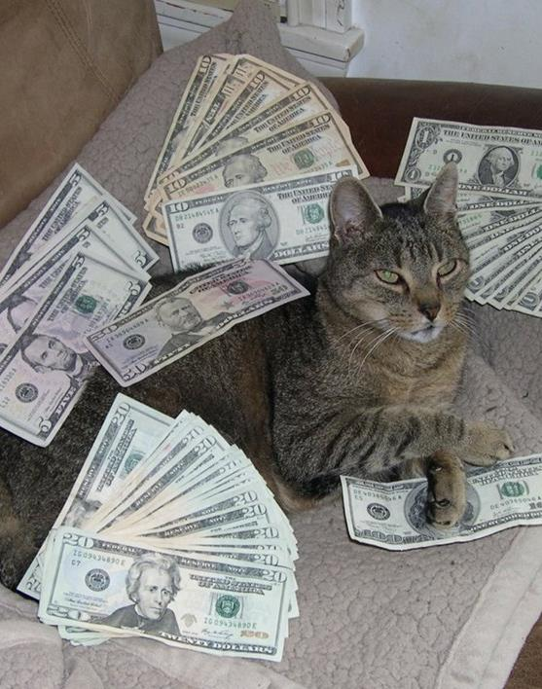
So your budget is closing with cash on hand…
It is a truth universally acknowledged that when a budget is closing with an unspent balance, the PI will ask
“Can we keep it?”

Slide 46
A quick note before we dive in
This does NOT apply to all unspent balances
If a budget is Cost Reimbursable or Letter of Credit, even if the award is not fully spent there will be no cash balance on hand to either refund or transfer to surplus, because we only invoice or draw down for actual expenditures
Typically budgets with balances eligible for surplus transfer are Milestone, Scheduled Payment, or Form of Payment 11 (such as clinical trial budgets or capitation sub budgets)

Slide 47
Great! That means we can keep the balance on our milestone budget, right?
Not so fast! Check your award agreement for language like “firm fixed price” or “UW may retain any unspent balance to support the PI’s ongoing research.”
Sometimes UW can retain a balance up to a maximum amount, with anything above it refunded to the sponsor.
Look for the following type/class combinations:
05/14 (fixed price grants)
05/31 (fixed price contracts)
05/35 (clinical trial agreements)

Slide 48
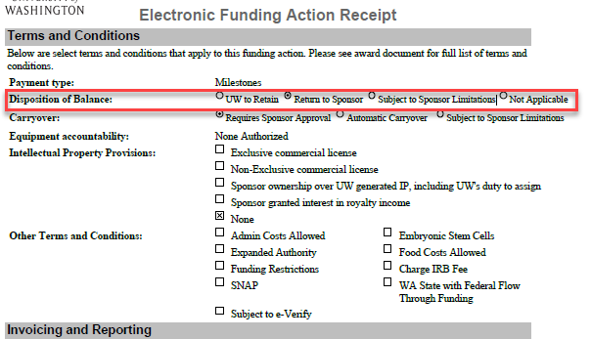
Can we keep it, continued…
FA notification should also provide guidance under Disposition of Balance

Slide 49
Can we keep it, continued…
If your award does NOT contain similar language and is NOT a clinical trial or capitation budget, the balance will almost certainly be returned to the sponsor
In some cases a sponsor tells us we can retain the balance when we contact them about a refund being due—but don’t count on it!
The remaining balance must be at least $25
If the remaining balance is >25% of the cash received, the department must provide justification for the excess balance

Slide 50
I’m sure we can keep this balance. Where does it go?
To a fixed price surplus budget (FPS), identifiable as type/class 05/34 — no exceptions!
GCA will check your org code at the 4th or 5th level for existing FPS budgets
If the balance is between $25 and $1000, we will transfer the balance to the FPS budget with the closest F&A rate
If the balance is over $1000, we will transfer the balance to the FPS budget with the nearest F&A rate, if that rate is within 10% of the award’s

Slide 51
Where does the surplus go, continued
If your org code has no FPS budget in place, or none with an F&A rate within 10% of the award’s for a balance >$1000, you must request a new FPS budget
The FPS request form is available for download here: https://finance.uw.edu/gca/sites/default/files/Fixed%20price%20surplus%20form%20_FINAL.xlsx
The surplus balance will be transferred to the FPS budget once the award budget is closed to status 4

Slide 52
Important Note!
Fixed price surplus budgets are set up under a unit's Dean, Director, or Chair rather than an individual PI
It is the expectation that these funds are for the benefit of the University, rather than an individual PI
The Dean/Director/Chair has the authority to direct the use of the funds at the request of an individual PI

Slide 53
Resource!
GCA FPS page: https://finance.uw.edu/gca/award-lifecycle/budget-setup/surplus

Slide 54
Questions?

Slide 55
End of Award: Non-Traditional Endings Early Terminations & Relinquishments (PI Transfer)
Cheryl Haycox

Slide 56
Definition for Early Termination and Relinquishment
Early Termination
Early termination is shortening the life of the project prior to completion
Relinquishments and Award Transfers
Relinquishments and award transfers are typically when the PI transfers to a new institution and will continue the project at that institution

Slide 57
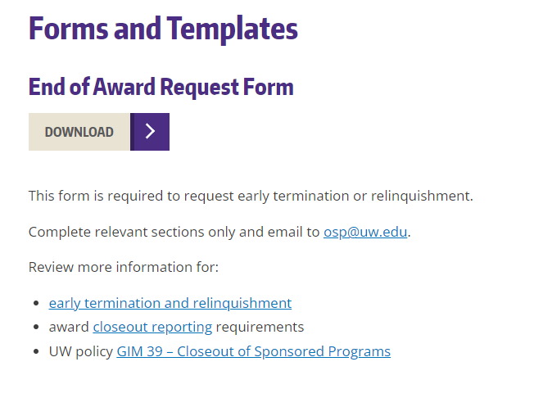
OSP has an intake form to help gather the appropriate information to ensure a smooth ending to awards:
Forms and Templates located under RESOURCE Tab:
Search End of Award Request Form
https://www.washington.edu/research/forms-and-templates/page/2/

Slide 58
Early Termination
Shortens the life of the project prior to completion
Some reasons might include:
Sponsor and/or Principal Investigator (PI) decide to end project earlier than planned
PI is unable to complete the project
Programmatic or financial reasons to end a project earlier than planned
Receipt of a competing renewal that overlaps a previous competing segment
Early terminations may also involve a de-obligation or revision to the award amount

Slide 59
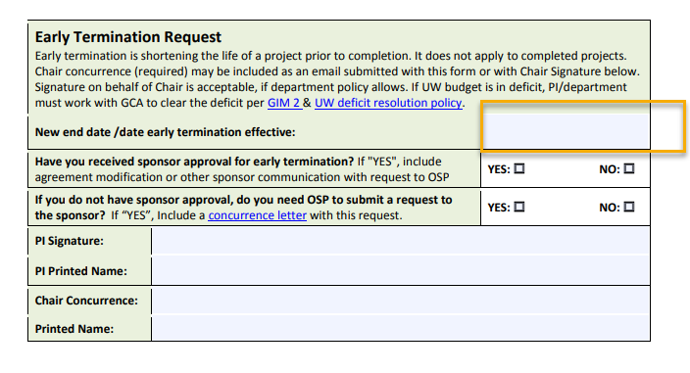
Form: The project is terminating early

Slide 60
Relinquishment/Transfer
Relinquishment and award transfers mean returning funds back to the sponsor and giving up the UW’s right to the funding
If another entity will be taking over the award, the sponsor re-issues the award as a NEW award to that entity
It is not a transfer directly from the UW to the new entity
Even if the end date is shortened, closeout requirements still apply per the terms and conditions of the award. Make sure to get all closeout documentation from the PI before they leave the UW!

Slide 61
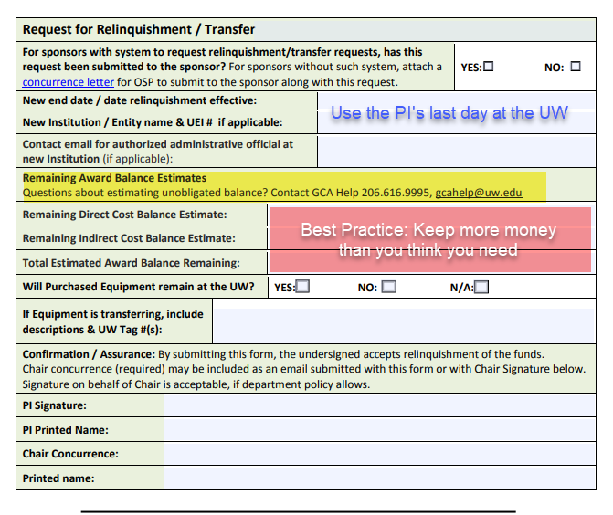
Form: Relinquishment/Transfer

Slide 62
Different process for NIH!
NIH
Department estimates how much we need to cover expenses through the PI’s last day
NIH will send an amendment to the UW after the new institution successfully completes the application. The amendment changes the end date and reduces the UW amount (based on the estimate)
The process can take many months
GCA can’t submit the final report until the window is opened in eRA Commons
New institution is awarded based on the amount entered on the relinquishment form
New institution will receive a supplement for any residual amount
If you over-relinquish (send too much back) you have to complete the entire process again, which will take months to get the funds back
Everyone Else
Will send an amendment changing the end date to the PI’s last day
GCA uses the new end date to reset the due date for final invoices and/reports as necessary
If there’s a cash balance, a refund is sent to the sponsor at closeout (occasionally, the sponsor will ask GCA to send $$ to the new institution)
Process is completed within 90 days typically

Slide 63
Other non-traditional endings

Slide 64
Fixed Price Award-remaining balance is over 25%
These can go through GCA!
Use Grant Tracker to provide:
Confirmation that the project was completed
A brief statement about why the unspent balance was so high
Which surplus budget GCA should use to transfer the surplus balance
Note: the IDC rate should match, or be within 10% of the award’s IDC rate

Slide 65
Deobligation
These used to require a form
Just need the sponsor to send an amended award agreement to OSP
OSP will send a Post Award Change (PAC) to GCA to reduce the award amount in the system

Slide 66
Questions?

Slide 67
Future Forum
August 2022
via
Zoom
https://finance.uw.edu/gca/
training-outreach/gca-forum
Survey about today’s forum will be sent out soon!

Slide 68
Contact Us
Grant Tracker: https://www.washington.edu/research/gca/budget/granttracker.html
Email: gcahelp@uw.edu
GCA Help Hotline: 206-616-9995 (9-12pm, 1-4pm)

