Slide 1
CORE Updates
Winter 2024 schedule published
Process change: Zoom link for webinar now included in enrollment confirmation email and all reminders
Enrollment open until day of class
CORE Home
CORE Registration

Slide 2
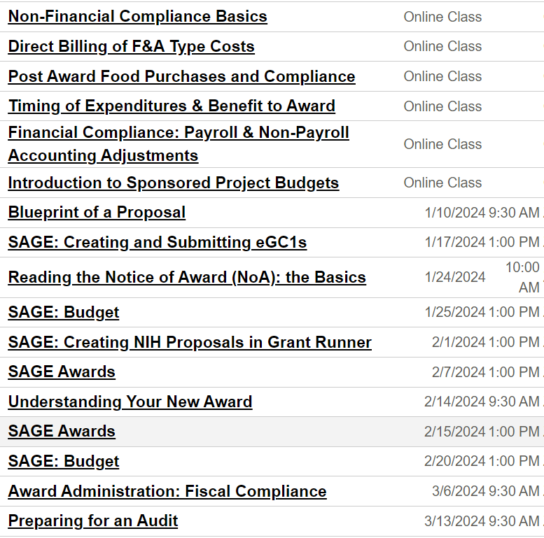
CORE
Courses
Jan-Mar 2024:
CORE Home
CORE Registration

