Slide 1
COMPLIANCE HOT TOPIC: IBS, EFFORT, AND SALARY CAP
MRAM
December 2023
Matt Gardner
Post Award Fiscal Compliance

Slide 2
Institutional Base Salary (“IBS”)
Under the Uniform Guidance…
“IBS is defined as the annual compensation paid by an IHE for an individual's appointment, whether that individual's time is spent on research, instruction, administration, or other activities.”
“Charges of a faculty member's salary to a Federal award must not exceed the proportionate share of the IBS for the period during which the faculty member worked on the award.”
2 CFR 200.430(h)(2)
MRAM – Matt Gardner – PAFC

Slide 3
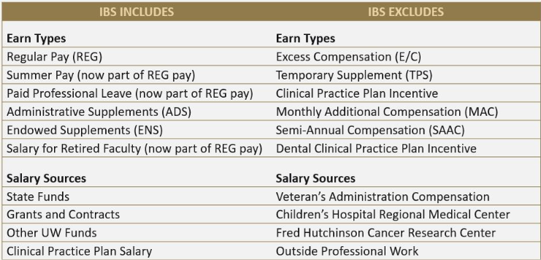
IBS at the UW
MRAM – Matt Gardner – PAFC

Slide 4
Effort Reporting & IBS
Effort Reports (and FECs) display effort based on IBS, not just REG pay
When faculty propose a level of effort on a sponsored award, that level is based on the IBS (GIM 35)
If a faculty has an Administrative Supplement (“ADS”) or Endowed Supplement (“ENS”), those are both included in the IBS
Salary Cap compliance is calculated on the full IBS, not just REG pay
MRAM – Matt Gardner – PAFC

Slide 5
Example #1
Faculty A’s monthly IBS:
REG 80%
ADS 20%
Faculty A proposes the following levels of effort on Awards where the salary cap applies:
Grant A: 25%
Grant B: 15%
Grant C: 10%
Total Sponsored Award proposed effort: 50%
Effort Statement will display effort based on IBS (REG and ADS), not just REG pay
In this scenario, a payroll allocation of 20% of REG pay to Grant A will NOT result in 20% effort to Grant A on the Effort Statement
MRAM – Matt Gardner – PAFC

Slide 6
Salary Cap Calculator
Calculator is needed for individuals with Clinical pay and/or an ADS/ENS
Calculator determines the adjustment needed to the payroll costing allocation in Workday, taking into account the ADS, to arrive at the proposed level of effort
Assumption is that an ADS/ENS is not being used to cover effort on a sponsored award
https://finance.uw.edu/pafc/calculatorstools
Calculator is not needed for individuals that only have REG pay.
MRAM – Matt Gardner – PAFC

Slide 7
Example #2 – Where things can become challenging…
Faculty A’s monthly IBS:
REG 80%
ADS 20%
Faculty A proposes the following levels of effort on Awards where salary cap applies:
Grant A: 25%
Grant B: 40%
Grant C: 30%
Total Sponsored Award proposed effort: 95%
MRAM – Matt Gardner – PAFC

Slide 8
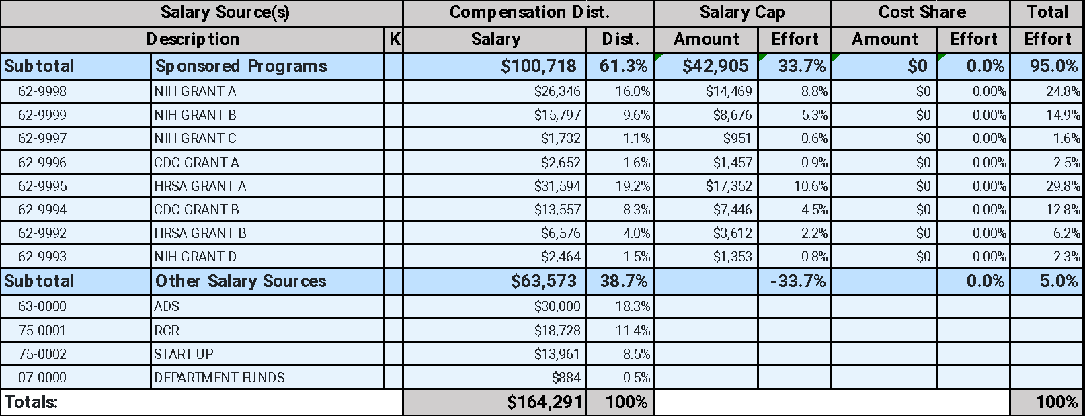
In the old effort system…
MRAM – Matt Gardner – PAFC

Slide 9
In Workday…
Salary Cap coverage must be tied to specific funding sources
Workday calculates the cap on the full IBS, not just REG pay
When a faculty has a high percentage of effort on sponsored awards which require salary cap coverage, and a large ADS, the calculator will break
MRAM – Matt Gardner – PAFC

Slide 10
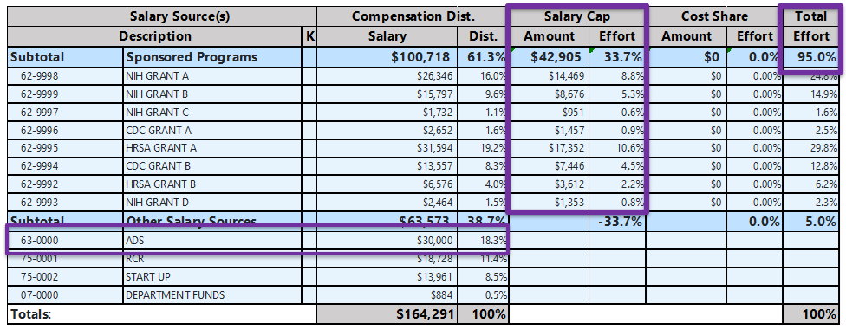
What you can’t do in Workday…
The Pre-Workday/FEC process whereby the ADS can exclusively cover over-the-cap portion isn’t possible.
There are a couple of options to handle these situations…
MRAM – Matt Gardner – PAFC

Slide 11
Salary Cap and ADS – Option #1
If the ADS is NOT to be used towards any sponsored award effort, then the faculty must reduce the amount of effort devoted to sponsored awards
Example: If Faculty A’s IBS is 80% REG and 20% ADS, and the ADS is not to be used towards any sponsored award effort, then… The maximum amount of IBS that may be committed to sponsored award is 80%
MRAM – Matt Gardner – PAFC

Slide 12
Salary Cap and ADS – Option #2
Charge the ADS to sponsored awards in proportion to the proposed effort on the award*
Faculty A’s monthly IBS:
REG 80%
ADS 20%
Faculty A proposes the following levels of effort on Awards where salary cap applies:
Grant A: 25%
Grant B: 40%
Grant C: 30%
Total Sponsored Award proposed effort: 95%
*Because an ADS/ENS is part of the UW’s Institutional Base Salary, it is permissible to charge the pay to sponsored award in proportion to the devoted effort
MRAM – Matt Gardner – PAFC

Slide 13
Salary Cap and ADS – Option #2
REG Payroll Allocation:
Grant A: 25%
Grant B: 40%
Grant C: 30%
ADS allocation:
Grant A: 25%
Grant B: 40%
Grant C: 30%
Workday will perform the Salary Cap calculation on the REG and ADS pay
MRAM – Matt Gardner – PAFC

Slide 14
Other Salary Cap Topics
There are Workday issues with Salary Cap relating to:
Hourly Employees and/or Retro Pay
Use of Salary Cap Fund
Jesse Rice reached out to Grant Managers with affected grants back in November with information on how to fix these issues in Workday.
MRAM – Matt Gardner – PAFC

Slide 15
Resources
PAFC Effort Team website:
https://finance.uw.edu/pafc/resources-salary-cap-issues-workday
Copies of slides decks and Zoom recordings as to how to fix these issues in Workday
There will also be an exception report published in the near future in order to track when these instances occur.
MRAM – Matt Gardner – PAFC

Slide 16
ECC Updates
ECC is live and the “Pre-Review” period for Project Statements is now open.
The certification period for Project Statements will being on 12/19/2023 with a due date of 2/21/2024.
The “Pre-Review” period does not have a hard end date. Once a statement is pre-reviewed it will move to the “Ready for Certification” status in ECC the following day.
PIs will get a notification when the Statement is “Ready for Certification” either on 12/19/23 or the day after the Pre-Review is completed
Notification will include a link to “How to Certify” resources
The earliest a statement can be “Ready for Certification” is 12/19/2023.
MRAM – Matt Gardner – PAFC

Slide 17
Manual FEC Process - Update
The PAFC Effort Team is working through the backlog of FECs which require manual certifications
The process is taking longer than expected and will likely stretch into the first quarter of 2024
MRAM – Matt Gardner – PAFC

Slide 18
Questions
Post Award Fiscal Compliance (PAFC)
gcafco@uw.edu (General compliance questions)
effortreporting@uw.edu (Effort or ECC-related questions)
https://finance.uw.edu/pafc/
Matt Gardner
mgard4@uw.edu
206-543-2610
MRAM – Matt Gardner – PAFC

