Slide 1
MRAM | Monthly Research Administration Meeting
December 14, 2023, 9:00 AM – 10:00 AM Join Webinar: https://washington.zoom.us/j/346891888 Click “CC” to Show Captions in your Zoom Controls
TOPIC | PRESENTER | EMAIL | MIN
Welcome | Kirsten DeFries Research Compliance & Operations | kirsten5@uw.edu | 2
PAFC Hot Topic: Salary Over the Cap | Matt Gardner Post Award Fiscal Compliance | gcafco@uw.edu | 15
Outgoing Staff Assignments - Process Changes | Amanda Snyder & Lynn Magill Office of Sponsored Programs, Procurement Services | acs229@uw.edu | 5
Changing Grant Worktags on Purchase Orders | Lynn Magill Procurement Services | pcshelp@uw.edu | 10
GCA Update | Vince Gonzalez Grant & Contract Accounting | vinceg@uw.edu | 10
SAGE Search Tips & Upcoming Release | Judy Chung & Mia Alberro Office of Research Information Services | sagehelp@uw.edu | 10
CORE Update | Laurie Stephan Collaborative On Research Education (CORE) | corehelp@uw.edu | 2
NEXT MEETING January 11, 2024 9:00 AM - 10:00 AM Questions about MRAM? email mramques@uw.edu

Slide 2
COMPLIANCE HOT TOPIC: IBS, EFFORT, AND SALARY CAP
MRAM
December 2023
Matt Gardner
Post Award Fiscal Compliance

Slide 3
Institutional Base Salary (“IBS”)
Under the Uniform Guidance…
“IBS is defined as the annual compensation paid by an IHE for an individual's appointment, whether that individual's time is spent on research, instruction, administration, or other activities.”
“Charges of a faculty member's salary to a Federal award must not exceed the proportionate share of the IBS for the period during which the faculty member worked on the award.”
2 CFR 200.430(h)(2)
MRAM – Matt Gardner – PAFC

Slide 4
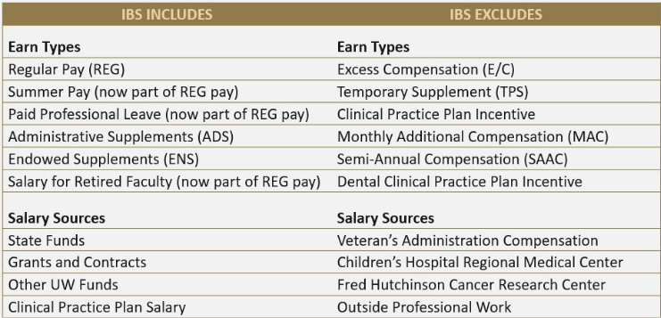
IBS at the UW
MRAM – Matt Gardner – PAFC

Slide 5
Effort Reporting & IBS
Effort Reports (and FECs) display effort based on IBS, not just REG pay
When faculty propose a level of effort on a sponsored award, that level is based on the IBS (GIM 35)
If a faculty has an Administrative Supplement (“ADS”) or Endowed Supplement (“ENS”), those are both included in the IBS
Salary Cap compliance is calculated on the full IBS, not just REG pay
MRAM – Matt Gardner – PAFC

Slide 6
Example #1
Faculty A’s monthly IBS:
REG 80%
ADS 20%
Faculty A proposes the following levels of effort on Awards where the salary cap applies:
Grant A: 25%
Grant B: 15%
Grant C: 10%
Total Sponsored Award proposed effort: 50%
Effort Statement will display effort based on IBS (REG and ADS), not just REG pay
In this scenario, a payroll allocation of 20% of REG pay to Grant A will NOT result in 20% effort to Grant A on the Effort Statement
MRAM – Matt Gardner – PAFC

Slide 7
Salary Cap Calculator
Calculator is needed for individuals with Clinical pay and/or an ADS/ENS
Calculator determines the adjustment needed to the payroll costing allocation in Workday, taking into account the ADS, to arrive at the proposed level of effort
Assumption is that an ADS/ENS is not being used to cover effort on a sponsored award
https://finance.uw.edu/pafc/calculatorstools
Calculator is not needed for individuals that only have REG pay.
MRAM – Matt Gardner – PAFC

Slide 8
Example #2 – Where things can become challenging…
Faculty A’s monthly IBS:
REG 80%
ADS 20%
Faculty A proposes the following levels of effort on Awards where salary cap applies:
Grant A: 25%
Grant B: 40%
Grant C: 30%
Total Sponsored Award proposed effort: 95%
MRAM – Matt Gardner – PAFC

Slide 9
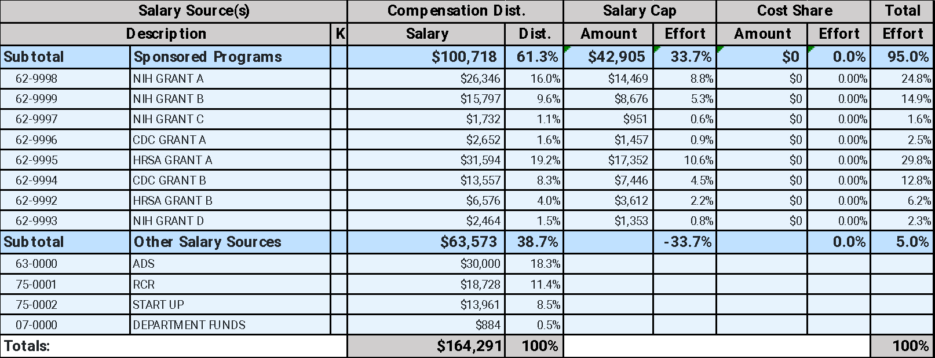
In the old effort system…
MRAM – Matt Gardner – PAFC

Slide 10
In Workday…
Salary Cap coverage must be tied to specific funding sources
Workday calculates the cap on the full IBS, not just REG pay
When a faculty has a high percentage of effort on sponsored awards which require salary cap coverage, and a large ADS, the calculator will break
MRAM – Matt Gardner – PAFC

Slide 11
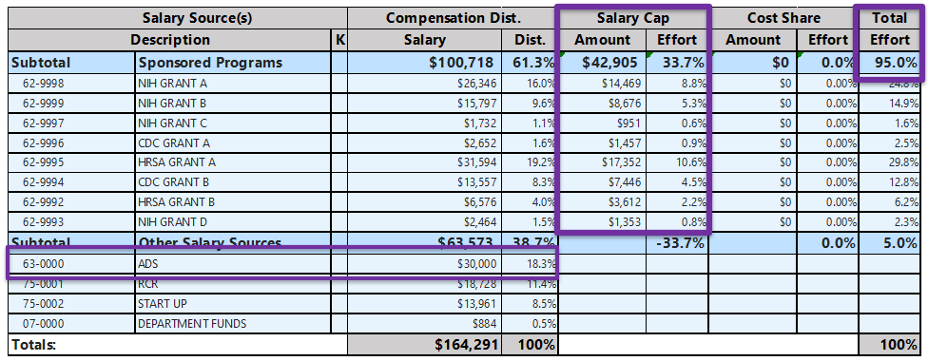
What you can’t do in Workday…
The Pre-Workday/FEC process whereby the ADS can exclusively cover over-the-cap portion isn’t possible.
There are a couple of options to handle these situations…
MRAM – Matt Gardner – PAFC

Slide 12
Salary Cap and ADS – Option #1
If the ADS is NOT to be used towards any sponsored award effort, then the faculty must reduce the amount of effort devoted to sponsored awards
Example: If Faculty A’s IBS is 80% REG and 20% ADS, and the ADS is not to be used towards any sponsored award effort, then… The maximum amount of IBS that may be committed to sponsored award is 80%
MRAM – Matt Gardner – PAFC

Slide 13
Salary Cap and ADS – Option #2
Charge the ADS to sponsored awards in proportion to the proposed effort on the award*
Faculty A’s monthly IBS:
REG 80%
ADS 20%
Faculty A proposes the following levels of effort on Awards where salary cap applies:
Grant A: 25%
Grant B: 40%
Grant C: 30%
Total Sponsored Award proposed effort: 95%
*Because an ADS/ENS is part of the UW’s Institutional Base Salary, it is permissible to charge the pay to sponsored award in proportion to the devoted effort
MRAM – Matt Gardner – PAFC

Slide 14
Salary Cap and ADS – Option #2
REG Payroll Allocation:
Grant A: 25%
Grant B: 40%
Grant C: 30%
ADS allocation:
Grant A: 25%
Grant B: 40%
Grant C: 30%
Workday will perform the Salary Cap calculation on the REG and ADS pay
MRAM – Matt Gardner – PAFC

Slide 15
Other Salary Cap Topics
There are Workday issues with Salary Cap relating to:
Hourly Employees and/or Retro Pay
Use of Salary Cap Fund
Jesse Rice reached out to Grant Managers with affected grants back in November with information on how to fix these issues in Workday.
MRAM – Matt Gardner – PAFC

Slide 16
Resources
PAFC Effort Team website:
https://finance.uw.edu/pafc/resources-salary-cap-issues-workday
Copies of slides decks and Zoom recordings as to how to fix these issues in Workday
There will also be an exception report published in the near future in order to track when these instances occur.
MRAM – Matt Gardner – PAFC

Slide 17
ECC Updates
ECC is live and the “Pre-Review” period for Project Statements is now open.
The certification period for Project Statements will being on 12/19/2023 with a due date of 2/21/2024.
The “Pre-Review” period does not have a hard end date. Once a statement is pre-reviewed it will move to the “Ready for Certification” status in ECC the following day.
PIs will get a notification when the Statement is “Ready for Certification” either on 12/19/23 or the day after the Pre-Review is completed
Notification will include a link to “How to Certify” resources
The earliest a statement can be “Ready for Certification” is 12/19/2023.
MRAM – Matt Gardner – PAFC

Slide 18
Manual FEC Process - Update
The PAFC Effort Team is working through the backlog of FECs which require manual certifications
The process is taking longer than expected and will likely stretch into the first quarter of 2024
MRAM – Matt Gardner – PAFC

Slide 19
Questions
Post Award Fiscal Compliance (PAFC)
gcafco@uw.edu (General compliance questions)
effortreporting@uw.edu (Effort or ECC-related questions)
https://finance.uw.edu/pafc/
Matt Gardner
mgard4@uw.edu
206-543-2610
MRAM – Matt Gardner – PAFC

Slide 20
Outgoing Staff Assignment
Process Change
December 2023 MRAM
Amanda Snyder & Lynn Magill
Office of Sponsored Programs & Procurement Services

Slide 21
Staff Assignments
Staff assignments provide a way to compensate salary, benefits, and related personnel expenses (e.g. tuition) for UW personnel working at another institution.
This is not a subaward.

Slide 22
Requesting Outgoing Staff Assignments
Outgoing staff assignment set up is requested through Procurement Services by submitting a Workday Requisition to Procurement (which will then become a Purchase Order after approvals).
Important: if you need a specific contract agreement between the UW and the other entity, please be sure to note that on the Requisition, and Procurement will assist and sign.

Slide 23
Incoming Staff Assignments
No changes to current processes.
Set up for Incoming Staff Assignments (to the UW from other institutions) are requested via an eGC1 in SAGE.
Review guidance on:
Non-Federal Affiliated & Collaborating Institutions

Slide 24
Questions

Slide 25
Changing Grant Worktags on Purchase Orders
MRAM
December 2023
Lynn Magill
Procurement Services

Slide 26
GCA UPDATE
Vince Gonzalez
Associate Director, Grant & Contract Accounting
December 14, 2023 MRAM

Slide 27
TOPICS
Backlog Update
Status Update by Process
Known Issues Updates
Tips for Success

Slide 28
STATUS UPDATE: BACKLOGS
As of Monday, December 11:
Award Setup: 1,636 unprocessed items
Reporting: 512 backlog reports
Closing: 3,738 backlog closings
Customer Service: 5 day response time
All backlog volumes are updated weekly on GCA Homepage

Slide 29
STATUS UPDATE: BY PROCESS
Award Setup
Advance extension temporary process ended
Advance requests are current
New Workday Award Line Lifecycle statuses webpage
Invoicing
Change to Month-End Close allows interim invoices to be sent on time (Month-End Close calendar with dates)
Creating invoices is subject to a schedule-please give GCA as much notice as possible for urgent requests
All requested invoice templates have been added to Workday
Work ongoing to correct incorrect posting of pre-WDF go-live expenses to the unallocated category
Notes:
Speaker notes for Invoicing:
The invoicing integration schedule is available on GCA’s Invoicing Sponsors webpage.
More invoice templates added to WD means more automation.

Slide 30
STATUS UPDATE: BY PROCESS
Reporting
Working with UW DATAGroup and Deloitte to automate financial reports
Highest population is SF425 for federal awards and UW standard report format (UWROE) for non-federal awards
Closing
X-functional Closing Working Group started this month
Closing actions (e.g. deobligations, deficits, residual balance transfers) will resume next quarter
Notes:
Speaker note for Closing: provide an explanation to campus when you're talking about Closing about what this actually refers to. Campus is thinking that we're not doing closeout actions (final invoices, reports) so we need to be more careful what we mean when we say closeout. This is a good opportunity for us to explain. (from Juan’s comment)

Slide 31
KNOWN ISSUES UPDATES
Program income job aids are published on our Program Income Guidelines webpage under “Resources”
Some “tuition” is appearing as “scholarships” in Workday
Notes:
Speaker note about Tuition posting as scholarships. We are working with subject matter experts on the topic to ensure correct categorization as well as ensure necessary updates are made in Workday.

Slide 32
TIPS FOR SUCCESS: EXPENSES
Process expense transfers timely
More questionable to auditors the longer they go on
Can jeopardize sponsor reimbursement
Review your expenses’ budget dates
Job aid available on UW Connect to edit budget dates
Work with Shared Environment to edit budget dates. GCA no longer has the ability.
Notes:
Speaker Note: Questions about budget dates can be directed to your Shared Environment.

Slide 33
TIPS FOR SUCCESS: SAGE
Check SAGE to see if your advance request has been processed
See How do I know if my advance request is processed? FAQ for step-by-step instructions
Read an item’s Comments & History section for information about returns and holds before reaching out to OSP or GCA
Include SAGE Budget Snapshot URL for Funding & budgeting change MODs
Notes:
Speaker note about advances: We received feedback in the GCA Fall Forum about prioritizing advance requests so we encourage departments to check SAGE to see if their request is processed.

Slide 34
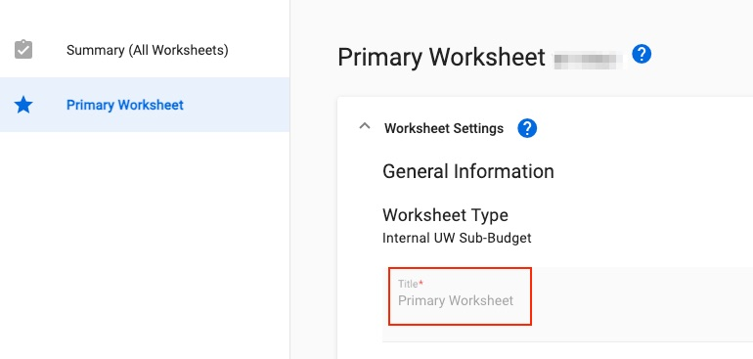
TIPS FOR SUCCESS: SAGE
Change the name your SAGE Budget Worksheet from “Primary Worksheet” to have a meaningful WD Grant Name
Update worksheet title in SAGE Budget and send GCA Only MOD to change WD Grant Name
Notes:
Speaker note: GCA uses worksheet title for grant name in most cases (exception: subaward). GCA can’t follow up with campus unit to get a different worksheet title (feedback from GCA Fall Forum).

Slide 35
QUESTIONS
Questions about using SAGE: sagehelp@uw.edu
Other questions can be sent to: gcahelp@uw.edu

Slide 36
SAGE SEARCH TIPS &
UPCOMING RELEASE
Judy Chung & Mia Alberro
Office of Research Information Services (ORIS)
December 14, 2023

Slide 37
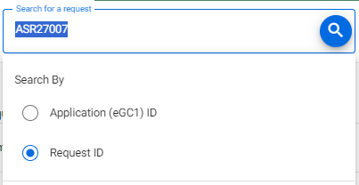
Award Search Tips
Search returns direct matches only.
Include prefixes (ASR, MOD, ADV, A)!
Remove trailing or leading spaces from copy/pasting
Search by Application ID (eGC1) will search for the eGC1 listed on the request.
Most MODs will not have an eGC1, so search by RequestID instead

Slide 38
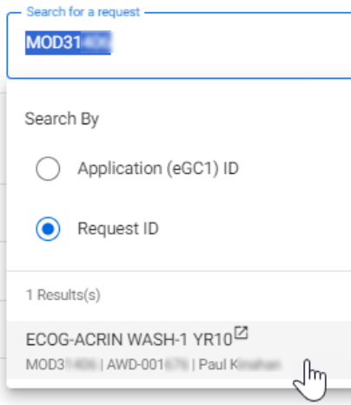
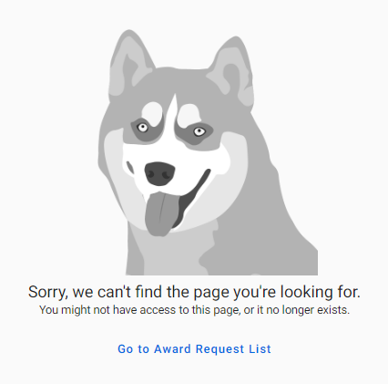
How Permissions Impact Search
Search will show all results regardless of permissions.
If you do not have permissions to access a request, attempting to open it will result in an error.
Error displayed if no permissions to view item
Notes:
Will fine tune the error msg for more clarity in a future release

Slide 39
What’s Next | Award Requests List
Release Date: December 20, 2023
Award Request List: More Data Available!
Short title, eGC1 ID for MODs, Cost Center, PI, Workday Award ID, Sponsor Name, Prime/Originating Sponsor Name

Slide 40
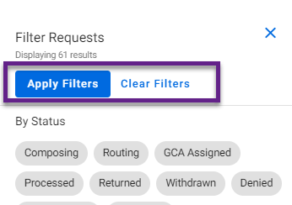
What’s Next | Filtering
New “Apply Filters” Button: Improves SAGE performance!
Select 1 or more filters
Click “Apply Filters” button
Click “Clear Filters” as needed

Slide 41
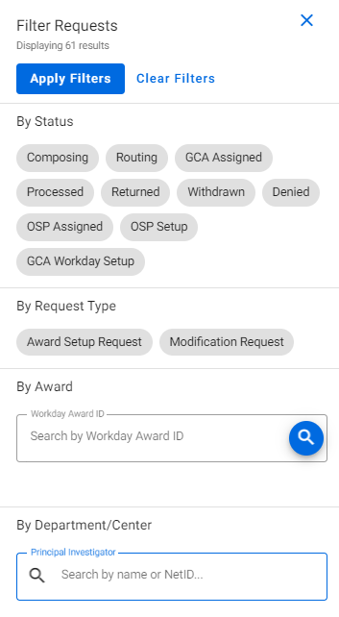
What’s Next | New Filters
New Filters Coming!
By Workday Award ID
By Principal Investigator
Tips
Use full Workday format for searching by award: AWD-005841
Helpful for seeing if OSP has already started an ASR or MOD
Open item in a new tab to retain prior filter (right-click)
Notes:
When OSP initiates an item, it will be in OSP Setup status. Once they return it to campus for completion, it will be in Composing status.

Slide 42
What’s Next | Budget Export &
Performance Improvements
Budget Export Updates (for MOD use)
The following data will be visible on worksheet exports:
Cost Center
Security Grant Hierarchy
Worksheet PI
Additional Performance Improvements
Quicker Award Search & Filters performance
Protects overall system stability

Slide 43
SAGE Notification Survey
We want your feedback!
Goal: Improve SAGE system notifications for award-related activity
Audience: SAGE users who set up or monitor ASRs and/or MODs
How to Participate
Use Microsoft Forms: SAGE Notifications
Open today, 12/14, through Wednesday, 12/20
The survey will take 10-15 minutes to complete

Slide 44
SAGE Resources
Award Setup & Modification Requests
Tips for Success for ASRs & Mods
Virtual Instructor-Led Classes
SAGE Awards
Wednesday, 2/7, 1 - 3 p.m.
Thursday, 2/15, 1 - 3 p.m.
SAGE Budget
Thursday, 1/25, 1 - 3
Office Hours
Today, December 14, 1-2 p.m.
Notes:
SAGE Office Hours will continue through at least the first quarter of 2024.

Slide 45
Questions?

Slide 46
CORE Updates
Winter 2024 schedule published
Process change: Zoom link for webinar now included in enrollment confirmation email and all reminders
Enrollment open until day of class
CORE Home
CORE Registration

Slide 47
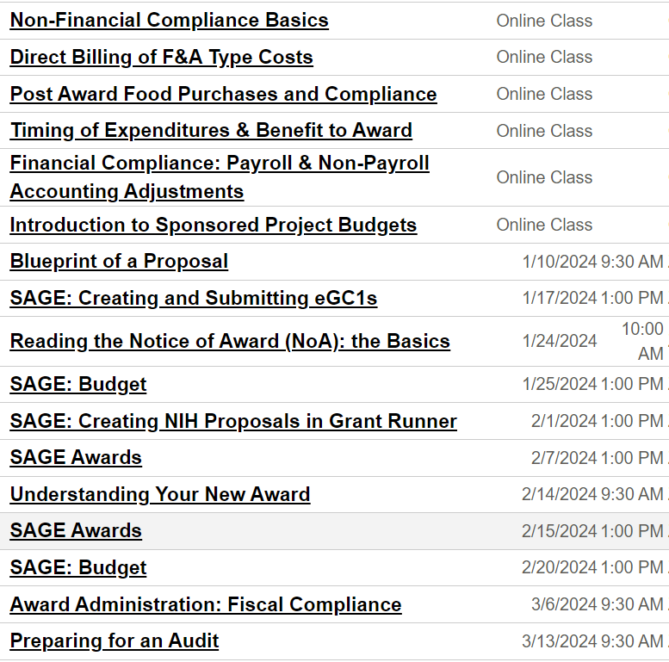
CORE
Courses
Jan-Mar 2024:
CORE Home
CORE Registration

