Slide 1
ORCID OVERVIEW
October 12, 2023
Aron Knapp & Kim Halstead
Office of Research Information Services

Slide 2
WHAT IS ORCID?
ORCID: Open Researcher and Contributor iD
An ORCID iD is a unique digital identifier that helps link researchers to their grants, publications, and other research-related work, through time.
ORCID profile data helps research institutions, funders, publishers, and other organizations better track and support research work.

Slide 3
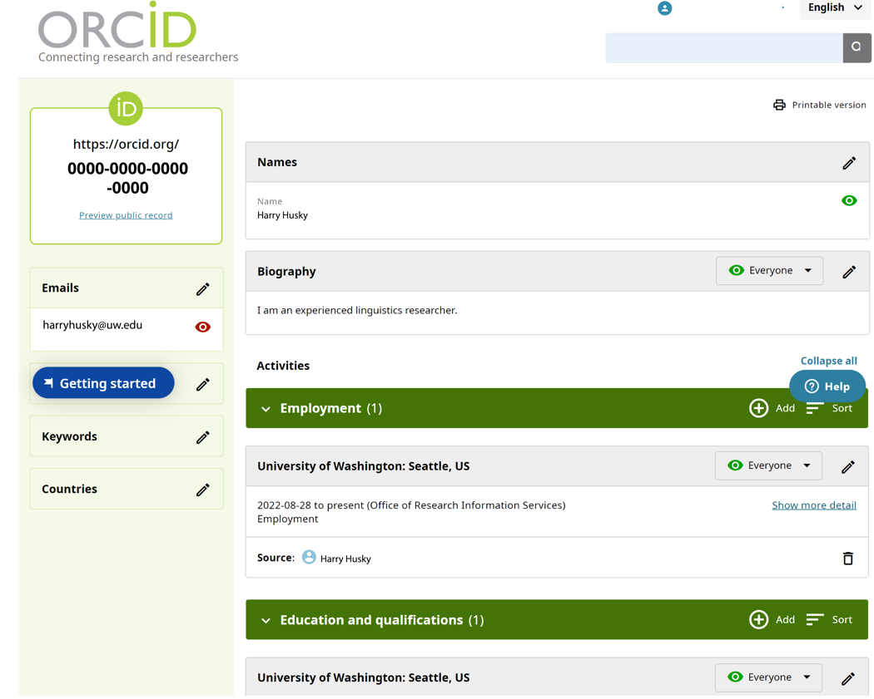
WHAT IS ORCID?

Slide 4
WHAT ARE THE BENEFITS OF ORCID?
Reduces Administration Time: ORCID profile data can be re-used for a number of reporting requirements:
Enables auto-population of biosketches and other documents required by some agencies (e.g., NIH and NSF)
Increasingly, publications, sponsors, and institutions such as the NIH are requiring ORCID iDs for certain applications
Ensure Compliance: Sponsors and publishers are increasingly requiring ORCID iDs.
Consistency: Researchers can use the same iD throughout their career, bringing record of their contributions with them.
Easier Publication Maintenance: The iD can link to all their research publications and other research-related material in a single place.
Enables Integrations: The ORCID API enables integrations with funders, publishers, repositories, UW’s SAGE and MyResearch applications, faculty profiles, and more.
Notes:
Consistency: Their unique iD persists throughout researchers’ lives, through name changes, institution changes, or if you change field of study. - The summary of publication history is helpful when connecting with publishers and prospective sponsors.

Slide 5
WHAT ARE THE BENEFITS OF ORCID?
ORCID enables the exchange of information between systems, reducing administrative burden.
Grants
Repositories
Researcher Information Systems
Publishers
Society Membership
Other Identifiers

Slide 6
WHAT COMMUNICATION ABOUT ORCID IS PLANNED?
The UW is strongly encouraging adoption of ORCID iDs and consistent profile maintenance.
Thursday, 10/5: Email sent from Mari Ostendorf to all active faculty and non-faculty researchers introducing ORCID and its benefits
Webpage published: ORCID iD Overview
Friday, 10/13: Email will be sent from ORIS to active faculty and non-faculty researchers who do not yet have an ORCID iD encouraging registration

Slide 7
WHAT COMMUNICATION ABOUT ORCID IS PLANNED?
Coming Soon: Email from ORIS to ORCID iD users who need to update their affiliation to the University of Washington
Correct Affiliation
Incorrect Affiliation

Slide 8
WHAT COMMUNICATION ABOUT ORCID IS PLANNED?
Email recipients will be asked to grant the University of Washington permission to update their affiliation.
Clicking allows the UW to update ORCID affiliation

Slide 9
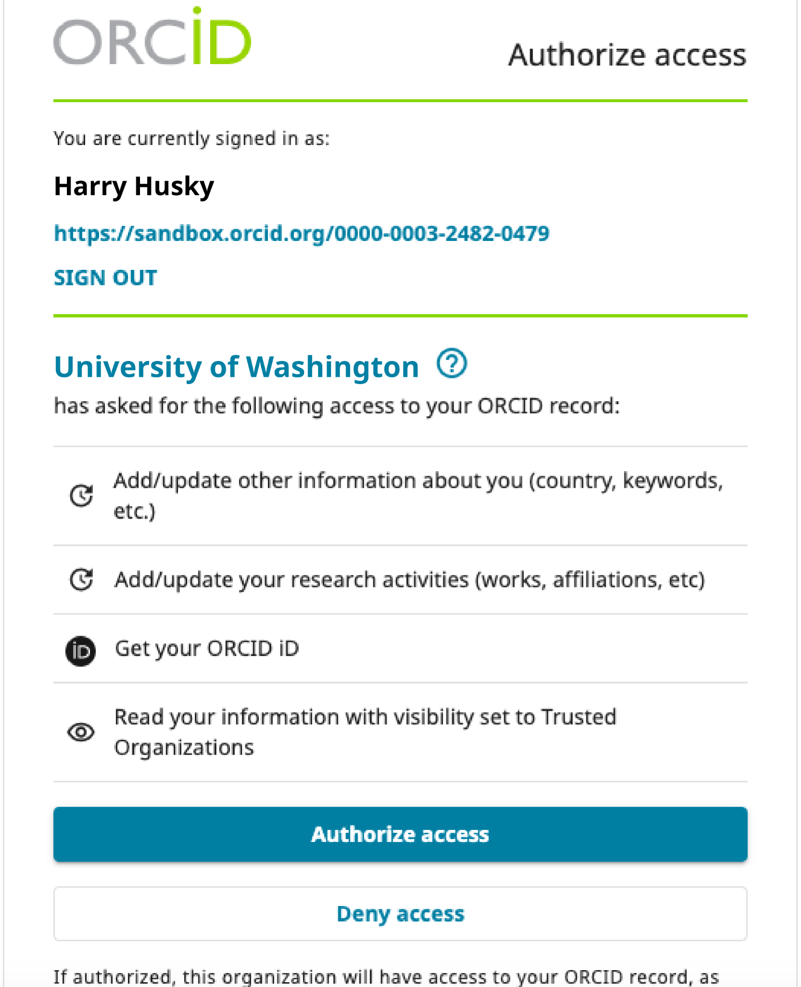
WHAT COMMUNICATION ABOUT ORCID IS PLANNED?
Recipients will be asked to grant permission to the UW to update their ORCID profile affiliation.

