Slide 1
OSP & GCA - Update
July 21, 2023 MRAM
Carol Rhodes, Office of Sponsored Programs
Vince Gonzalez, Grant & Contract Accounting

Slide 2
Prioritizing & Catching Up - OSP
Conversion of over ~700 PACs to SAGE Modifications (MOD)
Setup & processing of your requests may result in:
Denying Award Setup Requests
Returning eGC1s that should be a MOD
Denying MODs sent to incorrect office
Review: When will I need an eGC1 vs. a Modification Request?
Notes:
Carol
Note: Amanda & Josy will be presenting on Subawards after this presentation

Slide 3
Attach Agreement & Related Documents/Correspondence
Attach the award agreement or modification
Include attachments, exhibits, letters, award emails and/or correspondence
Sometimes related emails contain issue date, award #s, POs, additional terms, due dates, sponsor contacts, or conditions needed to process your request
Notes:
Carol-

Slide 4
How can I see what’s going on - ASRs & MODs? Request List Status & Assignments
Status
Assigned
Assignments & Status on request list
Notes:
Carol-

Slide 5
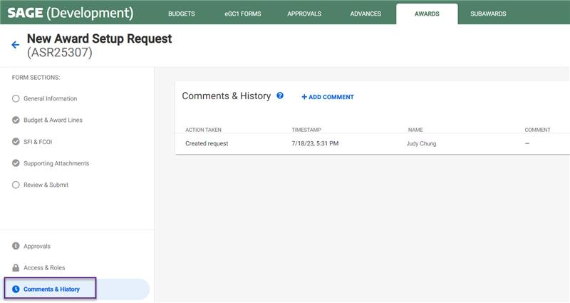
How can I see what’s going on - ASRs & MODs? Comments & History
Detailed history and comments within ASR and MOD
Status viewable on Requests List
Notes:
Carol-

Slide 6
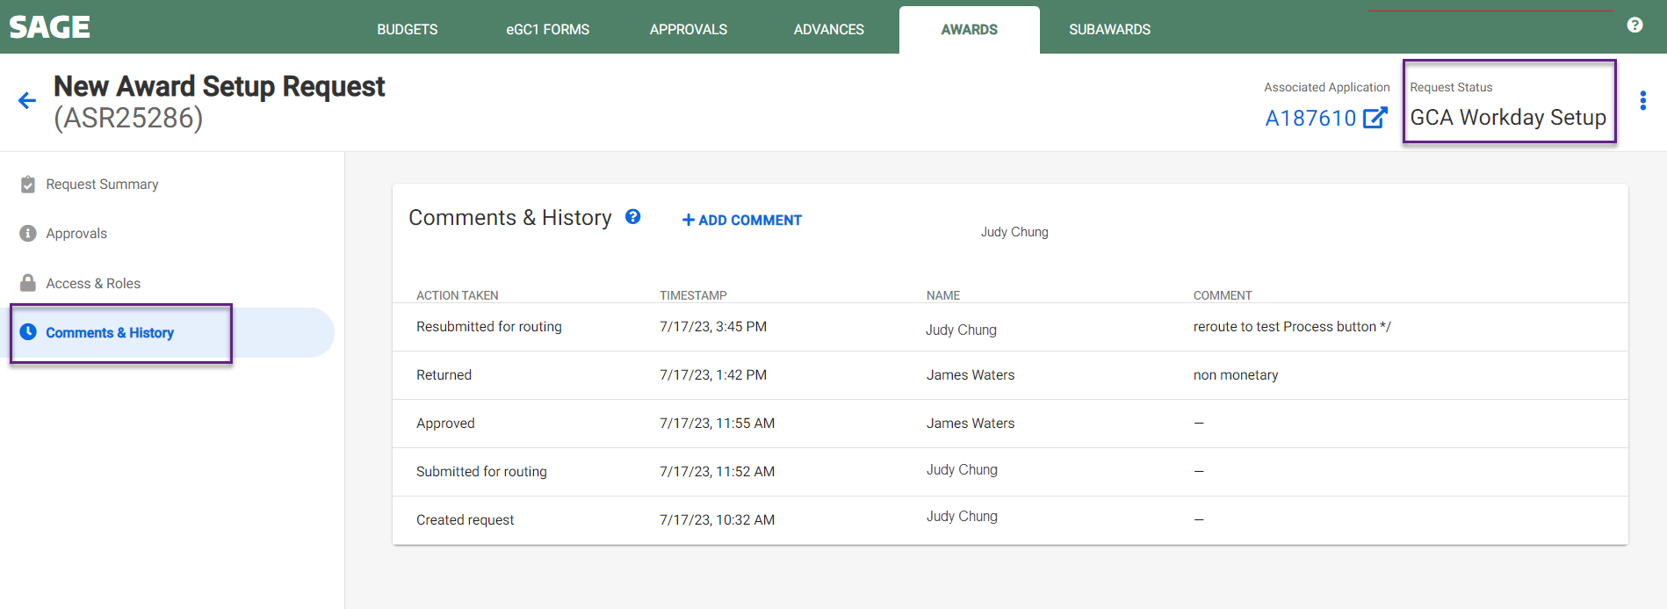
How can I see what’s going on - ASRs & MODs?
Award Request Status List
Detailed history and comments within ASR and MOD
Notes:
Carol-

Slide 7
Workarounds & Requests - GCA
Advances (ADVs) do not include the security hierarchy reference, please add to Comments & History
MODs - If the Grant Worktag (GR) reference is known, please add to the Comments & History
MODs - Please update SAGE Budget worksheet and add the SAGE Budget number to the Comments & History
GCA will return an item if unsure about any of the above to ensure proper setup
Notes:
Vince - Clarify that the SAGE Budget number in the 3rd bullet is not the FAS budget number.

Slide 8
Questions

