Slide 1
NIH SNAP Award Setup:
Current vs Future State
Bonus UWFT MRAM
June 16th, 2023
Vince Gonzalez, Associate Director
Grant & Contract Accounting

Slide 2
NIH SNAP Awards
The National Institutes of Health (NIH) have provisions that modify an award to streamline submission of information. These provisions are referred to as Streamlined Noncompeting Award Process (SNAP).
These SNAP provisions are outlined in an award document in Section III – Standard Terms and Conditions.
Special UWFT MRAM - Vince Gonzalez - Grant & Contract Accounting

Slide 3
SNAP Award Setup - Current State
Upon receipt of the year 1 (or 1st year of the competitive segment) of funding, GCA processes a New Funding Action and setup a budget number with a current period equal to the Project Period (or planned competitive segment).
Future years of funding (years 2 – 5), would be processed as Supplement Funding Actions
Special UWFT MRAM - Vince Gonzalez - Grant & Contract Accounting

Slide 4
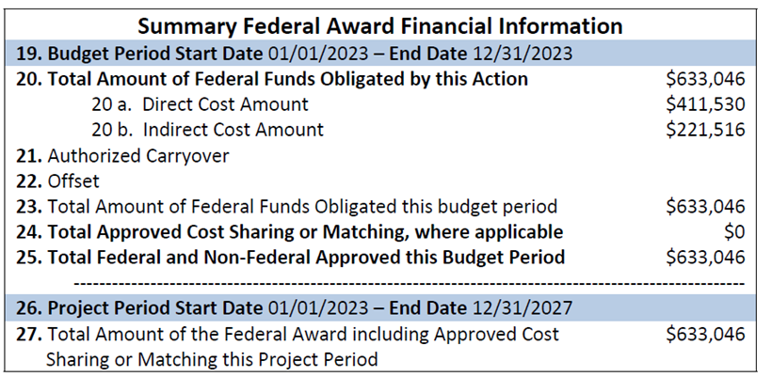
SNAP Setup - Current State (Continued)
GCA Sets Up Budget with Current Period of 1/1/2023 to 12/31/2027
Special UWFT MRAM - Vince Gonzalez - Grant & Contract Accounting

Slide 5
SNAP Award Setup - Future State
Upon receipt of year 1 (or 1st year of the competitive segment) of funding, GCA will process the Award Setup Request (ASR) and setup an Award Line for the period being funded, aka the Budget Period.
Future Periods of funding received (years 2 – 5) would be processed as Supplement & Extension Modifications (MODs).
Special UWFT MRAM - Vince Gonzalez - Grant & Contract Accounting

Slide 6
SNAP Setup - Future State (Continued)
GCA Will Set Up Award Line with dates of 1/1/2023 to 12/31/2023
Special UWFT MRAM - Vince Gonzalez - Grant & Contract Accounting

Slide 7
Impact on Award Management
Departments would need to wait for non-competing continuation years of funding to supplement and extend existing award line(s).
If there are delays in funding for non-competing years, a department may need to request a Temporary Budget Extension MOD to extend the award line and ensure award expenditures can continue to post.
Special UWFT MRAM - Vince Gonzalez - Grant & Contract Accounting

Slide 8
Similar Impact to Other Awards
This setup change will also impact awards setup similar to NIH SNAP, including but not limited to awards from:
National Science Foundation
U.S. Department of Energy
U.S. Department of Education
U.S. Geological Survey
National Oceanic & Atmospheric Administration
Special UWFT MRAM - Vince Gonzalez - Grant & Contract Accounting

Slide 9
Questions?
If you have additional questions, please feel free to reach out to me via email at vinceg@uw.edu
Special UWFT MRAM - Vince Gonzalez - Grant & Contract Accounting

