Slide 1
CORE Updates
Updates to existing overview courses
Grants Management for Investigators
Introduction to Research Administration (3/31)
New courses
Reading the Notice of the Award (NoA)
SAGE Awards
Coming Soon
Workday Reporting for Grant Managers (5/31)
CORE Home
CORE Registration

Slide 2
CORE Updates
Updates to courses coming summer
Setup and Manage Your Award
Processes at Award Closeout
Internal Controls
Updates to courses targeted for end of the year
Understanding Cost Share at the UW
Effort Reporting and Compliance
CORE Home
CORE Registration

Slide 3
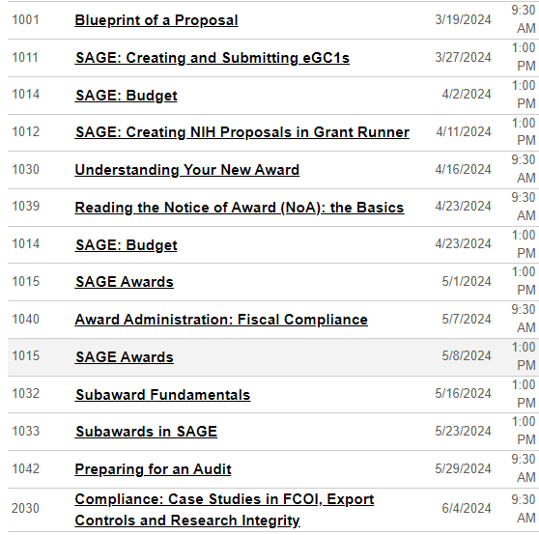
CORE
Instructor Led Courses
Mar-Jun 2024:
CORE Home
CORE Registration

Slide 4
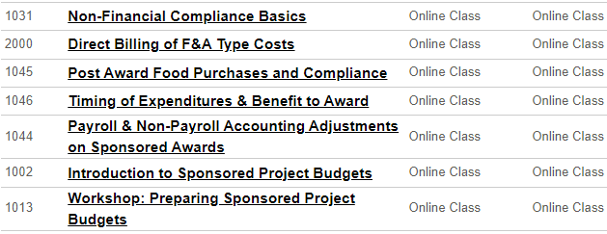
CORE
On-Demand Courses
Information about GMI
CORE Home
CORE Registration

