Slide 1
MRAM | Monthly Research Administration Meeting
March 14, 2024, 9:00 AM – 10:00 AM Join Webinar: https://washington.zoom.us/j/346891888 Click “CC” to Show Captions in your Zoom Controls
TOPIC | PRESENTER | EMAIL | MIN
Welcome | Carol Rhodes Office of Sponsored Programs | carhodes@uw.edu | 2
NIH Grants Policy Statement Update Highlights | Ari Santander & Adelia Yee Office of Sponsored Programs | osp@uw.edu | 15
Reporting Tools Expense & Award Remaining Balance | Mandy Morneault, Dinah Milliken Office of Research, DATAGroup | vicka@uw.edu dynamo@uw.edu | 10
GCA Update | Juan Lepez Grant & Contract Accounting | kabah12@uw.edu | 15
SAGE Update | Judy Chung Office of Research Information Services | jachung@uw.edu | 10
CORE Update | Laurie Stephan Collaborative On Research Education (CORE) | corehelp@uw.edu | 2
NEXT MEETING April 11, 2024 9:00 AM - 10:00 AM Questions about MRAM? email mramques@uw.edu

Slide 2
Federal Update Highlights:
NIH - Grants Policy Statement
updates anticipated March 2024
March 2024 MRAM
Ari Santander, Proposal & Awards Manager
Adelia Yee, Closeout/Central Operations Manager
Office of Sponsored Programs

Slide 3
Grants Policy Statement Update Highlights
NIH Grants Policy Statement (GPS) is updated annually.
These updates integrate all policy and guidance changes issued, e.g. NIH NOTICES, since the last GPS.
Highlighted topics covered in this presentation are changes that have occurred or are anticipated, with varying effective dates.
Corresponding NIH NOT are listed on relevant slides. Anticipated changes are noted.

Slide 4
International Subawards Requirements for Proposals & Awards
Expectations for international subrecipients to include acknowledgement of requirements at proposal stage in letters of support.
International subrecipients to provide access to all lab notebooks, data, and documentation that supports the research outcomes.
This access may be electronic access.
UW’s sample language for letters of support
Effective as of January 2024.
January UW Announcement
NOT-OD-23-182
Notes:
Ari

Slide 5
Common Forms Implementation
January 2025
NIH’s implementation of the common forms for the Biographical Sketch & Current and Pending (Other) Support will be January 2025.
Until then, use the current NIH Biosketch and Other Support Formats.
Notes:
Ari

Slide 6
SBIR / STTR Disclosure Requirement
SBIR / STTR Disclosure Requirement addresses a small business concern (SBC) applicant disclosing all funded and unfunded relationships with foreign countries.
Likely won’t impact UW.
However, be sure to ask SBC to inform all elements they need from the UW, when we will serve as the Research Institution.
If OSP needs to sign or submit, OSP needs time for this.
NOT-OD-23-139
Notes:
Ari

Slide 7
eRA Commons ID Required
All Personnel on the R&R Senior/Key Person Profile must have an eRA Commons ID, for due dates on or after January 2024.
Use the validation check to ensure no “errors” are caused by lack of the eRA Commons ID.
NOT-OD-24-042
Notes:
Ari

Slide 8
Timely Progress Report Submission
Reminder
NIH has a tool to search outstanding progress reports.
We encourage you to use it:
Pending Progress Reports
Use IPF# 9087701 to search for UW PIs
Notes:
Ari

Slide 9
Unilateral Closeout Reminder
NIH is strengthening enforcement of closeout reporting
NIH consistently emails award recipients, including the PI
Recipients have 120 days to submit reports
Within one year - unilateral closeout
NIH will report unilateral closeouts in SAM.gov
beginning with all unilateral closeout actions taken since January 2023
NOT-OD-24-055
Notes:
Adelia

Slide 10
Corrective Action
If a recipient fails to correct problems, NIH may take corrective action (suspension, termination, or withholding support)
UW Consequences GIM 39
Sponsor actions (delay awards, withhold awards, require different payment method, suspend awards)
OSP will not review or submit proposals
OSP and GCA restrictions

Slide 11
Plan Ahead
PIs who plan to retire or transfer?
Make sure they submit their final reports before they leave the UW!

Slide 12
Resources
NIH Policy Changes list
NIH January GPS Updates Webinar
NIH FY 2024 Issuance of the NIH GPS
NOT-OD-24-042 Commons ID Required
NOT-OD-23-182 International Subaward Requirements
UW International Subaward Requirements for Proposals & Awards
Closeout
NOT-OD24-055 Enforcement of Unilateral Closeout Reporting
NIH GPS 8.5.2 NIH Remedies for Noncompliance or Enforcement Actions
UW - GIM 39 - Consequences
OSP Closeout: closeout@uw.edu

Slide 13
Reporting Tools Expense & Award Remaining Balance
MRAM
March 2024
Mandy Morneault
Office of Research
Dinah Milliken
DATAGroup

Slide 14
DEMO has been removed
The Zoom video recording was edited to remove this demo portion, so sensitive information would not be published.

Slide 15
GCA UPDATE: MARCH 2024
Juan Lepez
Director, Grant & Contract Accounting
March 14, 2024 MRAM

Slide 16
TOPICS
Workflow Backlogs and Staffing Updates
Pre-7/1/23 Expense Transfer Deadline
Updates to Known Issues List
Upcoming Sponsor Changes

Slide 17
WORKFLOW BACKLOGS UPDATES
Award Setup
32% decrease since end of December
Backlogs are improving in Advance Requests and Modification Requests
Focusing additional resources on ASRs
Release of Award Plan integration

Slide 18
WORKFLOW BACKLOGS UPDATES
Reporting
4% increase in backlog since December
Added 3 FTE to Reporting Team (total = 8 FTE)
Invoicing
Metrics are pending
Added 1 FTE to Invoicing Team (total = 7 FTE)

Slide 19
WORKFLOW BACKLOGS UPDATES
Closing
No significant changes to backlog since December
Starting recruitment for Closing Team to start April/May 2024 (total = 4 FTE)
More Information
Workflow and Backlog Tracking
SPF Reducing Workflow Backlogs Strategy

Slide 20
PRE-7/1/23 EXPENSE TRANSFER DEADLINE
SPF is sunsetting the Pre-7/1/23 Expense Transfers after 3/31/24 for all sponsored awards
Consistent with University Policy GIM 15
Additional questions from campus:
Workday awards are not set up yet
Submit an ADV Request or
Send an email to gcahelp@uw.edu to get ASR prioritized if already in GCA
More Information: Pre-Workday Expense Transfer Process

Slide 21
KNOWN ISSUES UPDATES
Issue with company changes at award or award line
May result in canceling award line, canceling award and transferring expenses
GCA is documenting these changes and will provide web guidance here: Managing Your Award

Slide 22
KNOWN ISSUES UPDATES
F&A charging incorrectly for awards with F&A caps
Send an Award Portal ticket if F&A expenses are incorrect
GCA will reconcile F&A submitting final invoice/report
Global update to correct F&A is in progress

Slide 23
KNOWN ISSUES UPDATES
Payroll Accounting Adjustments (PAAs) are posting while award line is in CIP status
Please be aware that PAAs that post after the Final Action Date may not be included in a final financial report or final invoice
More information: Known Issues webpage

Slide 24
UPCOMING SPONSOR CHANGES
NASA now requires semi-annual Federal Financial Reports
First semi-annual FFR is due by 4/30/2024
Transition from Federal Cash Transaction Reports
More information: NASA Grant Information Circular GIC-23-06B

Slide 25
UPCOMING SPONSOR CHANGES
NOAA FFRs will be submitted through eRA Commons beginning 4/30/2024
Previous FFR due dates are extended to 4/30/2024
More information: Department of Commerce Office of the CIO Update

Slide 26
QUESTIONS
Questions about using SAGE or SAGE Budget: sagehelp@uw.edu
Other questions can be sent to: gcahelp@uw.edu

Slide 27
SAGE Updates
Judy Chung
Office of Research Information Services (ORIS)
March 14, 2024

Slide 28
SAGE Budget Integration to WD Plans
Released in February!
For Award Setup Requests (ASRs), SAGE Budget data now flows to Workday Plans via integration
This reduces GCA manual entry and speeds up processing time!

Slide 29
Budget Integration | Campus & GCA Views
SAGE maps your budget sub-object codes to Workday codes
GCA previews the totals that will flow to Workday, within the ASR
SAGE Budget Costs
GCA’s View in ASR

Slide 30
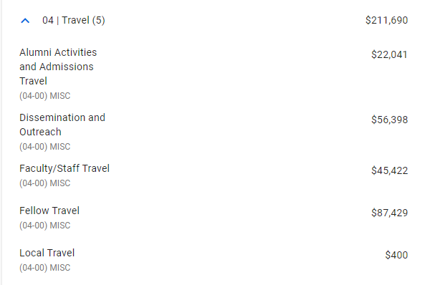
Budget Integration | Amounts
Amounts are totaled by: Ledger, object class, spend category for each worksheet/grant and period sent
5 Misc Travel entries in SAGE Budget
1 Travel entry in Workday Plan

Slide 31
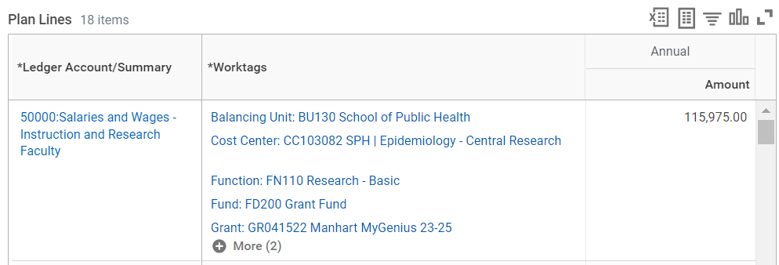
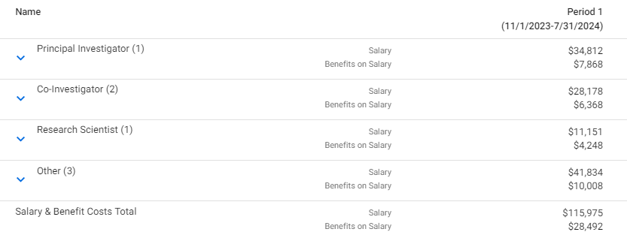
Budget Integration | Tips
Individual personnel are not sent to Workday Plans
Workday salary plan lines are summed up at the ledger level -- e.g. total faculty, total graduate students, etc.
1 Faculty salary plan line in Workday
7 Faculty listed in SAGE Budget
Takeaway: Higher-level, categorical budgets are just fine!

Slide 32
Quarter 3 | Pending March Release
Preliminary benefit rates in SAGE
PI escalation process - remediation (eGC1)
Award Notification content updates
Thank you to all who shared input!
More performance improvements
Error handling improvements
Bug fixes

Slide 33
Quarter 4 | Planned Work
Improve OSP & GCA flow of work
Advance Requests:
Add Workday required fields to Advance Requests
Integrate Advances to Workday
Integrate ASRs where Advances exist to Workday

Slide 34
Quarter 4 | Planned Work
Improve OSP & GCA flow of work
Automate OSP assignments
Modification Request updates
Adding sub-categories for modification type
Related award list updates for modification types & categories
Clarifying amounts
Others as time allows

Slide 35
Quarter 4 | Planned Work (cont.)
Prepare for SAGE Infrastructure Migration (2025)
Context: By June 2025, SAGE needs to migrate off of the existing infrastructure, as it will be retired
Migration goals: To ensure a more stable, secure, sustainable environment for SAGE long-term
Strategy: SAGE will move to cloud infrastructure (AWS), with upgraded servers and software
Near Term Impact: Expect feature work to slow down (but not halt) toward end of Q4, as more effort is shifted to migration to make the deadline

Slide 36
Reminder | SAGE Resources
SAGE Office Hours
Thursday, March 21, 11 a.m. – 12 p.m.
Wednesday, March 27, 11 a.m. – 12 p.m.
Resource Collections: Budget and Awards & Mods
Bookmark and review for the latest training, eLearning, and job aids:
SAGE Budget Resources
SAGE Awards and Modifications Resources
Notes:
An update on CORE classes will be presented following this presentation as well.

Slide 37
Reminder | Upcoming SAGE Classes
March
3/27, 1 - 3 p.m.: SAGE: Creating and Submitting eGC1s
April
4/2 & 4/23, 1 - 3 p.m.: SAGE: Budget
4/11, 1 - 3 p.m.: SAGE: Creating NIH Proposals in Grant Runner
May
5/1 & 5/8, 1 - 3 p.m.: SAGE Awards
5/23, 1 - 2:30 pm.: Subawards in SAGE
All SAGE Classes in CORE
Notes:
An update on CORE classes will be presented following this presentation as well.

Slide 38
CORE Updates
Updates to existing overview courses
Grants Management for Investigators
Introduction to Research Administration (3/31)
New courses
Reading the Notice of the Award (NoA)
SAGE Awards
Coming Soon
Workday Reporting for Grant Managers (5/31)
CORE Home
CORE Registration

Slide 39
CORE Updates
Updates to courses coming summer
Setup and Manage Your Award
Processes at Award Closeout
Internal Controls
Updates to courses targeted for end of the year
Understanding Cost Share at the UW
Effort Reporting and Compliance
CORE Home
CORE Registration

Slide 40
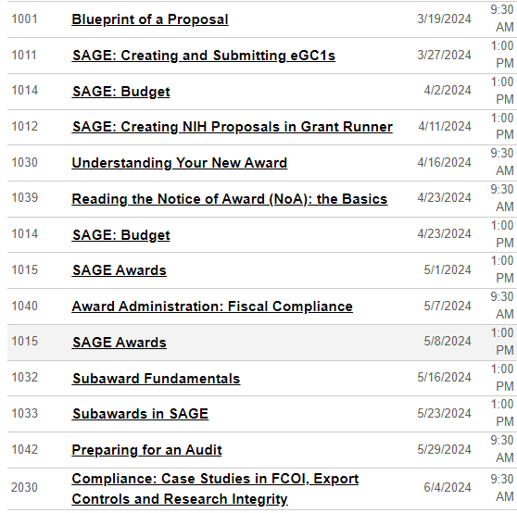
CORE
Instructor Led Courses
Mar-Jun 2024:
CORE Home
CORE Registration

Slide 41
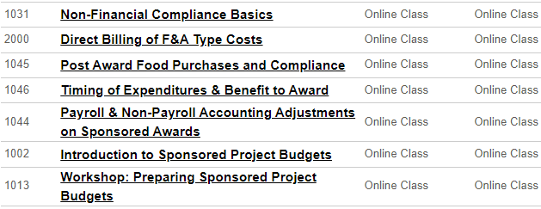
CORE
On-Demand Courses
Information about GMI
CORE Home
CORE Registration

