Slide 1
Washington Sales and Use Tax
University of Washington

Slide 2
Agenda
Retail Sales and Use Tax overview
Destination Based Sales Tax
Exemptions and How to Take Them
PAS
Procard
Questions

Slide 3
Retail Sales Tax Defined
Retail Sales Tax
Applies to tangible personal property
Doesn’t apply to pure services
State (6.5%) and Local (3.0%) components
Seller is liable, even if not collected

Slide 4
Use Tax Defined
Either sales or use tax, but not both
Tax on the use of goods or certain services when sales tax has not been paid
Paid by the consumer when the retail sales tax was not collected by the seller/service provider

Slide 5
Tangible personal property
No definition in statute
Generally something you can touch, smell, see but not real property
Includes services related to the tangible property
Many exemptions provided by statute
Eg. Some medical items used for patients, but does not apply to use in research.
Notes:
Medical goods

Slide 6
Services
Services related to tangible property are taxable
Personal services generally are not
Examples: Attorneys, Doctors, Dentists, Engineers, Public accountants
Test: Is the purchaser buying the service itself or the property related to the service

Slide 7
Destination Based Sales Tax
Came into effect July 2008
Rate imposed depends on whether item will be shipped or picked up:
If shipped, then rate at customer location applies
If picked up, then rate at seller location applies
Example: Store is in Seattle. Customer is in Tacoma.
If shipped – 9.3%
If picked up – 9.5%
Notes:
9.3% is Tacoma rate, 9.5% is Seattle rate.

Slide 8
Reporting destination based sales tax
UW reports destination based sales based on location codes
Department of Revenue allocates the tax to the appropriate city
UW Department needs to provide tax details to Cathy Sleipnes – sleipnes@uw.edu

Slide 9
Items in and outside of Washington
Goods received in WA even if the property will be used elsewhere - taxable
Delivery of goods to a freight forwarder to transport goods out of the state is not receipt of goods
Delivery to buyer outside of state not subject to WA taxes (may be subject to other state’s taxes)

Slide 10
Foreign Purchases
Foreign purchases of tangible goods, if not brought into Washington are not subject to Washington state sales or use tax
Value Added Tax may be applied when purchasing in foreign countries.
If possible purchase items through the internet in Washington
Keep in mind – there are sanctioned countries.
Eg. Iran, North Korea

Slide 11
Delivery Charges
Delivery charges
Charges for preparation and delivery of tangible personal property or services
Includes transportation, shipping postage, handling, crating and packing
Separately itemized charges still taxable
If sale itself is exempt from sales tax, no tax on delivery charges

Slide 12
Common Examples
Installing, cleaning, repairing of tangible personal property even if property not sold in connection of services
Repairing any personal property, machines, radios, etc.
Laundering, dyeing and cleaning
Computers
Prewritten software – taxable
Installation of prewritten software – taxable
Includes outright sales, leases, rentals, licenses to use, and any other transfer

Slide 13
Case Study
#1
Department buys books from vendor. Vendor lists shipping separately – is the shipping subject to sales tax?
Can you put the shipping under a tax exempt object code?
#2
Department contracts for a maintenance agreement on equipment in the department – taxable?
#3
Department hires a consultant to help with a project – taxable?
Can the department hire a consultant or do they have to hire an employee? To find out – join our employee versus independent contractor training in August!

Slide 14
Exemptions We See
Items purchased for resale
Items for use outside of the state and not brought into the state
Manufacturers’ Machinery and Equipment Exemption
High Technology Deferral
Notes:
Consumable items are articles the buyer is always deemed to use irrespective of whether the articles are being incorporated into an item for resale to a consumer. Example: house painter purchases paint for resale (exempt); however, brushes, masking tape, and equipment rentals are consumable items (taxable), even if only used on one job.

Slide 15
EXEMPTIONS: Items Acquired for Resale
Purchasers may be eligible for a sales tax exemption on items acquired for resale to a third party
UW has a seller’s permit
Currently need to supply a copy of the seller’s permit to be able to purchase for resale

Slide 16
EXEMPTIONS: Items Acquired for Resale
Use seller’s permit for:
Resale in the regular course of business without intervening use by the reseller, or
Use as an ingredient or component part of a new article of tangible personal property to be produced for sale, or
Use as a chemical used in processing a new article of tangible personal property to be produced for sale

Slide 17
Subsequent Sale of Items Acquired for Resale
Tax upon resale
Department selling item responsible for collecting the sales tax
If the product stays at the UW for the university’s own use, use tax payable
Department placing order must contact the UW’s Accounts Payable department to charge the department budget for the appropriate use tax amount

Slide 18
Exemptions: Items Acquired for Out-of-State Use
Goods for use outside the state of Washington, inform the seller no sales tax
Ordering department must state in the comments that the order should be flagged as exempt and that the goods are for use outside of Washington
Buyer will flag the order as exempt as it is processed, and include the appropriate language on the PO when applicable

Slide 19
Exemptions: Machinery and Equipment
Applies to purchases by manufacturers of machinery and equipment
Directly in a research and development operation
More than 50% of the time for a qualifying use
Useful life of more than 1 year
Cost of $1000 or more

Slide 20
Exemptions: Machinery & Equipment
Who’s involved:
Departments
Equipment Inventory
Purchasing
Accounts Payable

Slide 21
High Technology Deferral
Deferral on construction costs for building used for research and development in one of five fields:
Advanced computing
Advanced materials
Biotechnology
Electronic device technology
Environmental technology
Deferral also applies to purchase of “qualified machinery and equipment”

Slide 22
High Technology Deferral
Eight year qualifying use requirement
$1 million threshold to qualify for program
Annual survey participation

Slide 23
High Technology Deferral
For more information, visit the UW’s High-Tech Tax Deferral webpage at http://www.washington.edu/admin/sp/office/hitechdeferral.htm
If you think that you have a qualifying project contact:
Julia Shanahan

Slide 24
eCommerce: ProCurement Card & eProcurement
Procard: “Add Use Tax” box in PaymentNet:
A blank tax box tells the system NOT to charge the purchase a Washington State Use tax.
A checked tax box tells the system to CHARGE the purchase a Washington State Use tax.

Slide 25
eCommerce: ProCurement Card & eProcurement
Procard: “Add Use Tax” box in PaymentNet:
Steps
Receipt/invoice for ProCard transactions with an out of state merchant should be reviewed to determine if the merchant charged sales tax.
The tax box should be blank if an out of state merchant charged tax on the transaction.
The box should be checked if sales tax was not collected on the transaction and the item is subject to sales or use tax. If the tax box is checked, a Use Tax (Washington State sales tax) will be added to the transaction amount.
eProcurement
Sales tax is paid as billed by the vendor.

Slide 26
Purchasing & Accounting System (PAS)
Department
Requisition entry
Purchasing
Order update
Accounts Payable
Invoice entry and
Invoice processing

Slide 27
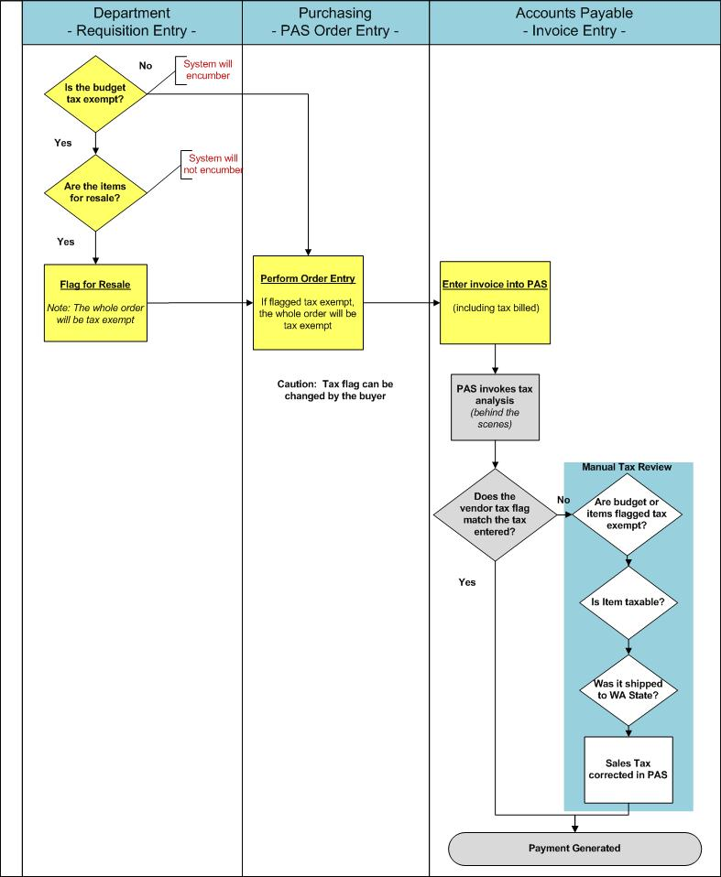
Purchasing & Accounting System (PAS)

Slide 28
Case Studies
ProCard Case study
Card holder has split the transaction to separate shipping, and handling into 03-24. Item being purchased is under 05-99.
Reconciler reviews the account and makes no modification.
ProCard staff has already made the monthly payment to JP Morgan and the transaction is now posted to MyFinancial Desktop.
What is the problem and how do you correct it?
Hint: Freight by itself is a service and not taxable.

Slide 29
Answer
Reconciler can change it in payment net before the payment is made to the bank to make shipping taxable.
If payment is already made, though, have to go through Procard department and request a correction.

Slide 30
Audit Case Study
The vendor has asked us for documentation that we paid the use tax on specific invoices because they did not charge sales tax.
Are we obligated to provide this information to the vendor?
What kind of documents can we provide?
If use tax wasn’t paid what happens?

Slide 31
Answer
Currently provide a letter rather than the DOR form
Check that use tax actually was paid
Terms and conditions in contracts often say we will pay use tax if sales tax not charged.
We may be required to provide the DOR form at some point.
If no use tax paid, then department will have to pay it and may owe penalties and interest.

Slide 32
Water Case Study
FACTS:
Buyer placed the order correctly
Department chose the correct object code
AP staff decided not to enter sales tax in the sales tax – XXXXXXX
PAS programming - realize that object code is taxable, budget is taxable, delivery address is local. Therefore, the system added use tax.
Vendor Control: - flagged the vendor incorrectly in vendor file

Slide 33
Answer
Sales/use tax charged twice
Buyer could place order with two separate line items – one for water – flagged tax exempt, one for the rental which is taxable
Department discovered the issue too late, should reconcile monthly
If there is a tax exempt item, department should enter comments if using PAS
If on Procard make sure box is not checked

Slide 34
Questions and contacts
Procurement Customer Service
Pramilla Chand, 616-9021, pchand@u.washington.edu
Tax Office
Julia Shanahan, 616-3003, jeshana@u.washington.edu

