Slide 1

Parent Orientation
Tuition Bill and How Best to Pay
Things to be Aware of
Questions
Managing The Maze

Slide 2
Tuition Bill
Tuition is Due by the
3rd Friday of the Quarter
Online Tuition Statement
  Found in MyUW
  Payment Options: http://f2.washington.edu/fm/sfs/tuition/payment/
Webcheck is free, fast, and safe
  Payment shows immediately
  No chance that check is lost in the mail or stolen
  Other options: check, credit card with a 2.3% fee, or in person

Slide 3
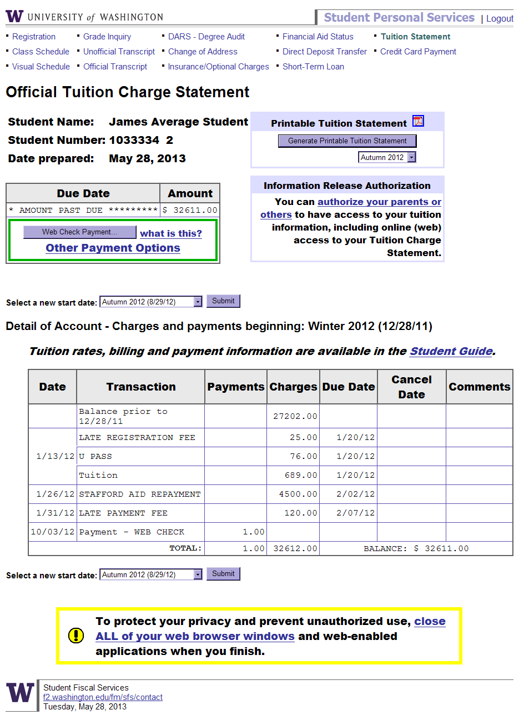

Slide 4
Tuition Bill
Student Gives YOU Access to the Bill
    You will receive an email with instructions
    Get your student’s UW number
    Ask your student for your challenge question

Slide 5
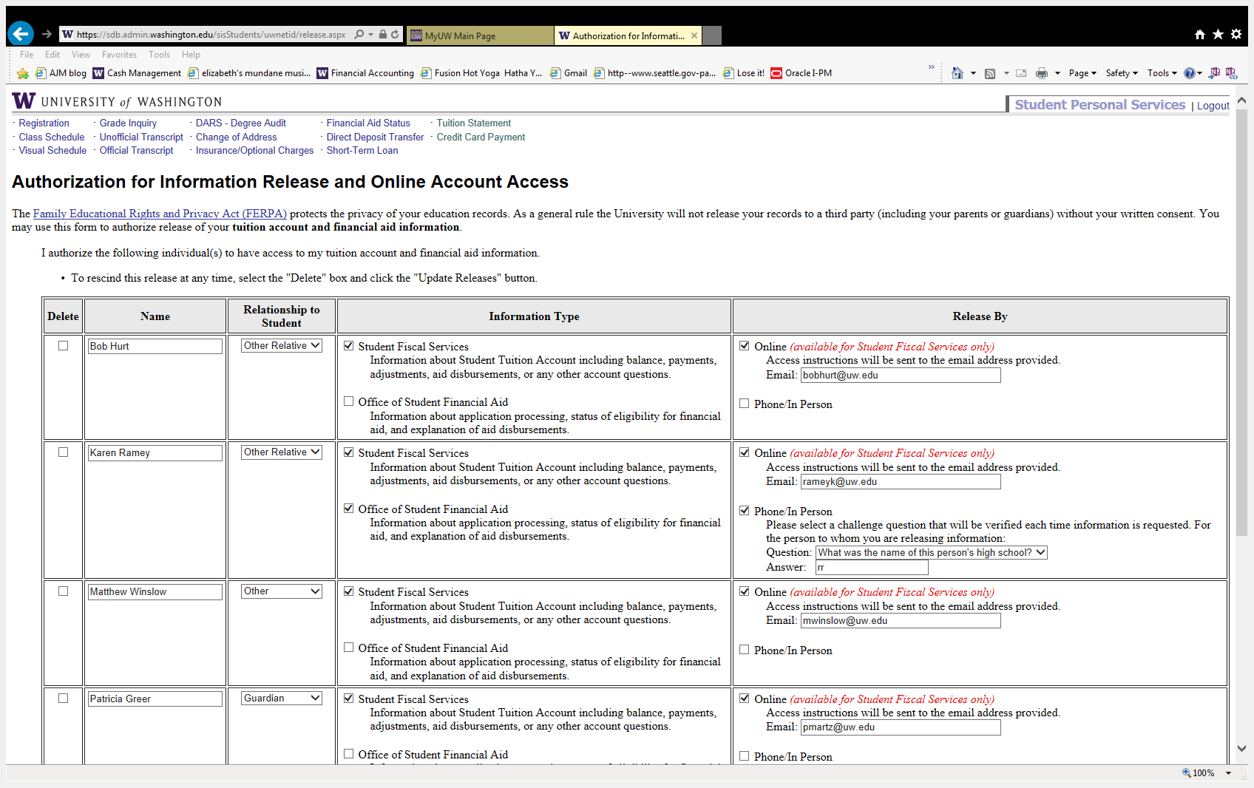
Student Gives YOU Access to the Bill

Slide 6
Things To Be Aware Of
Aid: Generally, tuition and fees are paid first from any scholarships, grants, or loans received
Additional fees: Fees can be charged throughout the quarter- check the bill periodically (Late changes or fees, lost U Pass, class fees etc.)
Important Dates: Make sure your student is aware of deadlines for class or credit changes without a penalty
Taxes: Opt out of the paper form-> you can print the 1098-T online to get it earlier and more efficiently
Call your tax accountant to ask about tax credits!

Slide 7
Student Loans – Financial Aid
FAFSA must be completed by February 28 (contact Financial Aid if this was not done)
Once an offer is made by the Financial Aid Office, student must accept aid and sign the appropriate promissory notes
Parent signs the Plus Loan Master Promissory Note and completes request process online: www.StudentLoans.gov
Always have student confirm that their tuition and fees are paid prior to using any funds sent to them via check or Direct Deposit

Slide 8
Fees you May See in Detail
Late Fees
    $50 to $249.99 → $50
    $250 and over → $120
Course/Lab fees
Tuition Forfeiture
Add/Drop Fee
Insurance
Short Term Loan
  $2500 available
UW Housing
Study Abroad
Other

Slide 9
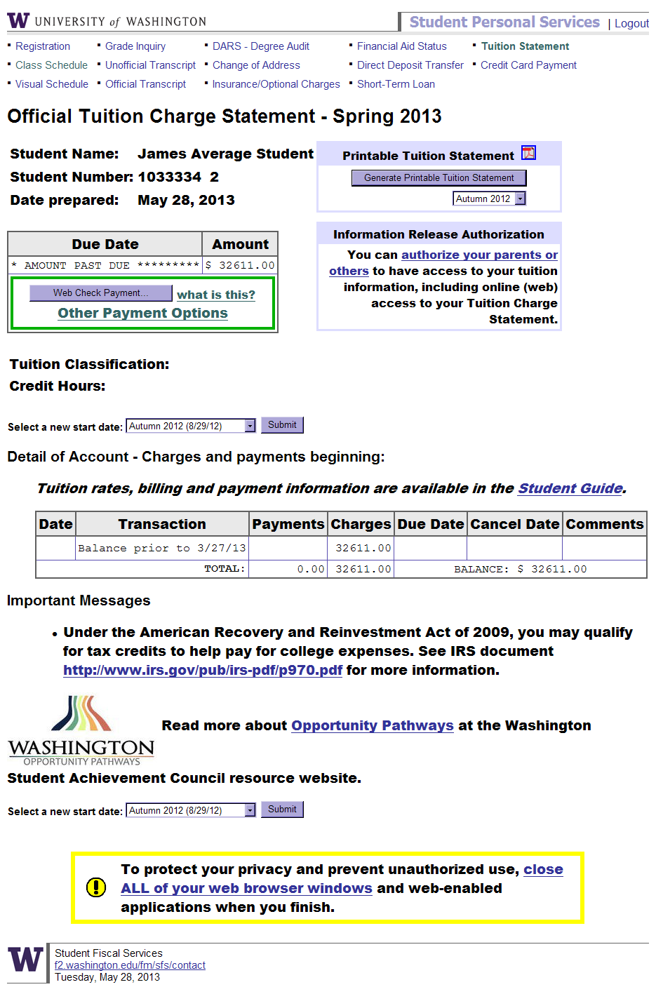
Taxes
U.S. Resident
American Opportunity
Form 1098T
Non U.S. Resident
Form 1042S
Visit: http://f2.washington.edu/fm/sfs/tax/credits

Slide 10
Additional Information
Payment Plan
Non-UW Scholarships
GET
Veterans

Slide 11
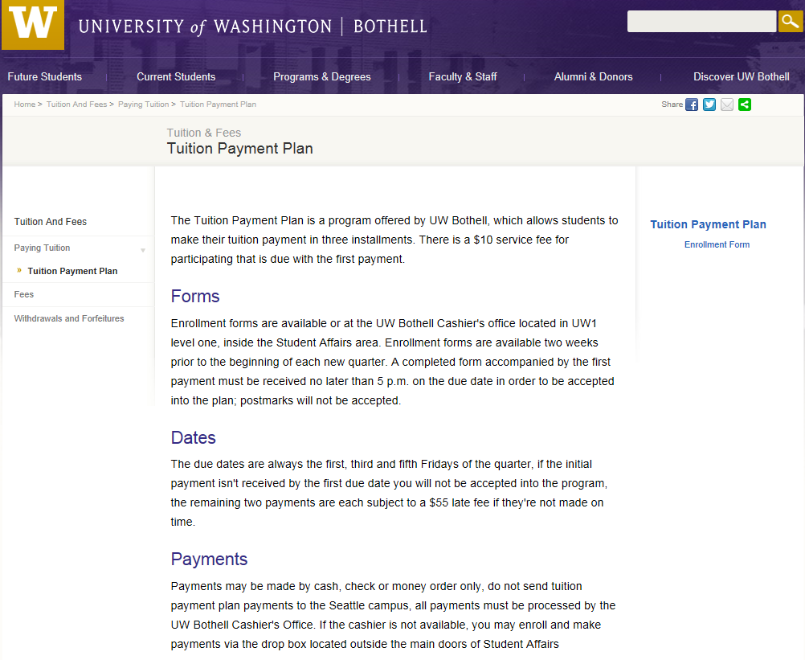
www.uwb.edu/tuition/paying/payment-plan
Guidelines
  Payments can be made in three installments during the current quarter
  Forms located in the Cashier’s Office
  $10 Service Fee due with the first payment
  Due dates are the first, third and fifth Friday of the quarter
  $55 Late fee
11

Slide 12
Non-UW Scholarships
Students need to report all scholarships to the Office of Student Financial Aid (OSFA), if they were not already reported on their award notice. Forgetting to report all scholarships can cause problems with their financial aid award and in some cases may require them to return some of their financial aid money.
Scholarships will reduce a student’s unmet need first, and then loans and/or work study before any grants or UW scholarships are reduced.
Always include the name and student number in a scholarship check.
Scholarships checks are sent to:
  University of Washington, Scholarships
  Box 24967
  Seattle, WA 98124-1967

Slide 13

Parents - Go to www.get.wa.gov
  You can request in Fall for all three quarters or
  You can request each quarter separately
  Questions about how much or how many units - contact the GET office
UW Process
  UW receives GET funds twice a week during the first three weeks of the quarter
  We will post your payment as soon as it is received
  The GET program can take up to 2 weeks to process payments- request early!!

Slide 14
Veterans
Student applies for the benefit in the UW Bothell VA office in the Student Success Center, UW1-160V
A office certifies the account and requests the money for the student
SFS pays tuition for the student after we receive the funds
VA funds usually come in the 4th or 5th week of the quarter- we waive late fee

Slide 15
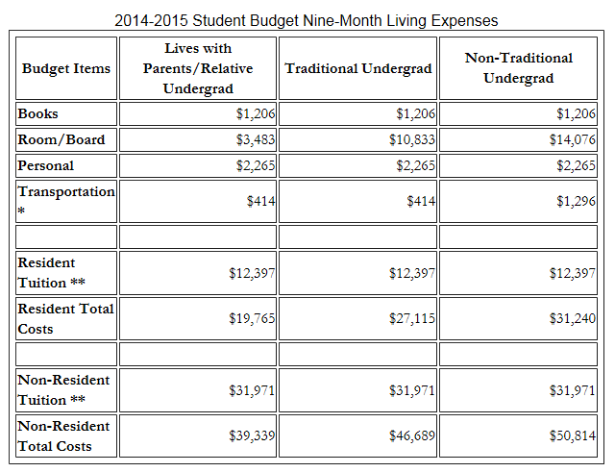
2014-2015 Student Budget

Slide 16

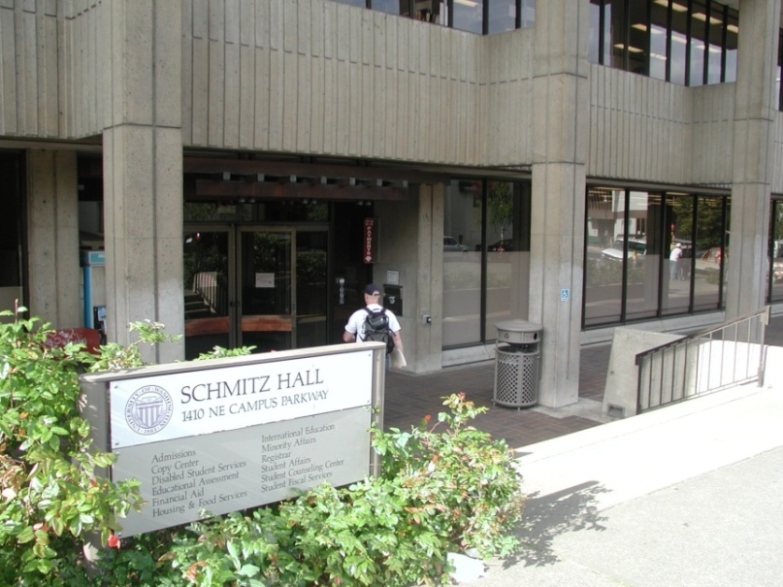
Which Office?
Financial Aid:
Handles Applications
Determines Eligibility
Monitors Eligibility
Helps Finalize Award
Revises Eligibility
Student Fiscal Services:
Items on The Tuition Statement
Payment of Tuition and Fees
Outside Sponsor Payments
Disbursement of Awarded Aid
Husky Hall Room 1130
Phone: 425-352-5240
Email: finaid@uwb.edu
www.uwb.edu/financialaid
129 Schmitz Hall - Seattle
Phone: 206-543-4694
Email: sfshelp@u.washington.edu
www.f2.washington.edu/fm/sfs/

